Slide 1
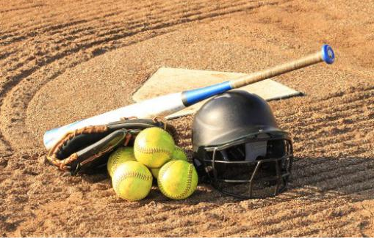
TYLER SOFTBALL CHAPTER Training
January 31, 2021

Slide 2
Outline
Member in Good Standing
Taking Care of Business
Communications with Co-Officials and Coaches
Rule 2- Definitions Pages 15-29 65 Topics
Rule 5- Dead Ball Table Pages 44-46

Slide 3
What you need to take care of to be a member in good standing
a. Pay your State Dues
b. Work the Chapter Tournament or Pay your Local Dues and Fine.
c. Attend either the State Meeting, Regional Clinic, or the Online Clinic.
d. Take and pass the test with a minimum score of 70 to be eligible for the Regular Season and a 80 or better to be eligible for Post Season consideration.

Slide 4
Taking Care of Business
Calling your partner once you learn you have a contest together, the plate umpire for the Varsity Contest is the Crew Chief and is responsible for initiating contact. If the Crew Chief does not initiate communications, then the partner should initiate.
Determine what color you are going to wear.
Determine if you may be able to ride together, if not determine where and what time to meet either onsite or prior to the site.
Call to two (2) Board Members (Oscar/Tom/Chuck/Shane) if you have something out of the ordinary to include a Fan, Coach, or Player ejection.

Slide 5
Taking Care of Business
Remember for all contests that you are assigned you are expected to be onsite by no less than 30 minutes prior to the start time of the contest.
Once on site find the home head coach and let them know that you are there and that you and your partner will get ready and be back on the field prior to 10 minutes before the contest will start.
Remember “If you deviate, then you must communicate”.

Slide 6
Rule 2 - Definitions
Why study the “Definitions?
You will learn softball terminology thus enhancing your ability to communicate effectively with your partner(s), coaches, and even players.
The Rule definitions are maintained in alphabetical order to allow for easier identification.
Rule 2 Definitions along with Rule 5 Dead Ball Tables will give you a good starting point that will assist you in adjudicating the contest you are officiating.
There are 65 Sections in Rule 2 and these cover just about every topic you could run into on the softball field. These are how to deal with Appeals, Hitting, Running, Illegal actions through Pitching and Intentional Walks. Please take time to become familiar with these Sections and the quick references that they offer.

Slide 7
Rule 2 - Definitions
Here is how Rule 2 Definitions can assist you.
Appeals- Live/Dead ball appeal
Ball- Batted/Blocked/Dead/Delayed Dead/Fly/Ground/Passed/Rotation Pg. 17
Catch- Pg.19
Conferences- Offense/Defense/Pregame Pg.20
Game Status- Halted/Suspended/Called Pg.23
Interference Pg.24
Obstruction Pg. 24
Substitution- Unreported/Illegal/Projected Pg. 28

Slide 8
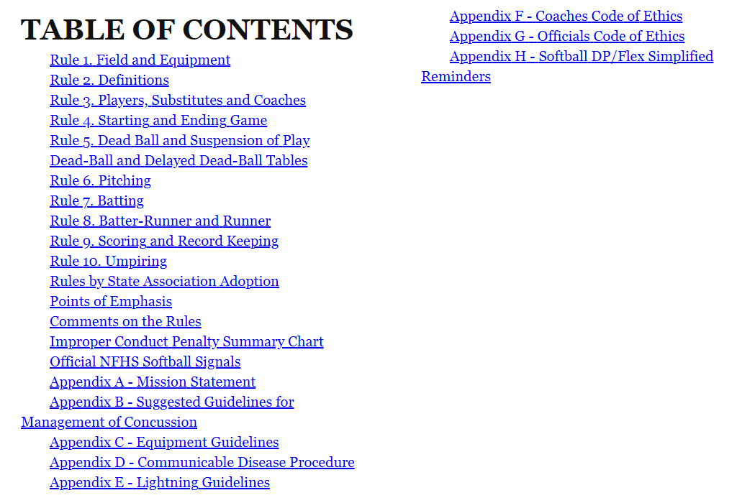

Slide 9
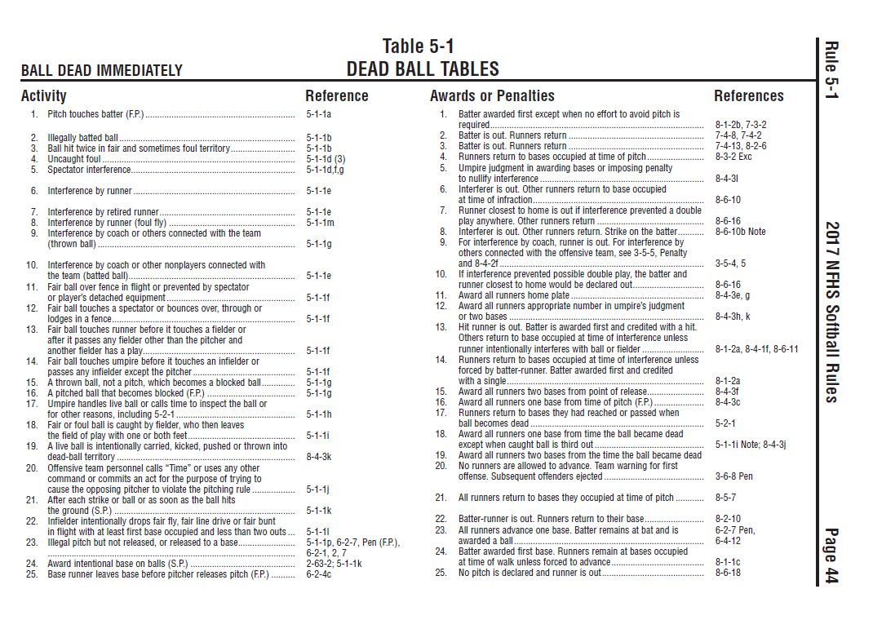
Dead Ball Tables
Rule 6 went onto clarify as to when the pitch starts and

Slide 10
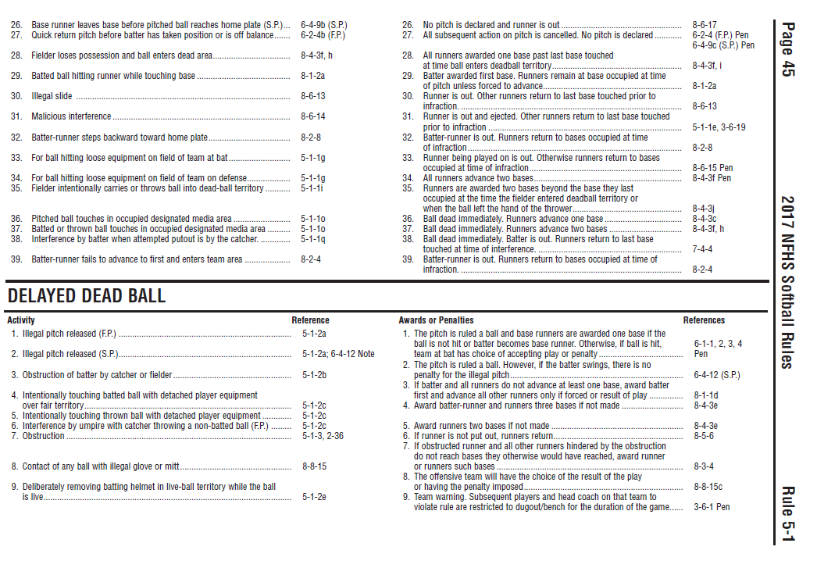
Dead Ball Tables

Slide 11
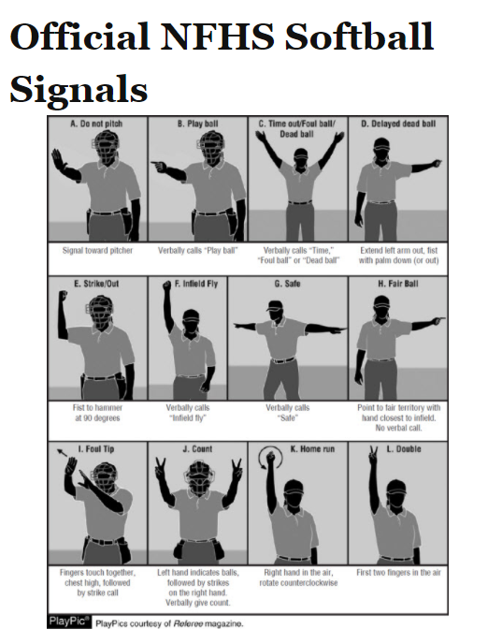

Slide 12
Questions

