Slide 1
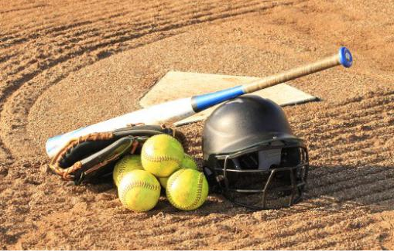
Tyler Softball Chapter Training Meeting
January 24, 2021

Slide 2
Training Outline
Scrimmages
a. Conduct
b. Uniform/Clothing Worn
c. Expectations
Approved Signals

Slide 3
Meeting Dates
January March
10th 14th
24th
31st April
11th (Good Standing)
February 25th (Elections/Scholarship)
21st

Slide 4
Conduct before and during scrimmages
Remember we are there to provide a service to the schools that choose to use us. Also remember you represent the Tyler Softball Chapter.
Once you receive notice either from the scrimmage Leader or Arbiter make sure that you have all your equipment ready.
It is not required that you wear your uniform during scrimmages, however you will still need to wear clothing that your plate gear fits under and is in good taste.
The scrimmage leader will make contact with all the members that are scheduled to be at the scrimmage with them and make sure that they know when and where to be.

Slide 5
Conduct before and during scrimmages
When the scrimmage leader shows up (early) they are to get with coach. If a member shows up earlier then the scrimmage leader please wait for the scrimmage leader to get there before meeting the coach if possible. If the coach comes up to you introduce yourself and let them know that the scrimmage leader will be there shortly.
If the scrimmage leader is late or does not show up then the next senior person will step up and take charge. Meet with the coach and find out what their plan is for the scrimmage session.
After learning how the coach wants to run the scrimmage relay this to the members that are there. Plan how you would like to support the coaches desired outcome of their scrimmage.

Slide 6
Conduct before and during scrimmages
Use your fellow veterans along with yourself to work with the younger officials teaching the basics. Remember to let them work as much as possible and help them along the way.
After the conclusion of the scrimmage make sure that you either call or send Chuck and Oscar a text letting them know the scrimmage site, how long the scrimmage went, who all was there and worked, and anything that came up that needs to be passed along.

Slide 7
Plate Mechanics to work on during scrimmages
Heel/Toe
VOICE Strike/Ball
Give sound while in DOWN position
Give signal in the UP position
Find THE zone and work it
Work on getting out from behind the plate
Communicate with your partner(s) as needed to keep the game running smooth
Demonstrate to the Coaches that you are comfortable back there and that you have command of the game.

Slide 8
Base Mechanics to work on during scrimmages
A Position
Walk the line
Watch the Pitcher
Call and signal the illegal pitch if seen
B and C Position
Watch the Runner(s)
Watch the Pitcher
Adjudicate as needed
Hustle! but don’t hurry, be in position to make the call!!

Slide 9
Thoughts of the UIC prior to and during the scrimmage
I need to ensure that the veterans get a chance to knock the rust off. I need to work with the lesser experienced officials on mechanics and the game of softball in general. Plus I too need to get some reps in and ensure that I’m ready for the season. I also need to work on studying and knowing the rules and case book scenarios.

Slide 10
Thoughts of the Veteran Official prior to and during the scrimmage
I need to knock the rust off, work on moving muscles I haven’t moved in a while, and observe and work with my future partners. I also need to work on studying and knowing the rules and case book scenarios.

Slide 11
Thoughts of the New/Lesser Experienced Official prior to and during the scrimmage
I need to work on my mechanics, my signals and ensuring that I have a good feeling going into the season. I need to ask questions and I need to listen to some of the more experienced officials. I also need to work on studying and knowing the rules and case book scenarios.

Slide 12
Physical Fitness
Take the time now to assess your state of physical fitness and the ware and tear that you will be putting your body through over the next 3 to 4 months.
I say this so that you can start a little training program before the beginning of the season in order to be ready for it.
By simply walking 2 or 3 times a week you will alter your state of physical fitness prior to the start of the season.

Slide 13
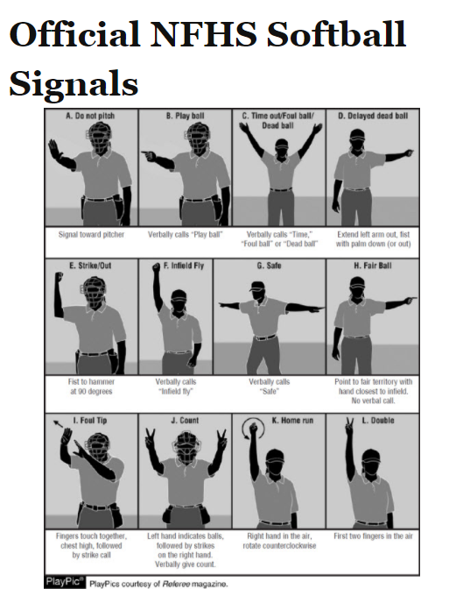

Slide 14
Questions

