Slide 1
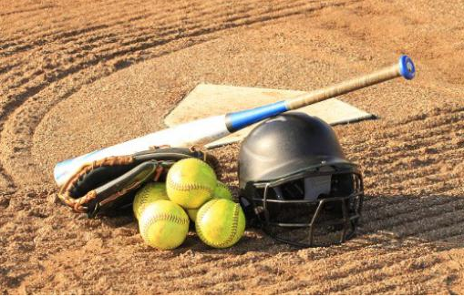
TYLER SOFTBALL CHAPTER Training
January 12, 2020

Slide 2
Outline
Officials Code of Ethics
Dress Code
Uniform
Pay Sheet
Communications Co-Officials and Coaches

Slide 3
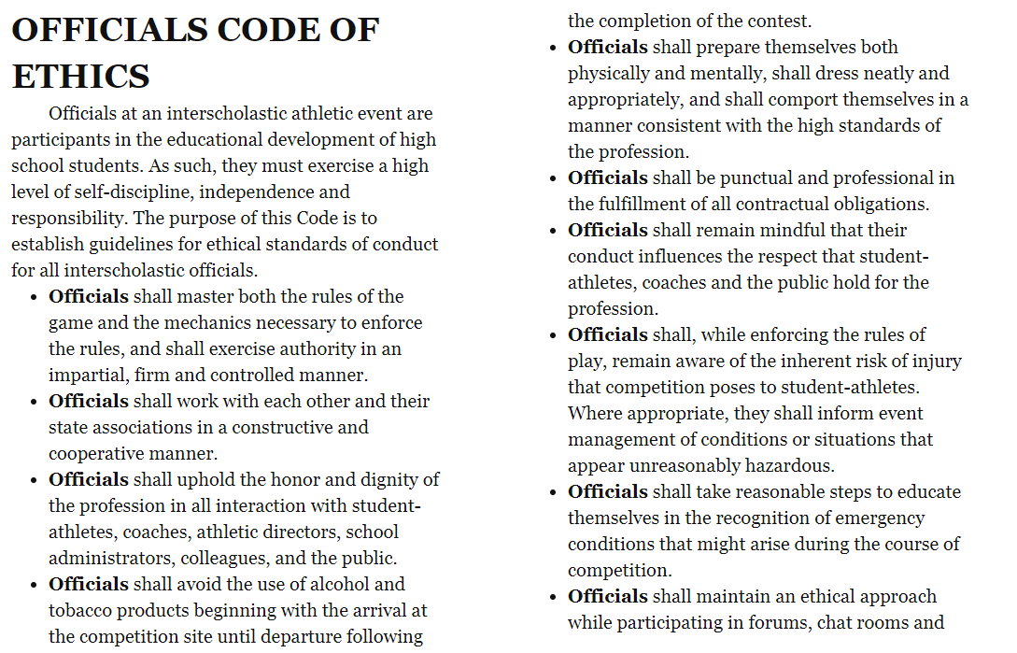
Notes:
Umpire Ethics according to NFHS

Slide 4
Dress Code
Uniform will be neat, pressed and highly maintained
Shoes will be Black or (Mostly) Black and free of dirt and clean prior to the contest
Male Umpires will not wear earrings
Female Umpires may wear STUD earrings only
If an Umpire has facial hair it will be neat, trimmed and well kept

Slide 5
Section 4 Equipment And Apparel
Article 1- Umpires working the plate in fast pitch shall wear a throat protector that is part of or attached to the mask and extends far enough to adequately protect the throat. A chest protector is recommended in fast pitch.
Article 2 The proper uniform for an umpire consists of :
Powder Blue/Navy Blue Shirt White/Blue or Black Undershirt Black Belt 1-1/2”
Heather Gray Slacks TASO Hat Predominantly Black Shoes
Blue or Black Calf Length Socks College Softball Jacket
Article 3- Casts, sprints and braces may be worn, if padded.

Slide 6
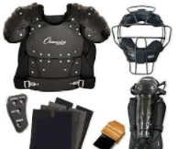
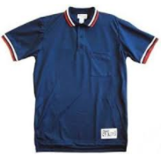
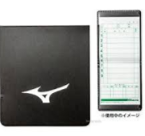
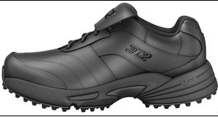
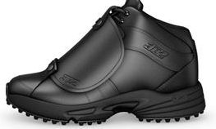
UNIFORM & GEAR

Slide 7
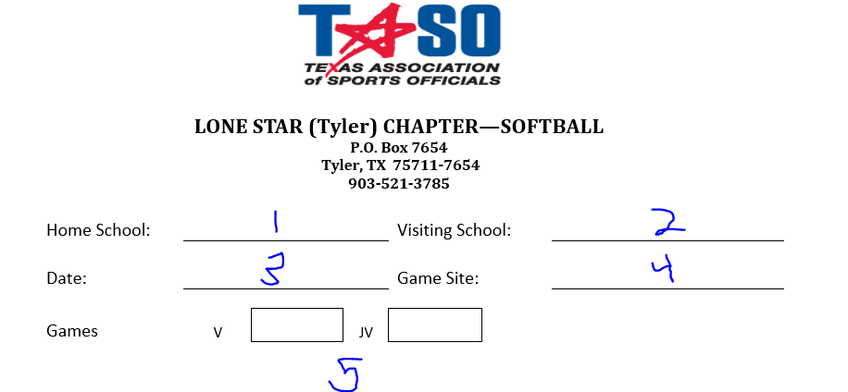
Pay Sheet
The Lead Official is responsible for bringing the pay sheet and their W9 form, their partner is responsible for bringing their own W9.
1- Home School
2- Visiting School
Date
Game Site
Type and Number of Games

Slide 8
Pay Sheet

Slide 9
Pay Sheet

Slide 10
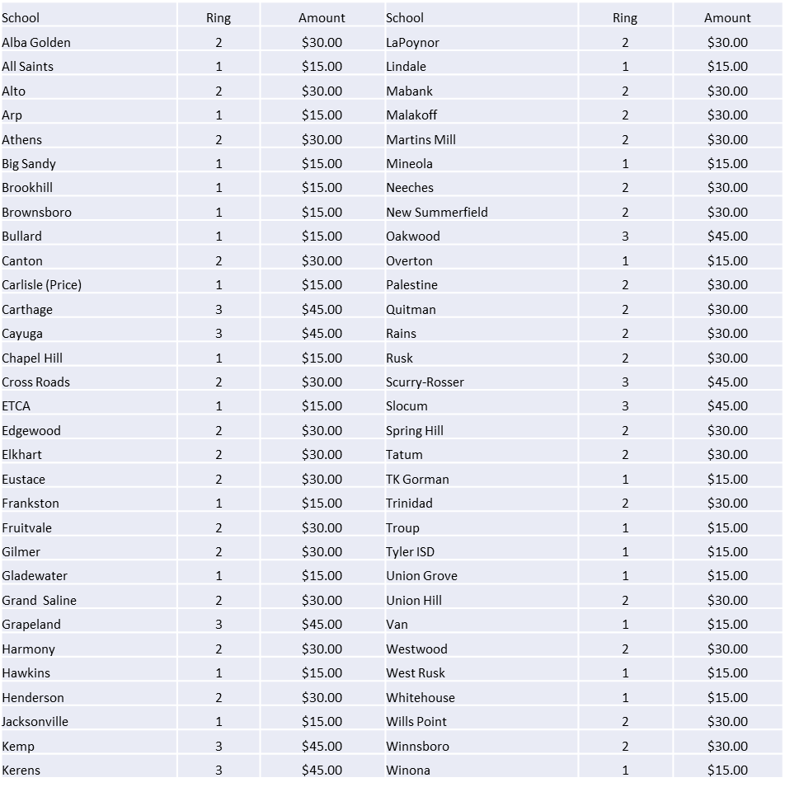
Mileage Reimbursement

Slide 11
COMMUNICATIONS
Partner
Pre-Game:
Where and When to meet
What color shirt to wear and “new”
or “old”
During:
As needed to effectively adjudicate
the contest
After:
As needed if something needs to be
communicated to BOD Members and
TASO.
Coach
Pre-Game:
Senior umpire communicate to home
coach what time you and your partner
will be onsite for their contest
During:
As needed to answer questions and
adjudicate the contest within the rules
Remember the “Officials” Golden Rule on
Communications. Silence cannot be miss-quoted

Slide 12
Test Questions and Answers
Texas UIL District Executive Committees may approve the use of a 15 run ahead after 3 innings run rule. Use of this rule in non-district games can be used if either team is in favor of it.
TRUE or FALSE
A base coach’s box is a “safe harbor”. In other words as long as the base coach remains in the coach’s box, he/she is not required to accommodate a fielder attempting to put out a batter or a runner
TRUE or FALSE

Slide 13
Test Questions and Answers
The first team offense of deliberately removing the batting helmet when it is required to be worn, results in:

Slide 14
Test Questions and Answers
A team warning issued upon the conclusion of the play

Slide 15
Test Questions and Answers
With a 3-2 count, B1 steps completely out of the batters box during F1’s delivery. The pitch is high and out of the strike zone.

Slide 16
Test Questions and Answers
The pitch is a called strike. The umpire will call time and declare the batter out.

Slide 17
Questions

