Slide 1


Tyler TASO Lone Star Softball Chapter Training
March 10, 2019

Slide 2
Training Outline
Obstruction v. Interference
Uniform Policy
When a play ends
Plays or Situations from the group

Slide 3
Obstruction
Obstruction Defined
The act of a defensive team member:
  Who hinders or impedes a batter from striking at or hitting a pitched ball.
  Who impedes the progress of a runner or batter-runner who is legally running the bases unless the fielder is:
    In possession of the ball or
    In the act of making an initial play on a batted ball 8-2-6.
  NOTE: Contact is not necessary to impede the progress of a runner or the batter-runner.

Slide 4
Obstruction
Items Necessary for Obstruction
Fielder must block the offensive player’s chosen base path without possession of the ball, and not in the act of fielding a batted ball.
The fielder’s position must hinder or impede the offensive player.
NOTE: If the fielder doesn’t hinder or impede the offensive player there is no obstruction. This is umpire judgment.

Slide 5
Obstruction
Items to Remember
Obstructed runners can not be put out between the two bases where they were obstructed:
  Unless there is a subsequent play on another runner
  interference
  They pass another runner
  If properly appealed for missing a base, or leaving a base too early on a caught fly ball or batter-runner flies out for the third out, when the batter-runner is obstructed and she flies out.

Slide 6
Obstruction
Items to Remember
If the obstructed runner is put out prior to reaching the base which would have been reached had there been no obstruction:
  Signal dead ball.
  Award the obstructed runner and any other runners affected by the obstruction the base(s) they would have reached had there been no obstruction.
If the obstructed runner is put out after passing the base which would have been reached had there been no obstruction or advanced beyond the two bases where the obstruction occurred:
  The out stands.
  The ball remains live.

Slide 7
Obstruction
When Obstruction Occurs
Signal delayed dead ball and verbalize “Obstruction”.
  How long should the signal be held?
Protect the runner(s) to the base(s) they would have reached had there been no obstruction.
3. If the obstructed runner is put out prior to reaching the base they would
have reached had there been no obstruction, or between the two
bases where they were obstructed, call “Dead Ball” and award the
runner(s) the base(s) they would have reached in the umpire’s
judgment had there been no obstruction.

Slide 8
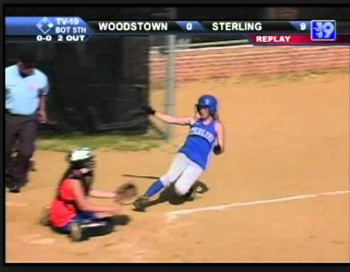
Obstruction
Example 1

Slide 9
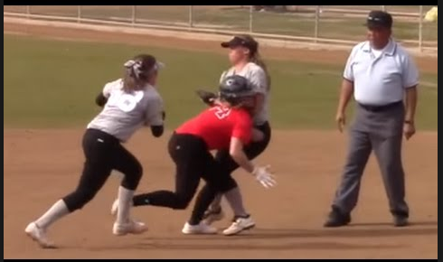
Obstruction
Example 2

Slide 10
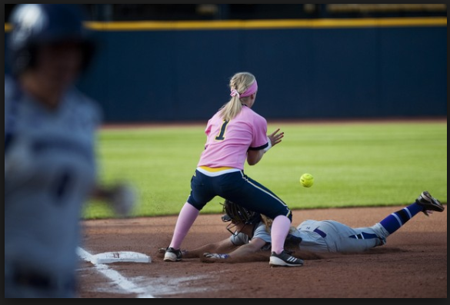
Obstruction
Example 3

Slide 11
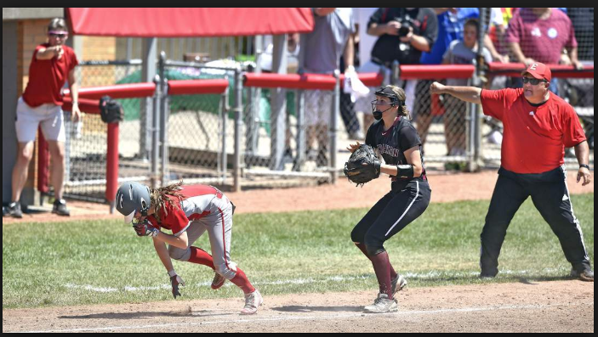
Obstruction
Example 4

Slide 12
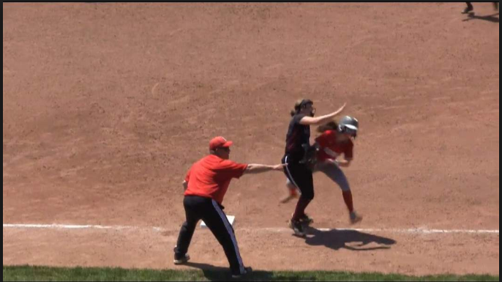
Obstruction
Example 4

Slide 13
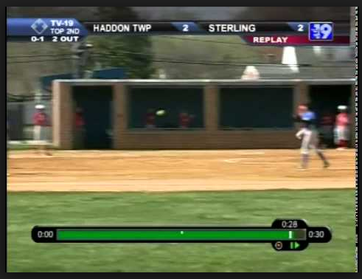
Obstruction
Example 5

Slide 14
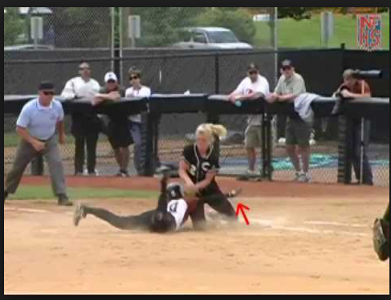
Obstruction
Example 6

Slide 15
Interference
Interference Defined
The act of an offensive player or team member, umpire or spectator that impedes, hinders, or confuses a defensive player attempting to execute a play. Contact is not necessary.

Slide 16
Interference
Types Interference
On-Deck Batter
Batter
Batter-Runner
Runner
Aiding a Runner
Coach
Spectator
Umpire

Slide 17
Interference
When Interference Occurs
Signal Dead Ball
  Exceptions are Umpire Interference and Aiding a Runner.
Someone is called out
  Except Umpire Interference
Return runner(s) not out as a result of the Interference to last base(s) touched at the time of the Interference. All outs made on the play stand.

Slide 18
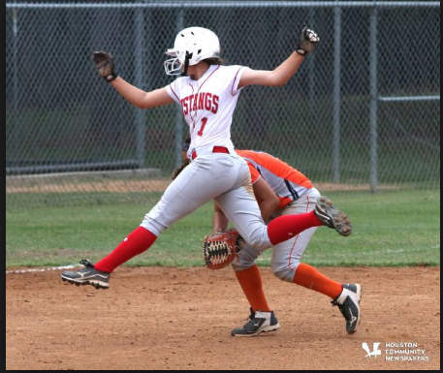
Interference
Batter-Runner

Slide 19
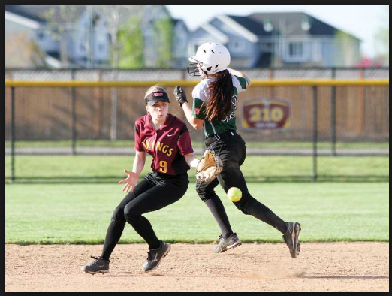
Interference
Batter-Runner

Slide 20
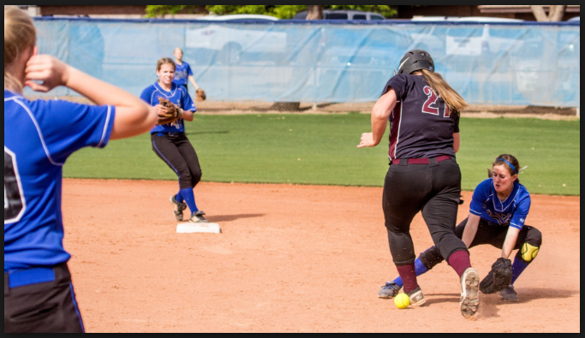
Interference
Batter-Runner on a Hit Ball

Slide 21
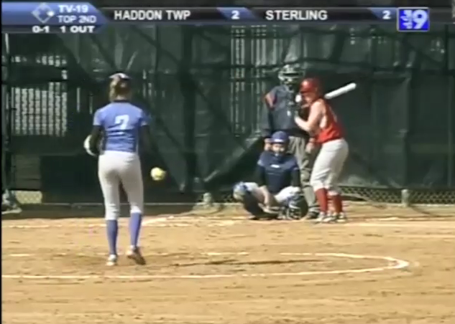
Interference
Batter-Runner Double Play (Video)

Slide 22
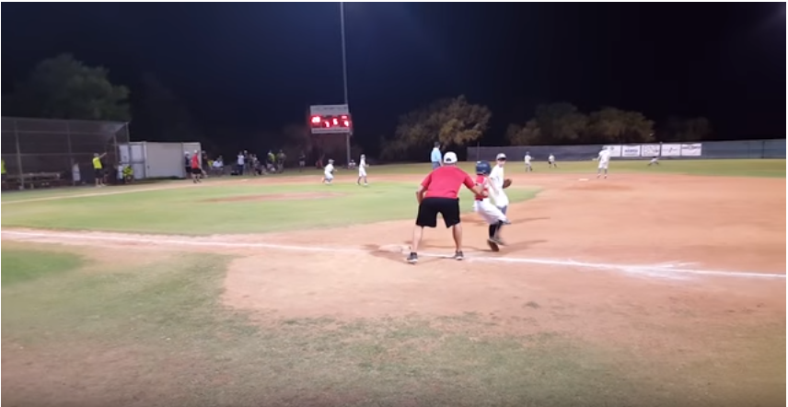
Interference
Coaches

Slide 23
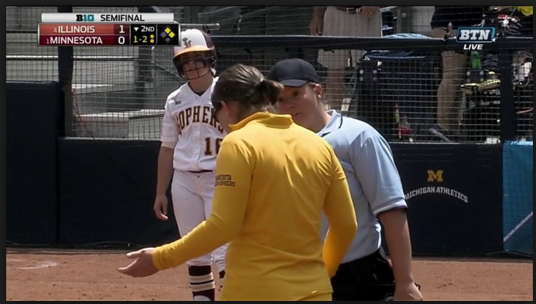
Interference
Batter (Video)

Slide 24
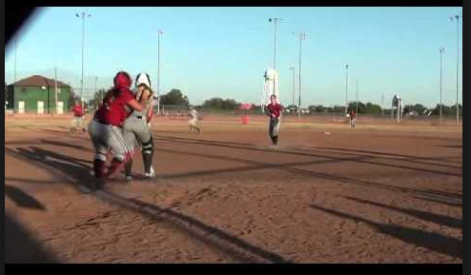
Interference
Batter (Video)

Slide 25
Play Over
Actions for Umpires After a Play is Over
Once all action has stopped and the ball has been returned to the circle, then and only then will the umpires one at a time move to their location and ready for the next the play. After the base umpire moves to their location and are ready to watch and observe the action the plate umpire will then move behind the plate and ready for the next pitch. There will be times when once the ball is in the circle “time” will be called and both umpires will move simultaneously to avoid delaying the game. During these times you must still know what is going on, so always be aware of whats going on.

Slide 26
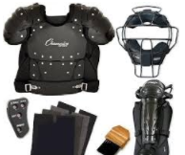
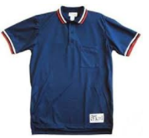


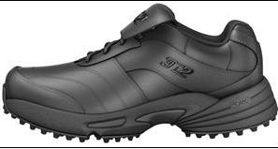
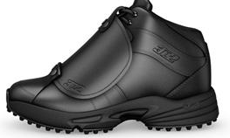
UNIFORM & GEAR

Slide 27
Uniform
The proper uniform for an umpire consists of :
Powder Blue/Navy Blue Shirt
White/Blue or Black Undershirt
Black Belt 1-1/2”
Heather Gray Slacks
TASO Hat
Predominantly Black Shoes
Navy Blue or Black Calf Length Socks
College Softball Jacket

Slide 28
Plays or Situations
Plays or situations that you have seen and or handled in your games so far this year.

Slide 29
CLOSING
Obstruction
Interference
Umpire Action after a Play is Over
Uniform
Plays or Situations

Slide 30

QUESTIONS

