Slide 1
Tyler TASO Lone Star Softball Chapter Training
APRIL 14, 2019

Slide 2
Training Outline
3- Person Mechanics
Starting Positions on a Diamond
Principles and Responsibilities
Videos
Plays or situations from the group
Questions

Slide 3
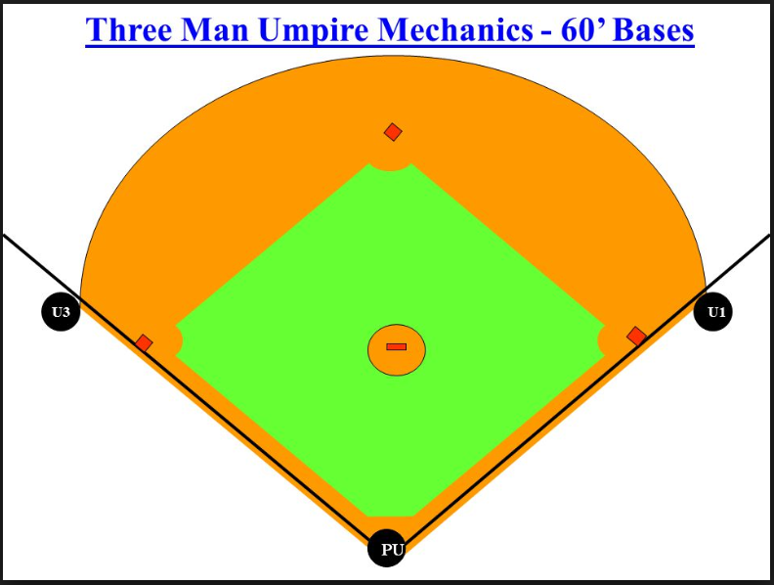
3 Person Mechanics

Slide 4
3 Person Mechanics

Slide 5
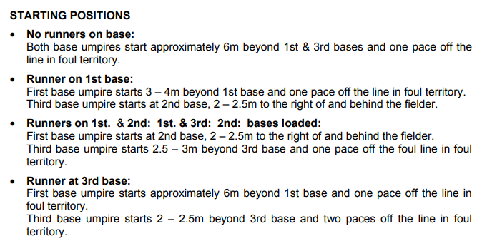
3 Person Mechanics

Slide 6
3 Person Mechanics

Slide 7
3 Person Mechanics

Slide 8
3 Person Mechanics

Slide 9
3 Person Mechanics

Slide 10
3 Person Mechanics

Slide 11
3 Person Mechanics

Slide 12
3 Person Mechanics

Slide 13
3 Person Mechanics

Slide 14
3 Person Mechanics

Slide 15
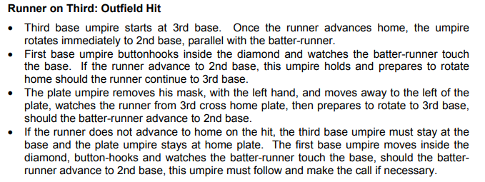
3 Person Mechanics

Slide 16
3 Person Mechanics

Slide 17
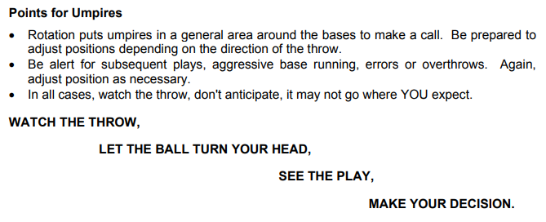
3 Person Mechanics

Slide 18
Plays or Situations
Plays or situations that you have seen and or handled in your games so far this year.

Slide 19
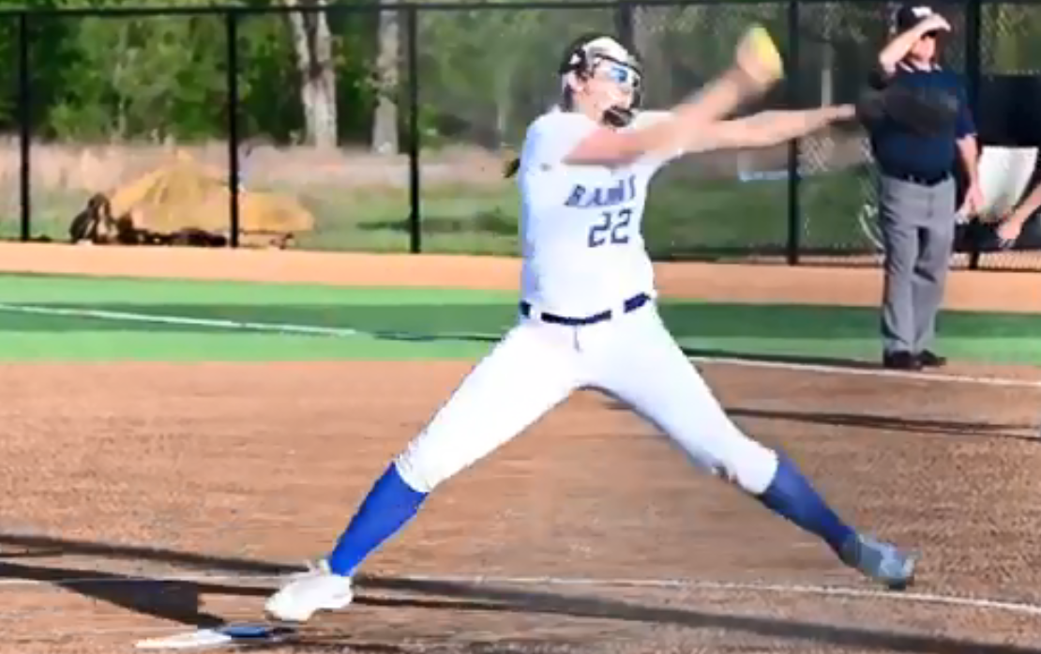
Plays or Situations

Slide 20
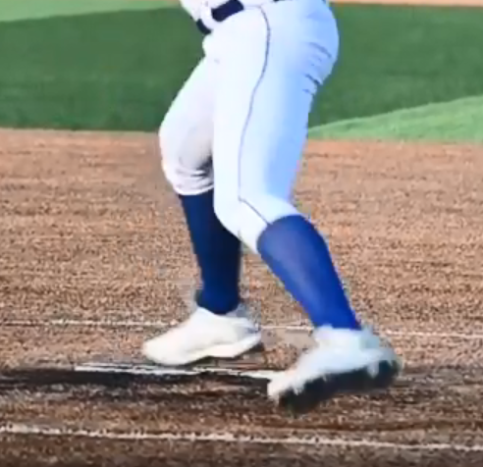
Plays or Situations

Slide 21
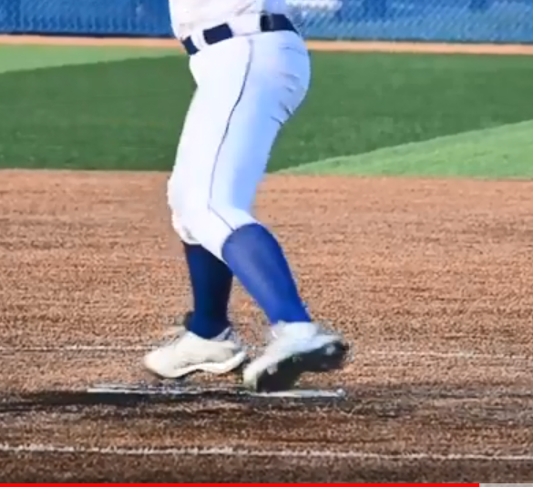
Plays or Situations

Slide 22
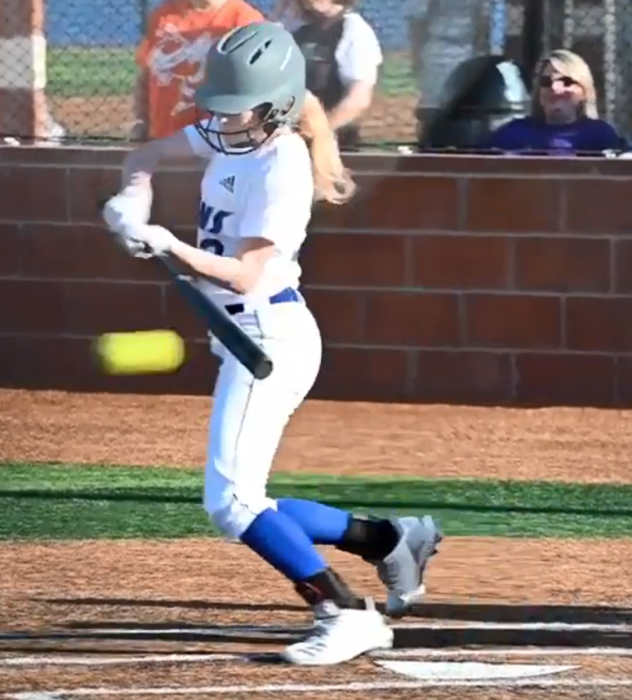
Plays or Situations

Slide 23
CLOSING
Knowing and using three person mechanics.
Call what you see leave the guessing game out of it.
If you are not 100% sure of something that has no bearing on the game then leave it alone.

Slide 24
QUESTIONS

