Slide 1
Tyler TASO Lone Star Softball Chapter Training
March 24, 2019

Slide 2
Training Outline
Case Book Scenarios
  Gloves and Mitts (Rule 1)
  Catchers Equipment (Rule 1)
  Substitution Re-Entry (Rule 3)
  Illegal Substitute (Rule 3)
  Unreported Substitute (Rule 3)
  Suspension of Play (Rule 5)
  Infractions by the Pitcher (Rule 6)
  Positions and Batting Order (Rule 7)
  Batter Interference with Catcher (Rule7)
  Three-Foot Running Lane (Rule 8)
  Pitcher or Catcher Re-Enter (Rule 8)

Slide 3
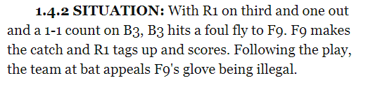
Gloves and Mitts
Situation 1.4.2
What are the coaches options?

Slide 4
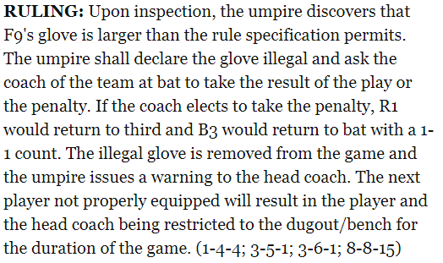
Gloves and Mitts
Situation 1.4.2

Slide 5
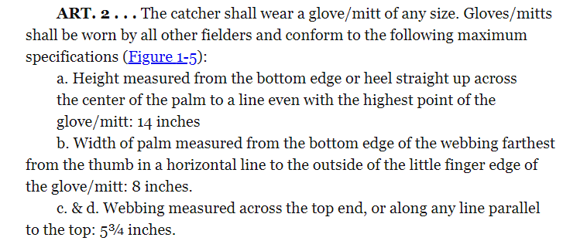
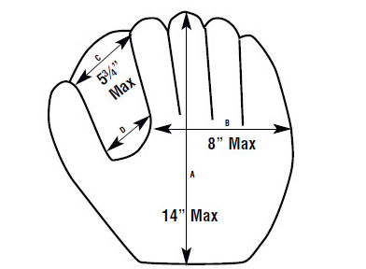
Gloves and Mitts
Rule 1.4.2

Slide 6
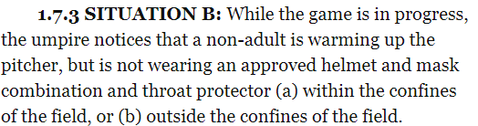
Catchers Equipment
Situation 1.7.3
What action should the Umpire(s) take?

Slide 7
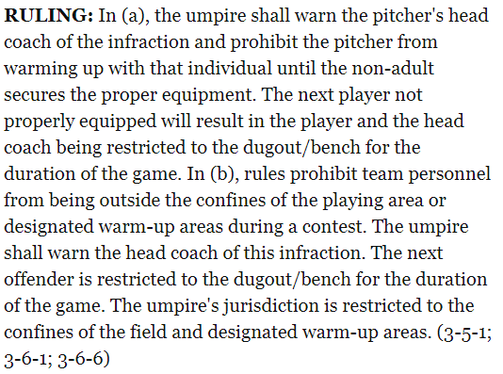
Catchers Equipment
Situation 1.7.3

Slide 8
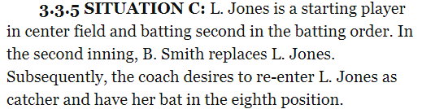
Substitution Re-Entry
Situation 3.3.5
What action should the Umpire(s) take?

Slide 9

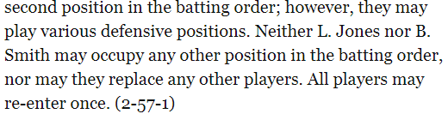
Substitution Re-Entry
Situation 3.3.5

Slide 10
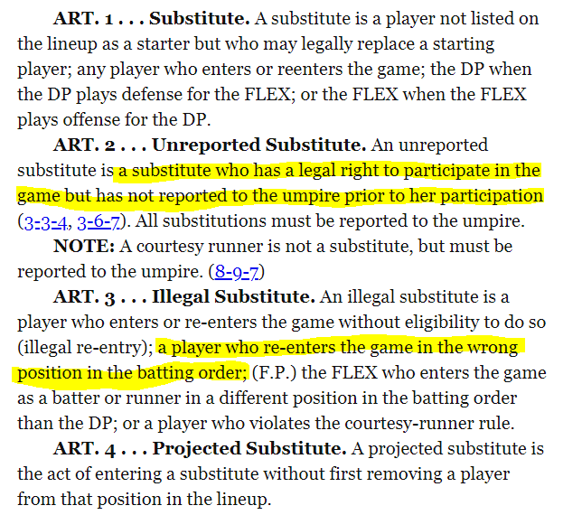
Substitute
Definition

Slide 11
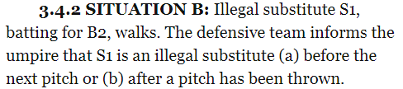
Illegal Substitute
Situation 3.4.2
What action should the Umpire(s) take?

Slide 12
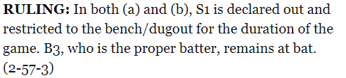
Illegal Substitute
Situation 3.4.2

Slide 13
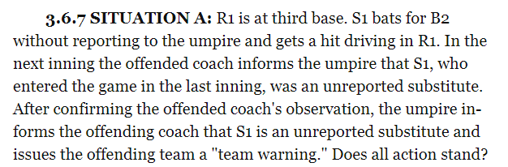
Unreported Substitution
Situation 3.6.7
What action should the Umpire(s) take?

Slide 14
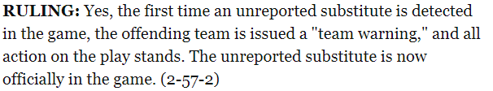
Unreported Substitution
Situation 3.6.7

Slide 15

Suspension of Play
Situation 5.2.1
What action should the Umpire(s) take?

Slide 16
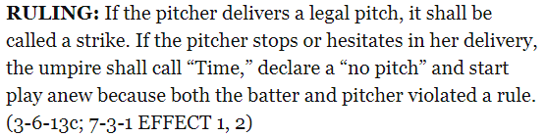
Suspension of Play
Situation 5.2.1

Slide 17
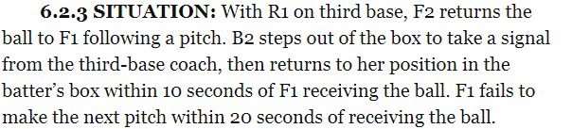
Infractions by the Pitcher
Situation 6.2.3
What action should the Umpire(s) take?

Slide 18
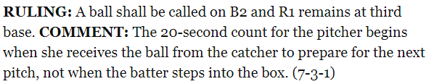
Infractions by the Pitcher
Situation 6.2.3

Slide 19
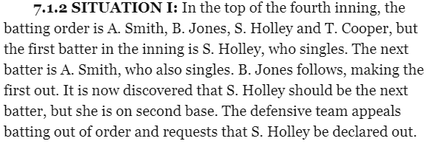
Positions and Batting Order
Situation 7.1.2
What action should the Umpire(s) take?

Slide 20
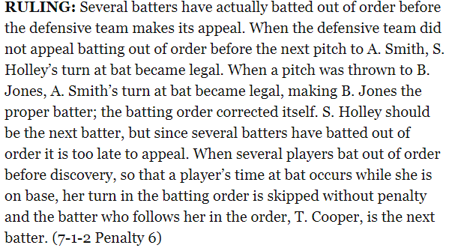
Positions and Batting Order
Situation 7.1.2

Slide 21
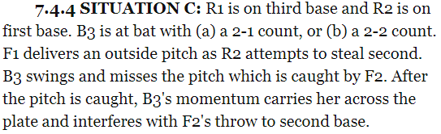
Batter Interference with Catcher
Situation 7.4.4
What action should the Umpire(s) take?

Slide 22
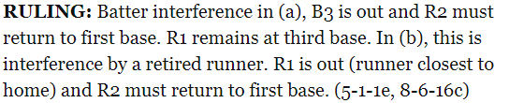
Batter Interference with Catcher
Situation 7.4.4

Slide 23
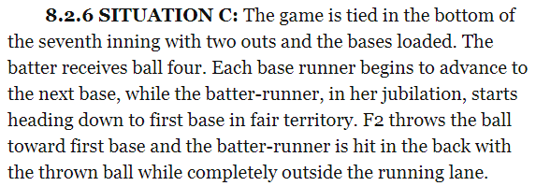
Three-Foot Running Lane
Situation 8.2.6
What action should the Umpire(s) take?

Slide 24

Three-Foot Running Lane
Situation 8.2.6

Slide 25
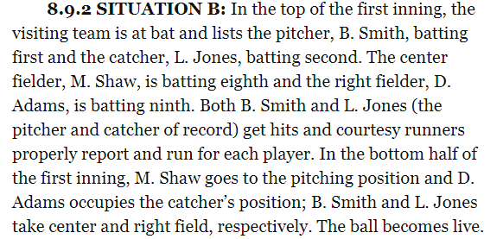
Pitcher or Catcher Re-Enters
Situation 8.9.2
What action should the Umpire(s) take?

Slide 26


Pitcher or Catchers Re-Enters
Situation 8.9.2

Slide 27
Plays or Situations
Plays or situations that you have seen and or handled in your games so far this year.

Slide 28
CLOSING
Case Book
Knowing the Rules and also knowing the intent of the Rule so that you know how to adjudicate them.

Slide 29

QUESTIONS

