Slide 1
Tyler TASO Lone Star Softball Chapter Training
December 8, 2019

Slide 2
Training Outline
Welcome to High School Softball
Meeting Dates for the 2020 Softball Season
Rule Changes and POE’s
Teamwork
Uniform

Slide 3
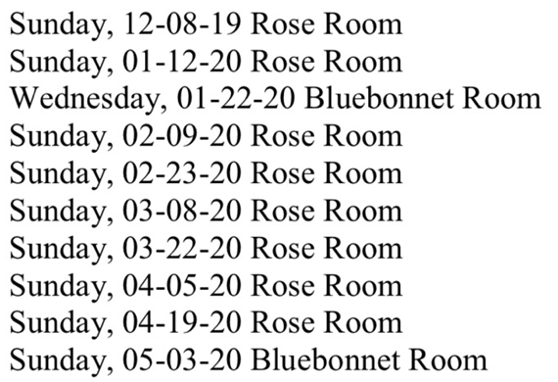
2020 Meeting Schedule

Slide 4
Damaged Bat vs. Illegal Bat
As a Point of Emphasis, clarification was need to delineate the difference between a player using a bat that is damaged versus a bat that is illegal for high school play. By definition , a bat that is damaged (Rule 2-4-3c) is removed from the game without penalty (Rule 7-4-2 Note). An illegal bat that is non-approved or altered will continue to result in the head coach and the batter being ejected.

Slide 5
Damaged Bat
A damaged bat is defined as a bat that was once legal, but is broken, cracked, dented, rattles or has sharp edges that might deface the ball.

Slide 6
Illegal/Altered Bat
1. Does not bear the ASA 2000 or 2004 or USA Certification Stamp
2. The bat must not appear on USA Softball’s Non-Approved Bats with Certification Marks list
3. Not contain materials inside the bat or treatments/devices used to alter the bat specifications and/or enhance the performance (shaving, rolling or artificially warming the bat barrel)

Slide 7

ASA 2000, 2004 and USA Softball Certification Marks

Slide 8
Detached Catchers Equipment
Language has been clarified in Rule 8-4-3d regarding F2 (Catcher) using detached equipment to stop a pitch. When F2 stops a wild pitch or passed ball with detached equipment, the batter is not awarded bases. However, if that pitch completed the batter’s turn at bat, she has become a batter-runner and is awarded a base.

Slide 9
Detached Catchers Equipment
Play: With R1 at first base and no outs, B2 is at bat with a count of (a) no balls, one strike, or (b) three balls, two strikes. B1 swings and misses at the next pitch, which get by F2. F2 stops the ball using her detached equipment.
What is the ruling in (a) and (b)?

Slide 10
Detached Catchers Equipment
In both cases, the ball is dead.
In (a), B2 remains at bat with a count of no balls, two strikes and R1 is awarded second base.
In (b), since B2 has completed her time at bat, R1 is awarded second base and B2 is awarded first base.

Slide 11
OLD
Rule 6-1-1
Pitching Regulations
Prior to starting the delivery (pitch), the pitcher shall take a position with the pivot foot on or partially on the top surface of the pitcher’s plate and the non-pivot foot in contact with or behind the pitcher’s plate. Both feet must be on the ground within or partially within the 24-inch length of the pitcher’s plate.

Slide 12
NEW
Rule 6-1-1
Pitching Regulations
Prior to starting the delivery (pitch), the pitcher shall take a position with the pivot foot in contact with the pitchers plate and the non-pivot foot in contact with or behind the pitcher’s plate. Both feet must be on the ground within or partially within the 24-inch length of the pitcher’s plate.

Slide 13
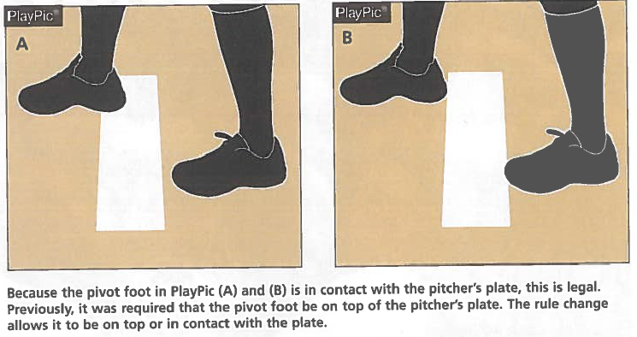

Slide 14
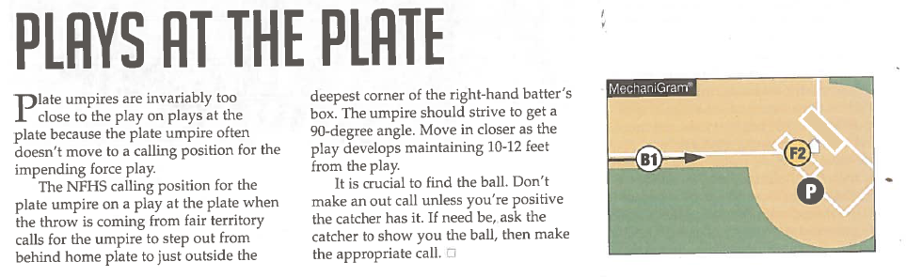
Plays At The Plate

Slide 15
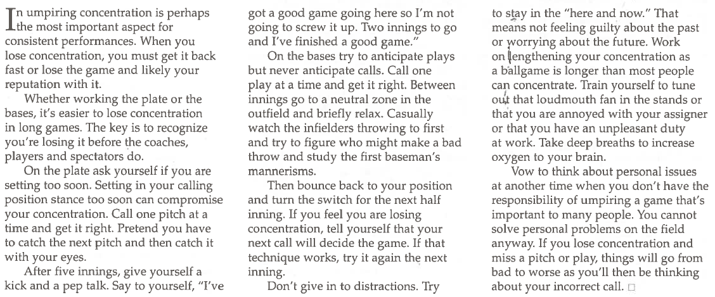
Keeping Focus a MUST for Umpires

Slide 16
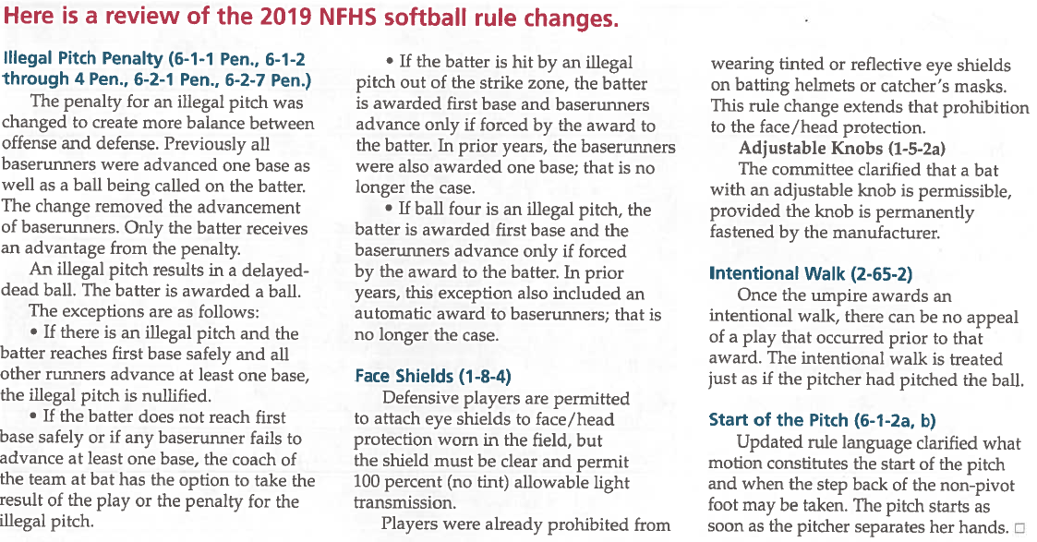
FLASHBACK: 2019 Rule Changes

Slide 17
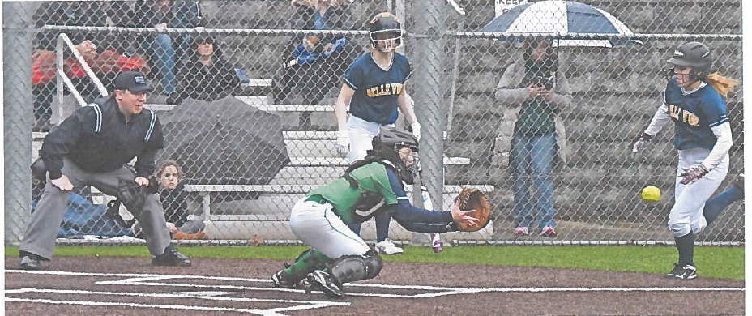
Keep Key Elements Of Each Play in Sight

Slide 18

Teamwork

Slide 19
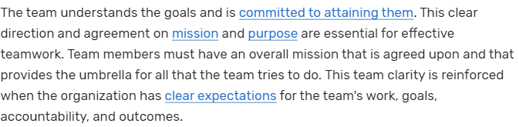
The Team is Clear About Its Mission

Slide 20
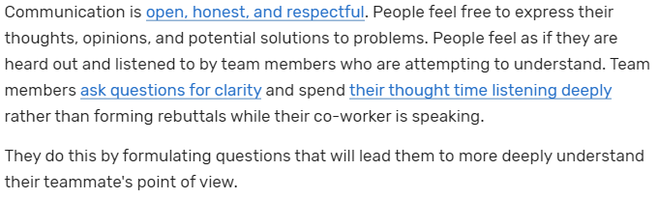
Respectful Communication is the Norm

Slide 21
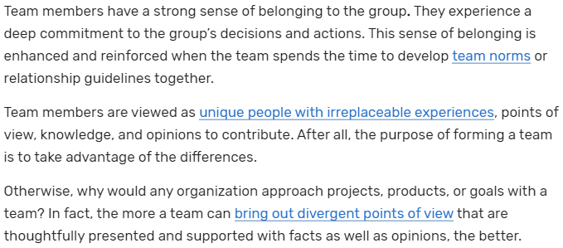
Strong Sense of Group Commitment

Slide 22
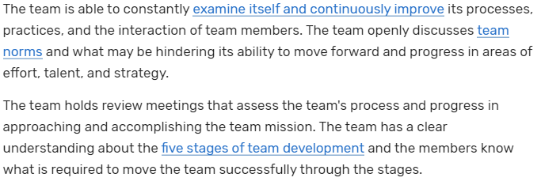
Engages in Continuous Improvement

Slide 23
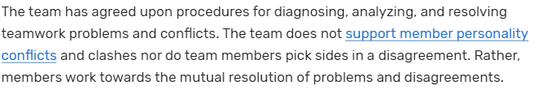
Solves Teamwork Problems and Conflicts

Slide 24
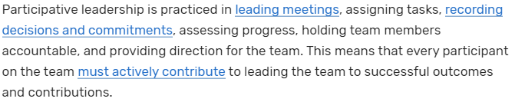
Practices Participative Leadership

Slide 25
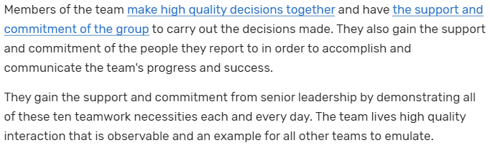
Makes High Quality Decisions

Slide 26
Uniform
Powder Blue/Navy Blue Shirt
White/Blue or Black Undershirt
Black Belt 1-1/2”
Heather Gray Slacks
TASO Hat Predominantly Black Shoes
Blue or Black Calf Length Socks
College Softball Jacket

Slide 27
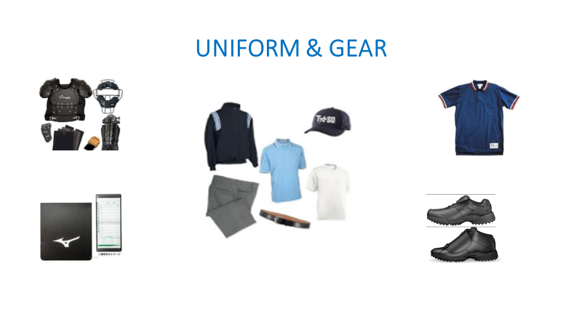

Slide 28

Questions

