Slide 1
Tyler Lonestar Softball Chapter
Week One Training
December 3, 2017

Slide 2
Training Outline
Arbiter Training and familiarization
What you must do to be a member in good standing
Uniform
Taking care of your business
Scrimmage Expectancies
Physical Fitness
Rule 2 Definitions

Slide 3
2017-2018 Meeting Dates

Slide 4
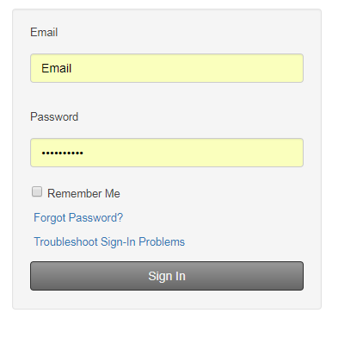
Arbiter Training How to log in

Slide 5
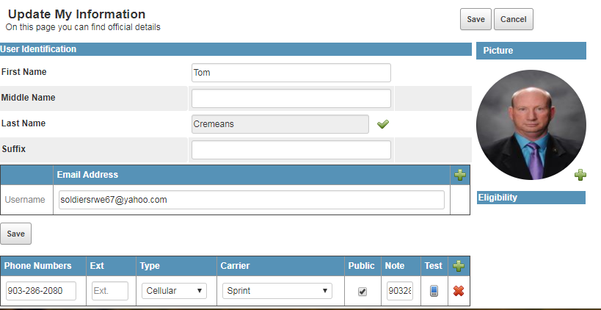
Arbiter Training How to check and update your Profile

Slide 6
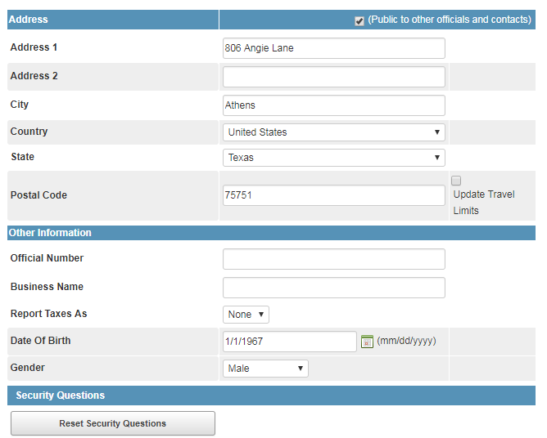
Arbiter Training How to check and update your Profile

Slide 7
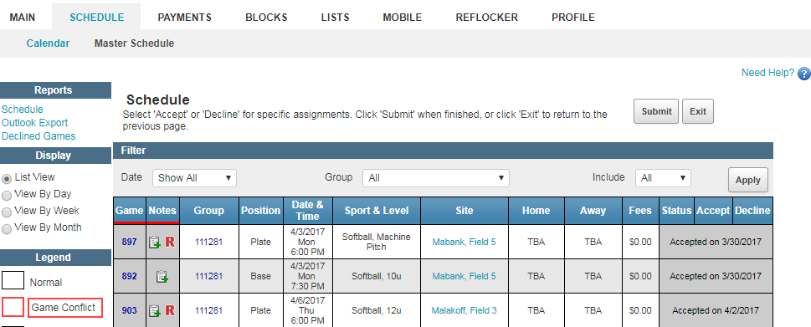
Arbiter Training How to check game assignments and partners

Slide 8
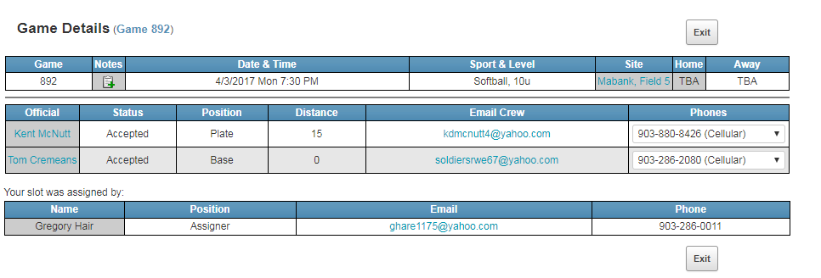
Arbiter Training How to check game assignments and partners

Slide 9
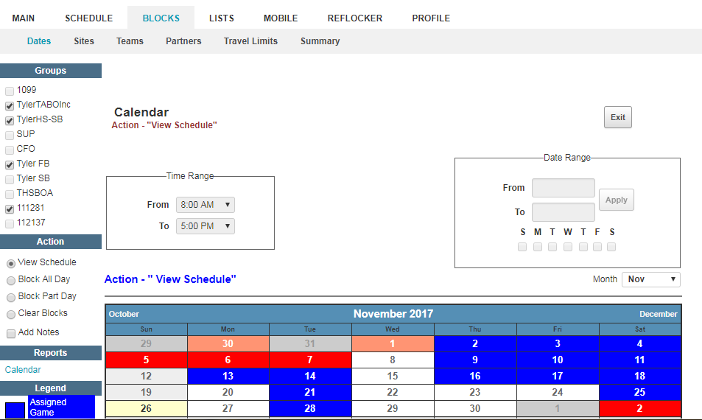
Arbiter Training How to set up blocks

Slide 10
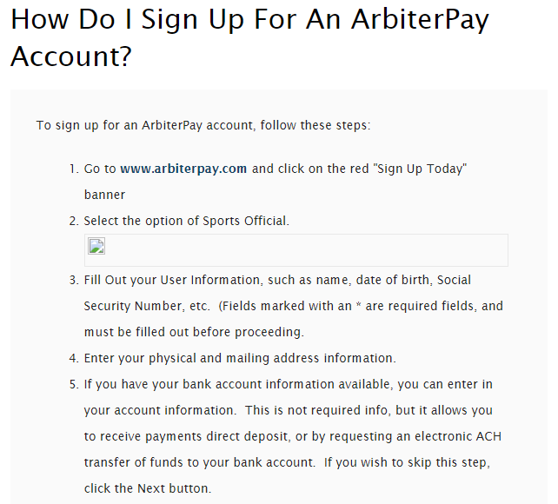
Arbiter Training How to set up an Arbiter Pay Account

Slide 11
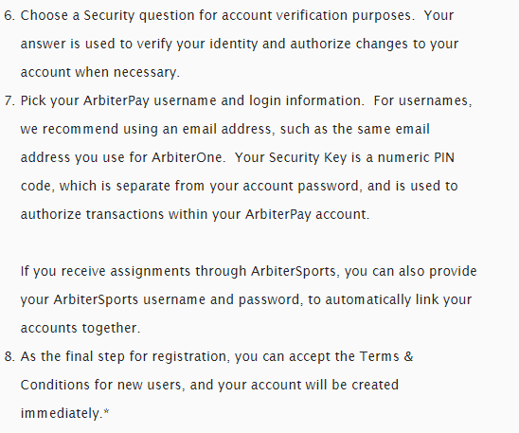
Arbiter Training How to set up an Arbiter Pay Account

Slide 12
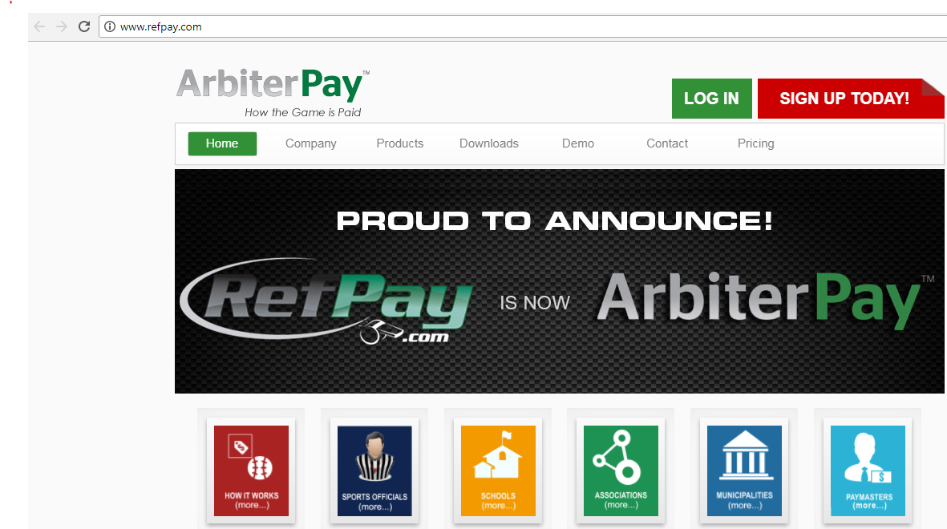
Arbiter Training How to set up an Arbiter Pay Account

Slide 13
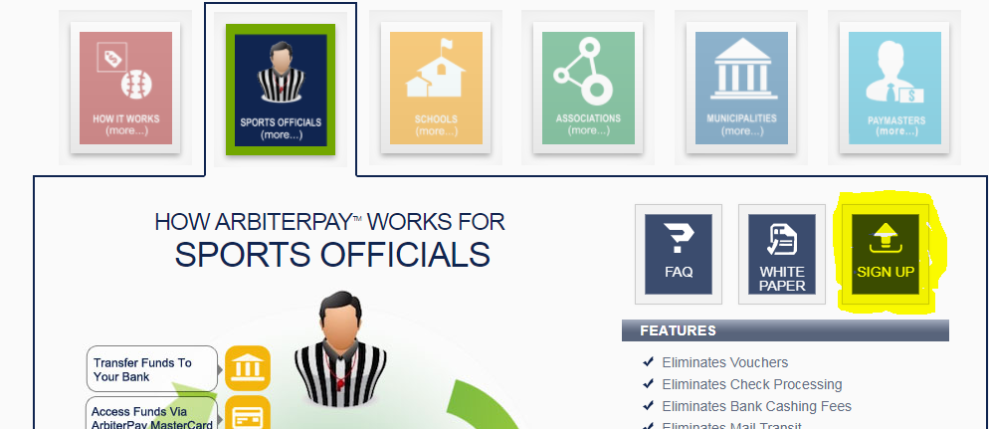
Arbiter Training How to set up an Arbiter Pay Account

Slide 14
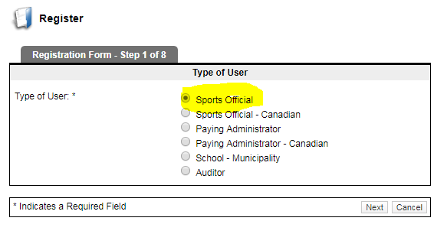
Arbiter Training How to set up an Arbiter Pay Account

Slide 15
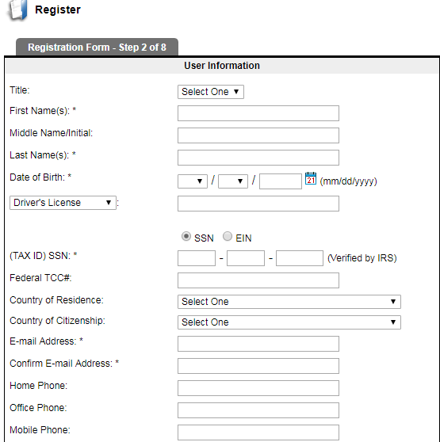
Arbiter Training How to set up an Arbiter Pay Account

Slide 16
What you need to take care of to be a member in good standing
a. Pay your State Dues
b. Work the Chapter Tournament or Pay your Local Dues and Fine.
c. Attend either the State Meeting, Regional Clinic, or the Online Clinic.
d. Take and pass the test with a minimum score of 70 to be eligible for the Regular Season and a 80 or better to be eligible for Post Season consideration.

Slide 17
UNIFORM
Worn:
Powder Blue Shirt White Undershirt for Powder Blue
Navy Blue Shirt Navy Blue or Black Undershirt for Navy Blue
Heather Gray Western Cut Pants Black Belt 1-1/4”
Black or Navy Blue Calf Socks Black Shoes/Plate Shoes
TASO Hat Jacket (College Softball)
Additional Equipment Needed:
Chest Protector Mask Shin Guards
Cup Indicator Ball Bag (Navy Blue) 1 or 2
Brush Coin (For flipping) Time Piece

Slide 18
UNIFORM

Slide 19
Taking Care of Business
Calling your partner once you learn you have a contest together, the plate umpire for the Varsity Contest is the Crew Chief and is responsible for initiating contact. If the Crew Chief does not initiate communications, then the partner should initiate.
Determine what color you are going to wear.
Determine if you may be able to ride together, if not determine where and what time to meet either onsite or prior to the site.
Call to 2 Board Members if you have something out of the ordinary to include a Fan, Coach, or Player ejection.

Slide 20
Taking Care of Business
Remember for all contests that you are assigned you are expected to be onsite by no less than 30 minutes prior to the start time of the contest.
Once on site find the home head coach and let them know that you are there and that you and your partner will get ready and be back on the field prior to 10 minutes before the contest will start.
Remember “If you deviate, then you must communicate”.

Slide 21
Conduct before and during scrimmages
Remember we are there to provide a service to the schools that choose to use us. Also remember you represent Tyler Softball Chapter.
Once you receive notice either from the scrimmage Leader or Arbiter make sure that you have all your equipment ready.
It is not required that you wear your uniform during scrimmages, however you will still need to wear clothing that your plate gear fits under.
The scrimmage leader will make contact with all the members that are scheduled to be at the scrimmage with them and make sure that they know when and where to be.

Slide 22
Conduct before and during scrimmages
When the scrimmage leader shows up (early) they are to get with coach. If a member shows up please wait for the scrimmage leader to get there before meeting the coach if possible, if the coach comes up to you introduce yourself and let them know that the scrimmage leader will be there shortly.
If the scrimmage leader is late or does not show up then the next senior person will step up and take charge. Meet with the coach and find out what their plan is for the scrimmage session.
After learning how the coach wants to run the scrimmage relay this to the members that are there. Plan how you would like to support the coaches desired outcome of their scrimmage.

Slide 23
Conduct before and during scrimmages
Use your fellow veterans along with yourself to work with the younger officials teaching the basics. Remember to let them work as much as possible and help them along the way.
After the conclusion of the scrimmage make sure that you either call or send Greg a text letting him know the scrimmage site, how long the scrimmage went, who all was there and worked, and anything that came up that needs to be passed along.

Slide 24
Physical Fitness
Take the time now to assess your state of physical fitness and the ware and tare that you will be putting your body through over the next 3 to 4 months.
I say this so that you can start a little training program before the beginning of the season in order to be ready for it.
By simply walking 2 or 3 times a week you will alter your state of physical fitness prior to the start of the season.

Slide 25
Rule 2- Definitions
The best place to learn “Softball” Lingo is Rule 2 in the Softball Rule Book. Here you will learn what everything means from an Appeal to Walk.
There are 65 Sections in the 2017 Rule Book.
Let’s take a look at Rule 2

Slide 26
Questions
?

