Slide 1
Tyler Softball Chapter January 21, 2018
General Meeting Agenda
President’s Report
a. Tournament Update
b. Pass out Rule/Case Books as needed
Treasure Report
Assigner Report
Training
Closing Remarks

Slide 2
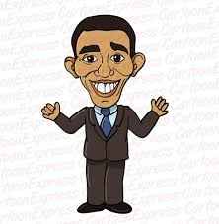
President’s Report

Slide 3
Treasures’ Report

Slide 4
Assignment Secretary’s Report

Slide 5
Tyler Lonestar Softball Chapter
Training
January 21, 2018

Slide 6
Training Outline
Questions on any of the Rule Changes & POE’s and how they affect umpires
Rule 3 Substitutions
To be in “Good Standing”
Scrimmages and our expected conduct
Home Plate Meeting (Role Play)

Slide 7
Rule Changes/Additions
Rule 2-65-2:
In an effort to improve the flow of the game and align with current trends of the sport, this change will allow the coach, pitcher, or catcher of the defensive team to make a request to the umpire for the batter to be intentionally walked to first base.

Slide 8
Rule Changes/Additions
Rule 2-65-2:
Umpires- Once the request is made by either the coach, pitcher, or catcher the plate umpire will call “Dead Ball” and award the batter runner first base. Once the request is made and granted by the plate umpire and “Dead Ball” is called there is no reversing the request.
Please remember that the request can be made anytime in the at bat, it does not have to be made prior to the 1st pitch of the at bat.

Slide 9
Rule Changes/Additions
Scenario #1
Batter R4 steps into the batters box she has been killing the ball all day long. With the pitcher on the pitching plate and prior to the pitch or taking a sign the catcher turns to you the plate umpire and says we want to walk her. You announce “Dead Ball” and instruct the batter that she has been walked and that she needs to move toward 1st Base. The batter moves out the box toward for first base and the Defensive Coach yells from the dugout and says “I did not say to walk the batter.” What do you do?

Slide 10
Rule Changes/Additions
Sample Answer
As the plate umpire you move toward the Defensive Head Coach and they will move toward you. You then explain that their catcher requested the walk and you the granted it. Once you announced “Dead Ball” the act became irrevocable and the batter runner was sent to 1st Base. Coach becomes a little “Hot” and says that she never issued that command to her catcher. You say the request was command and granted and it cannot be changed. Coach still “Hot” continues that she did not issue that command to walk the batter. You have explained this twice now and are becoming a little perturbed as well so you inform the coach unless they have something else to discuss this conversation is over. The coach doesn’t like and turns away mumbling under their breath moving toward the dugout. You move back to the plate and resume play.

Slide 11
Rule Changes/Additions
Rule 3-2-7c:
Added language to address the use and placement of the wristband playbook/play card and defines this item as a piece of equipment. It also addresses restrictions on color.

Slide 12
Rule Changes/Additions
Umpires- Any wristband with a playbook/play card attached shall be considered equipment and is permitted as long as it is a single, solid color, and it is not optic yellow. It does not have to match the color of the upper garment. It shall only be worn on the non pitching arm.
We will enforce this by using common sense if the equipment is used then it is our job to ensure that it is used in the proper manner so as to not give one team an advantage over the other.

Slide 13
Rule Changes/Additions
Rule 3-7-1 (NOTE):
Provides umpires with the authority to allow a reasonable number of warm-up pitches to an incoming pitcher due to circumstances that require a pitcher to be removed by rule.

Slide 14
Rule Changes/Additions
Examples-
a. Injury
b. Disqualification
c. Weather

Slide 15
Rule Changes/Additions
Rule 6-1-2b:
At anytime prior to the start of the pitch the pitcher may step back with the non-pivot foot with the hands together or separated. There appears to be no advantage to the hands being apart or together prior to stepping back. This rule change may also help the developing pitcher

Slide 16
Rule Changes/Additions
Clarification- Any step backward shall begin prior to the start of the pitch. (The pitch starts when one hand is taken off the ball or the pitcher makes any motion that is part of the windup after the hands have been brought together). The step backward may end before or after the hands come together. Once the pitch has started, the pitcher shall not take more than one step which must be forward, toward the batter and simultaneous with the delivery.

Slide 17
2018 POE’s
Coaches Responsibility Pregame Conference-Equipment
Rule 3-2-15 Has been removed. Per Rule 4-1-2d, coaches are responsible for verifying at the pregame conference that all their players are legally and properly equipped. Coaches are encouraged to review the following rules:
1-4 Gloves /Mitts
1-5 Bats
1-6 Batting Helmets
1-7 Catchers Equipment

Slide 18
2018 POE’s
3-2 Uniforms and Player Equipment
Penalties for illegal equipment range from correcting the problem if possible or having the equipment removed. Possible restriction to the dugout or ejection for the player and coach depending on the severity of the infraction could occur.
Other equipment-
Coaches should also review Rule 1-8 other equipment. To be familiar with what other equipment is permitted for players and coaches. (infielders facemasks)

Slide 19
2018 POE’s
Hit by Pitch
Rule 8-1-2c describes a situation in which the ball is not in the strike zone (this is a dead-ball strike) and is not completely in the batter’s box (hit by pitch and awarded first base). In the area between the strike zone and completely in the batter’s box, it was intended that the batter still make an effort to avoid being hit.
Layman’s Terms- If the ball is anywhere outside of the batter’s box in the “River” a batter must make an attempt to avoid being hit. The batter’s box is the batter’s and no attempt must be made to avoid a pitched ball.

Slide 20
2018 POE’s
Courtesy Runner for the Pitcher and/or Catcher
Rule 8-9-2 has a unique exception: When an injury or disqualification occurs in the top of the first inning to the pitcher and/or catcher identified on the lineup card and she is unable to face the first batter in the bottom of first inning, the player who ran for her is retroactively her substitute, no longer a courtesy runner. All substitution rules apply and the pitcher and/or catcher has left the game. If the pitcher and/or catcher is able to play in another position on the field, the player who ran for her is retroactively her substitute and is no longer a courtesy runner. All substitution rules apply.

Slide 21
Rule 3 Players, Substitutes and Coaches(Pg.30-40)
Section 1: Players, Substitutes and Coaches
Section 2: Uniforms, Players Equipment
Section 3: Substituting
Section 4: Illegal Substitute
Section 5: Coaching
Section 6: Bench and Field Conduct
Section 7: Charged Conferences

Slide 22
Rule 3 Players, Substitutes and Coaches(Pg.30) Section 1 Players, Positions

Slide 23
Rule 3 Players, Substitutes and Coaches(Pg.30) Section 1 Players, Positions

Slide 24
Rule 3 Players, Substitutes and Coaches(Pg.30) Section 1 Players, Positions

Slide 25
Rule 3 Players, Substitutes and Coaches(Pg.30) Section 2 Uniforms, Player Equipment

Slide 26
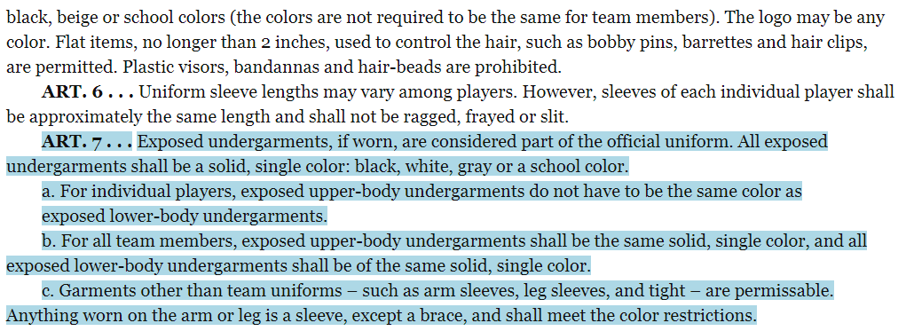
Rule 3 Players, Substitutes and Coaches(Pg.30) Section 2 Uniforms, Player Equipment

Slide 27
Rule 3 Players, Substitutes and Coaches(Pg.30) Section 2 Uniforms, Player Equipment
Exception: Any wristband with a playbook/playcard attached shall be considered equipment and is permitted as long as it is a single, solid color, and is not optic yellow. It does not have to match the color of the upper garment. It shall only be worn on the non-pitching arm.

Slide 28
Rule 3 Players, Substitutes and Coaches(Pg.30) Section 2 Uniforms, Player Equipment

Slide 29
Rule 3 Players, Substitutes and Coaches(Pg.30) Section 2 Uniforms, Player Equipment

Slide 30
Rule 3 Players, Substitutes and Coaches(Pg.30) Section 2 Uniforms, Player Equipment

Slide 31
Rule 3 Players, Substitutes and Coaches(Pg.30) Section 2 Uniforms, Player Equipment

Slide 32
Rule 3 Players, Substitutes and Coaches(Pg.30) Section 3 Substituting

Slide 33
Rule 3 Players, Substitutes and Coaches(Pg.30) Section 3 Substituting

Slide 34
Rule 3 Players, Substitutes and Coaches(Pg.30) Section 3 Substituting

Slide 35
Rule 3 Players, Substitutes and Coaches(Pg.30) Section 3 Substituting

Slide 36
Rule 3 Players, Substitutes and Coaches(Pg.30) Section 3 Substituting

Slide 37
Rule 3 Players, Substitutes and Coaches(Pg.30) Section 3 Substituting

Slide 38
Rule 3 Players, Substitutes and Coaches(Pg.30) Section 3 Substituting

Slide 39
Rule 3 Players, Substitutes and Coaches(Pg.30) Section 3 Substituting

Slide 40
Rule 3 Players, Substitutes and Coaches(Pg.30) Section 4 Illegal Substitution

Slide 41
Rule 3 Players, Substitutes and Coaches(Pg.30) Section 4 Illegal Substitution

Slide 42
Rule 3 Players, Substitutes and Coaches(Pg.30) Section 4 Illegal Substitution

Slide 43
Rule 3 Players, Substitutes and Coaches(Pg.30) Section 4 Illegal Substitution

Slide 44
Rule 3 Players, Substitutes and Coaches(Pg.30) Section 4 Illegal Substitution

Slide 45
Rule 3 Players, Substitutes and Coaches(Pg.30) Section 5 Coaching

Slide 46
Rule 3 Players, Substitutes and Coaches(Pg.30) Section 5 Coaching

Slide 47
Rule 3 Players, Substitutes and Coaches(Pg.30) Section 5 Coaching

Slide 48
Rule 3 Players, Substitutes and Coaches(Pg.30) Section 6 Bench and Field Conduct

Slide 49
Rule 3 Players, Substitutes and Coaches(Pg.30) Section 6 Bench and Field Conduct

Slide 50
Rule 3 Players, Substitutes and Coaches(Pg.30) Section 6 Bench and Field Conduct
Article 12 (Change) No participant, coach or administrator shall use alcohol or any form of tobacco product
(e-cigarette or similar items) beginning with the arrival at the competition site until departure following the
Completion of the contest.

Slide 51
Rule 3 Players, Substitutes and Coaches(Pg.30) Section 6 Bench and Field Conduct

Slide 52
Rule 3 Players, Substitutes and Coaches(Pg.30) Section 6 Bench and Field Conduct

Slide 53
Rule 3 Players, Substitutes and Coaches(Pg.30) Section 6 Bench and Field Conduct

Slide 54
Rule 3 Players, Substitutes and Coaches(Pg.30) Section 7 Charged Conferences
Note: If the incoming pitcher has already pitched in the game, she will receive five warm-up pitches.
When a pitcher is removed by rule and the incoming pitcher has not pitched in the game, the umpire
Is authorized to permit additional warm-up pitches.

Slide 55
Rule 3 Players, Substitutes and Coaches(Pg.30) Section 7 Charged Conferences

Slide 56
What you need to take care of to be a member in good standing
a. Pay your State Dues
b. Work the Chapter Tournament or Pay your Local Dues and Fine.
c. Attend either the State Meeting, Regional Clinic, or the Online Clinic.
d. Take and pass the test with a minimum score of 80.

Slide 57
Test Question
R2 is on second base when B1 hits a hard one-hop smash that deflects off F5 to F6. While running to third, R2 tries but is unable to avoid F6, and no one is retired on the play.

Slide 58
Test Answer
Interference occurs if the act is intentional or if the ball deflected off the pitcher.

Slide 59
Test Question
R1 is on first base as B2 bats with a 1-1 count. B2 squares in the batter's box and holds her bat in a bunting stance within the strike zone as the pitch passes the plate low and in the dirt.

Slide 60
Test Answer
The pitch is called a strike.

Slide 61
Test Question
Team A's pitcher has a pink digital camouflage arm sleeve on her pitching arm extending from her uniform top all the way down to her wrist. The ruling should be:

Slide 62
Test Answer
Illegal, the sleeve must be removed or covered. Sleeves must follow the same color restrictions as exposed undergarments.

Slide 63
Test Question
With a 3-2 count, B1 steps completely out of the batter's box during F1's delivery. The pitch is high and out of the strike zone.

Slide 64
Test Answer
The umpire will declare a strike and B1 is out

Slide 65
Test Question
R1 on first base. B1 swings at a pitch that hits her arm and goes to the backstop. R1 advances to third. The plate umpire declares a dead ball and directs R1 back to first. She goes directly back to first without touching second base. The defense appeals and R1 is declared out.

Slide 66
Test Answer
FALSE

Slide 67
Conduct before and during scrimmages
Remember we are there to provide a service to the schools that choose to use us. Also remember you represent Tyler Softball Chapter.
Once you receive notice either from the scrimmage Leader or Arbiter make sure that you have all your equipment ready.
It is not required that you wear your uniform during scrimmages, however you will still need to wear clothing that your plate gear fits under.
The scrimmage leader will make contact with all the members that are scheduled to be at the scrimmage with them and make sure that they know when and where to be.

Slide 68
Conduct before and during scrimmages
When the scrimmage leader shows up (early) they are to get with the coach. If a member shows up please wait for the scrimmage leader to get there before meeting the coach if possible, if the coach comes up to you introduce yourself and let them know that the scrimmage leader will be there shortly.
If the scrimmage leader is late or does not show up then the next senior person will step up and take charge. Meet with the coach and find out what their plan is for the scrimmage session.
After learning how the coach wants to run the scrimmage relay this to the members that are there. Plan how you would like to support the coaches desired outcome of their scrimmage.

Slide 69
Conduct before and during scrimmages
Use your fellow veterans along with yourself to work with the younger officials teaching the basics. Remember to let them work as much as possible and help them along the way.
After the conclusion of the scrimmage make sure that you either call or send Oscar a text letting him know the scrimmage site, how long the scrimmage went, who all was there and worked, and anything that came up that needs to be passed along.

Slide 70
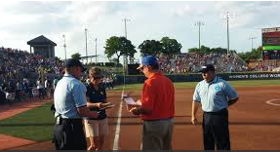
Home Plate Meeting

Slide 71
Questions
?

Slide 72
Closing Remarks
?

