Slide 1
Tyler Lonestar Chapter
The training your about to take part in is to help ensure that ALL members of the Tyler TASO Softball Association are on the same sheet of music regarding Jewelry.
Jewelry- What is acceptable

Slide 2
Jewelry
Removes language prohibiting the wearing of jewelry.
Rationale: Removing the language prohibiting jewelry places the softball rules in line with other NFHS sports that have removed the restriction. Umpires still have the authority to rule on anything that is considered a distraction or increases risk to any player.
Rule 3-2-12, 3-6-11 Jewelry

Slide 3
Jewelry
Umpires still have the authority to rule on anything that is considered a distraction or increases risk to any player.
Ok this statement right here is what were addressing. If you determine that the jewelry is a distraction or risk to player safety, you MUST call/text Oscar/Tom/Chuck/or Shane.
Rule 3-2-12, 3-6-11 Jewelry

Slide 4
Jewelry
On the following pages you’ll see pictures of Jewelry and how WE deem it to be.
Rule 3-2-12, 3-6-11 Jewelry

Slide 5
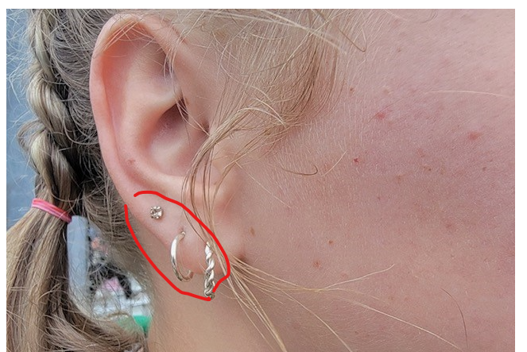
Jewelry
Rule 3-2-12, 3-6-11 Jewelry
No Issue

Slide 6
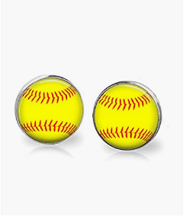
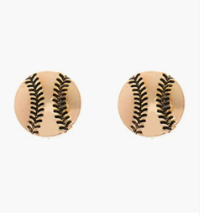
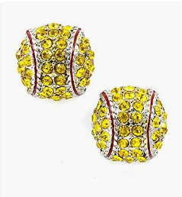
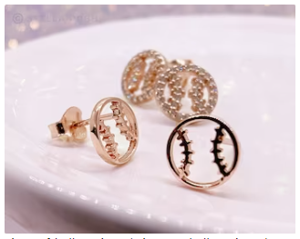
Jewelry Earring’s
Rule 3-2-12, 3-6-11 Jewelry
Allowed

Slide 7
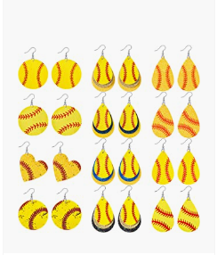
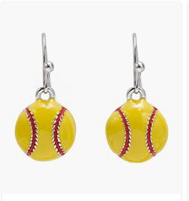
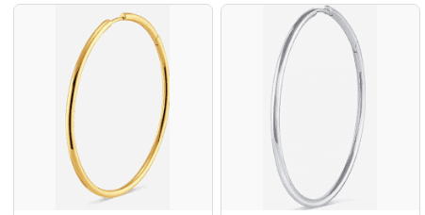
Jewelry Earring’s
Rule 3-2-12, 3-6-11 Jewelry
Not Allowed

Slide 8
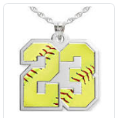
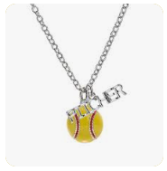
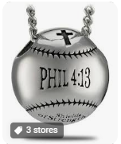
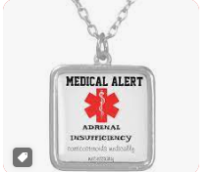
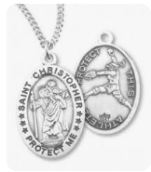
Jewelry- Necklaces
Remember that ALL necklaces must be tucked inside of the players uniform Shirt/Jacket/or Sweatshirt. No Exceptions
Rule 3-2-12, 3-6-11 Jewelry

Slide 9
Jewelry- Watches
The rule prohibiting jewelry has been removed, allowing team personnel to now wear jewelry; however, the rule regarding the use of electronics is still in place. The use of electronic devices by team personnel to transmit or record information pertaining to their players or team’s performance is only permitted within the dugout.
Items such as smartwatches are permitted to be utilized as a watch but cannot be used to transmit or receive data outside of the dugout.
If you determine that a coach and player are circumventing the rules, be prepared to adjudicate the situation
Rule 3-2-12, 3-6-11 Jewelry

Slide 10
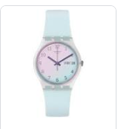
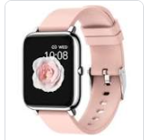
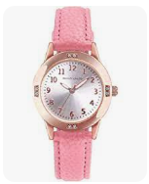
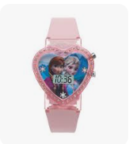
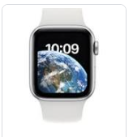
Jewelry- Watches
Rule 3-2-12, 3-6-11 Jewelry

Slide 11
Jewelry- Closing Remarks
Jewelry is here to stay, and we’ll have to learn how to deal with it. As for now the training that was just presented is to give you a starting point of the things, we’ll tolerate vs. the things that we will not tolerate. If you have an issue with jewelry, please treat it as any other issue that you are required to alert 2 of the following 4 personnel immediately after your contest.
Oscar Strain Chuck Allen
Tom Cremeans Shane Helms
Rule 3-2-12, 3-6-11 Jewelry

Slide 12
Questions

