Slide 1
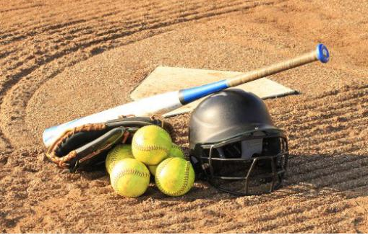
TYLER SOFTBALL CHAPTER Coaches Meeting
January 22, 2019

Slide 2
Agenda
Welcome
Introductions (Coaches and Officials)
Rule Changes and POE’s
Arbiter
Questions
Closing Remarks

Slide 3
Welcome

Slide 4
Introductions

Slide 5
2020 NFHS SOFTBALL Rules Power Point
Rules Changes Major Editorial Changes
Points of Emphasis
Notes:
Welcome to the 2020 Softball Power Point Rule Interpreters Meeting.

Slide 6
2020 NFHS SOFTBALL RULES CHANGES
Notes:
2019 NFHS SOFTBALL RULES CHANGES

Slide 7
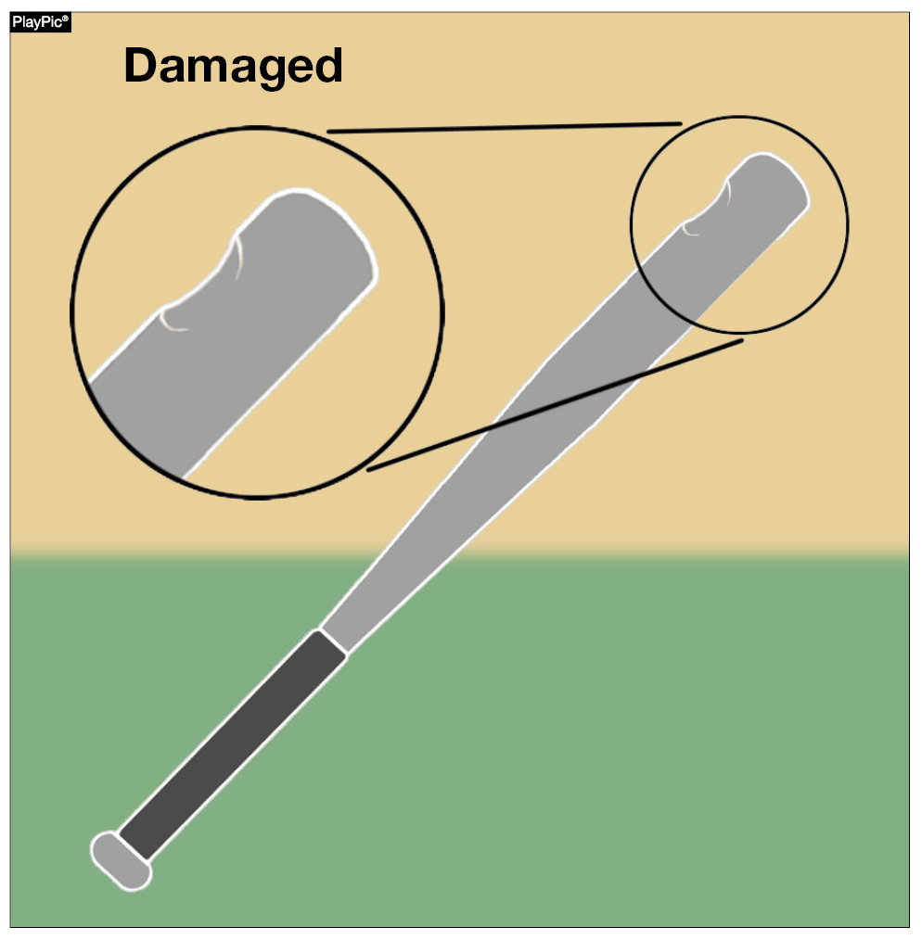
bats Rules 1-5-1c,d,e, 2-4-3, 7-4-2 penalty NOTE
A damaged bat has been defined as a bat that was once legal but is now broken, cracked or dented. A damaged bat shall be removed without penalty. A bat that continually discolors the ball may be removed from the game with no penalty at the discretion of the umpire. Players who attempt to use damaged bats after they have been removed are then subject to the penalties for unsporting behavior.
Notes:
BATS - RULES 1-5-1c-e, 2-4-3, 7-4-2 PENALTY NOTE
A damaged bat has been defined as a bat that was once legal but is now broken, cracked or dented. A damaged bat shall be removed without penalty. A bat that continually discolors the ball may be removed from the game with no penalty at the discretion of the umpire. Players who attempt to use damaged bats after they have been removed are then subject to the penalties for unsporting behavior.
Rationale: Language was added to provide a clear definition of a damaged bat, delineating it from illegal and altered bats. Damaged bats are not to be considered illegal bats and therefore, they do not carry the same penalty as illegal bats. Damaged bats should be removed from the game without penalty. Language was also added to clarify the new certification marking (USA Softball All Games mark).

Slide 8
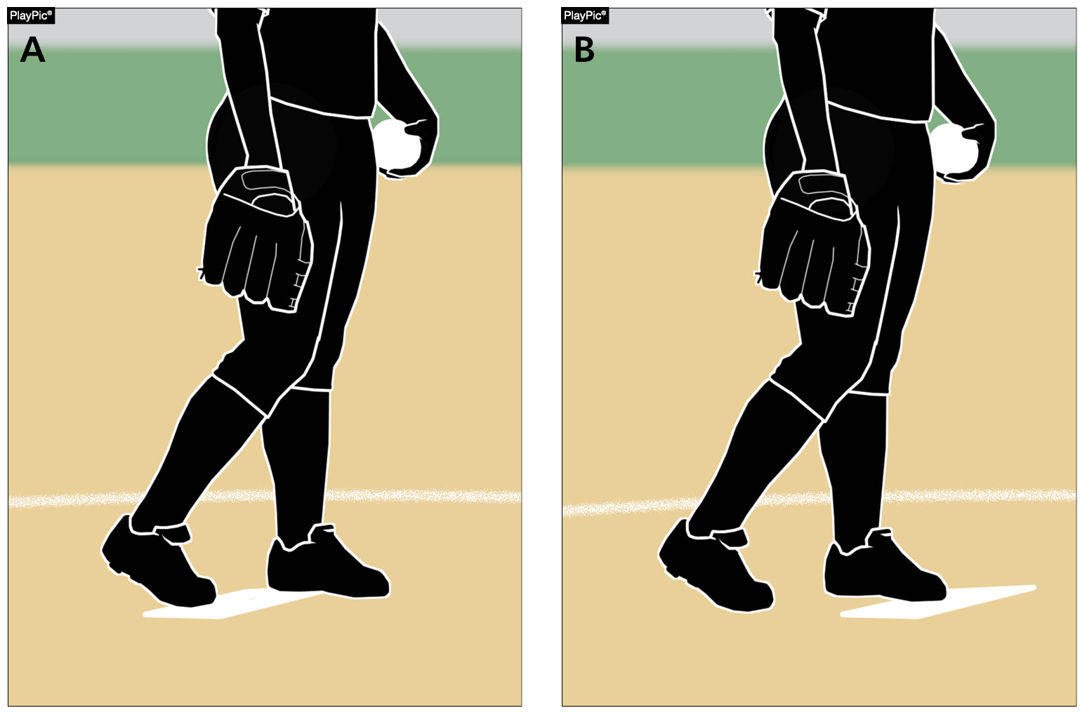
Pitching regulations Rules 6-1-1, 6-1-2a
Whether both feet are in contact with the pitching plate (PlayPic A) or only the pivot foot is in contact with the pitching plate (PlayPic B), the pitcher shall take (or simulate taking) a signal from the catcher.
Notes:
PITCHING REGULATIONS - RULES 6-1-1, 6-1-2a Whether both feet are in contact with the pitching plate (PlayPic A) or only the pivot foot is in contact with the pitching plate (PlayPic B), the pitcher shall take (or simulate taking) a signal from the catcher.
Rationale: Prior to starting the delivery of the pitch, the pitcher shall take a position with the pivot foot in contact with the pitcher's plate. The rule language no longer limits the pivot foot to contacting just the top surface of the pitcher’s plate.

Slide 9
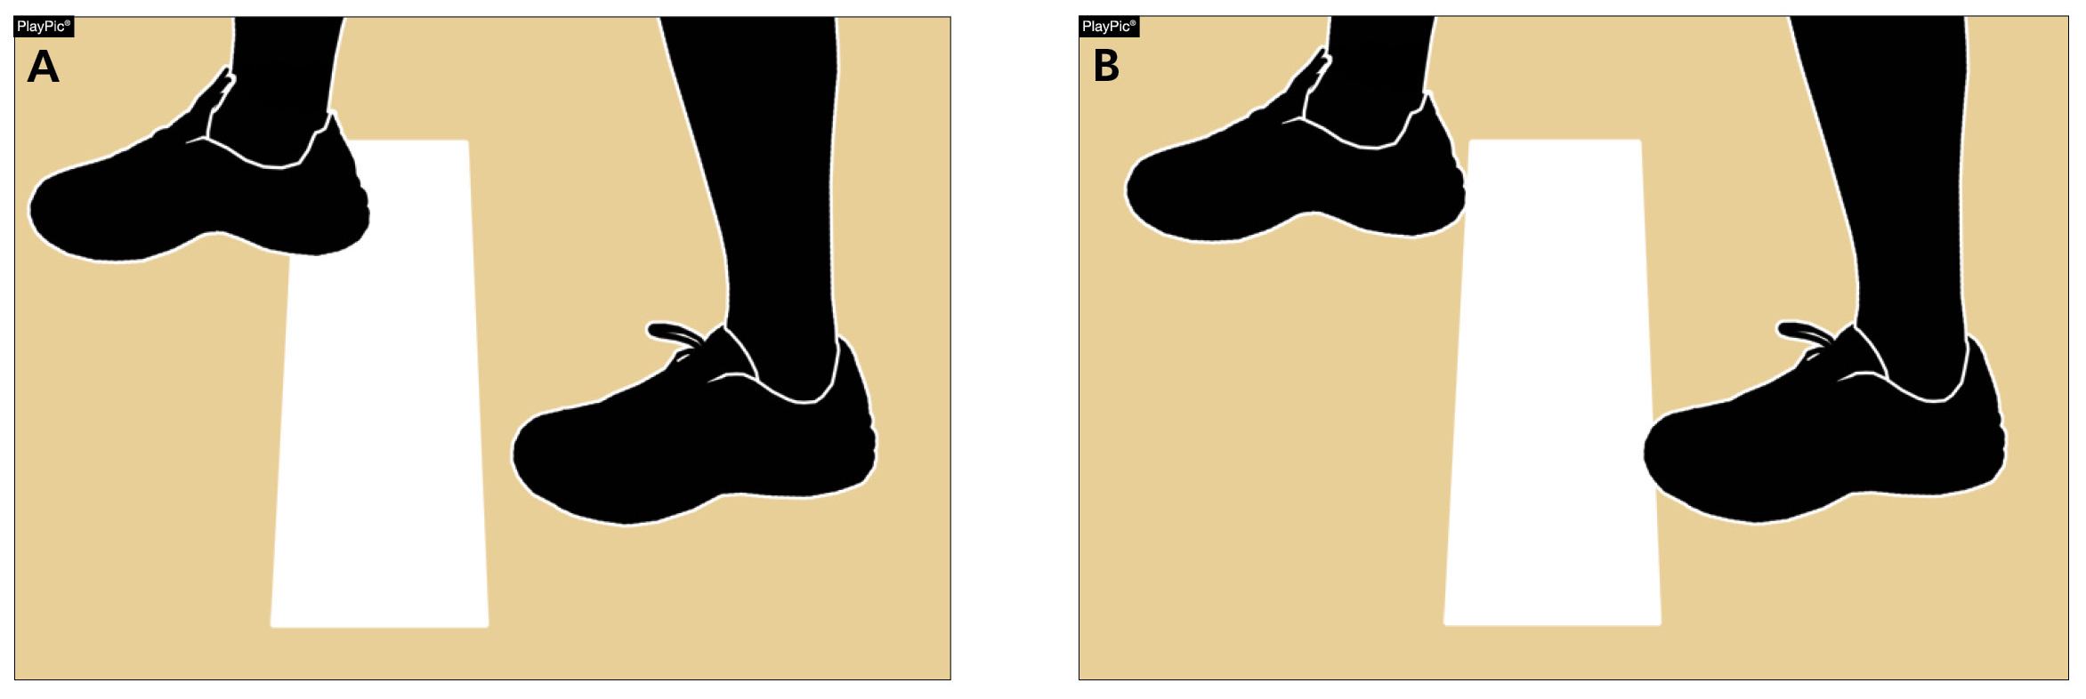
Pitching regulations Rules 6-1-1, 6-1-2a
Because the pivot foot in PlayPic (A) and (B) is in contact with the pitcher’s plate, this is legal. Previously, it was required that the pivot foot be on top of the pitcher’s plate.
The rule change allows it to be on top or in contact with the plate.
Notes:
PITCHING REGULATIONS - RULES 6-1-1, 6-1-2a Because the pivot foot in PlayPic (A) and (B) is in contact with the pitcher’s plate, this is legal. Previously, it was required that the pivot foot be on top of the pitcher’s plate. The rule change allows it to be on top or in contact with the plate.
Rationale: New language clarifies that the pivot foot must be in contact with the pitcher’s plate, rather than on the top surface of the pitcher’s plate.

Slide 10
How a team scores Rule 9-1-1 EXCEPTION C
A run is not scored if the runner advances to home plate during action in which the third out is made by a preceding runner who is declared out on an appeal play.
Previous wording only described a runner failing to touch a base. This new wording makes it clear that if the preceding runner is called out for any appeal play, the following runs would not score.
Notes:
HOW A TEAM SCORES - RULE 9-1-1 EXCEPTION C
A run is not scored if the runner advances to home plate during action in which the third out is made by a preceding runner who is declared out on an appeal play. Previous wording only described a runner failing to touch a base. This new wording makes it clear that if the preceding runner is called out for any appeal play, the following runs would not score.
Rationale: New language clarifies that on any appeal play, a run is not scored if the third out is made by a preceding runner.

Slide 11
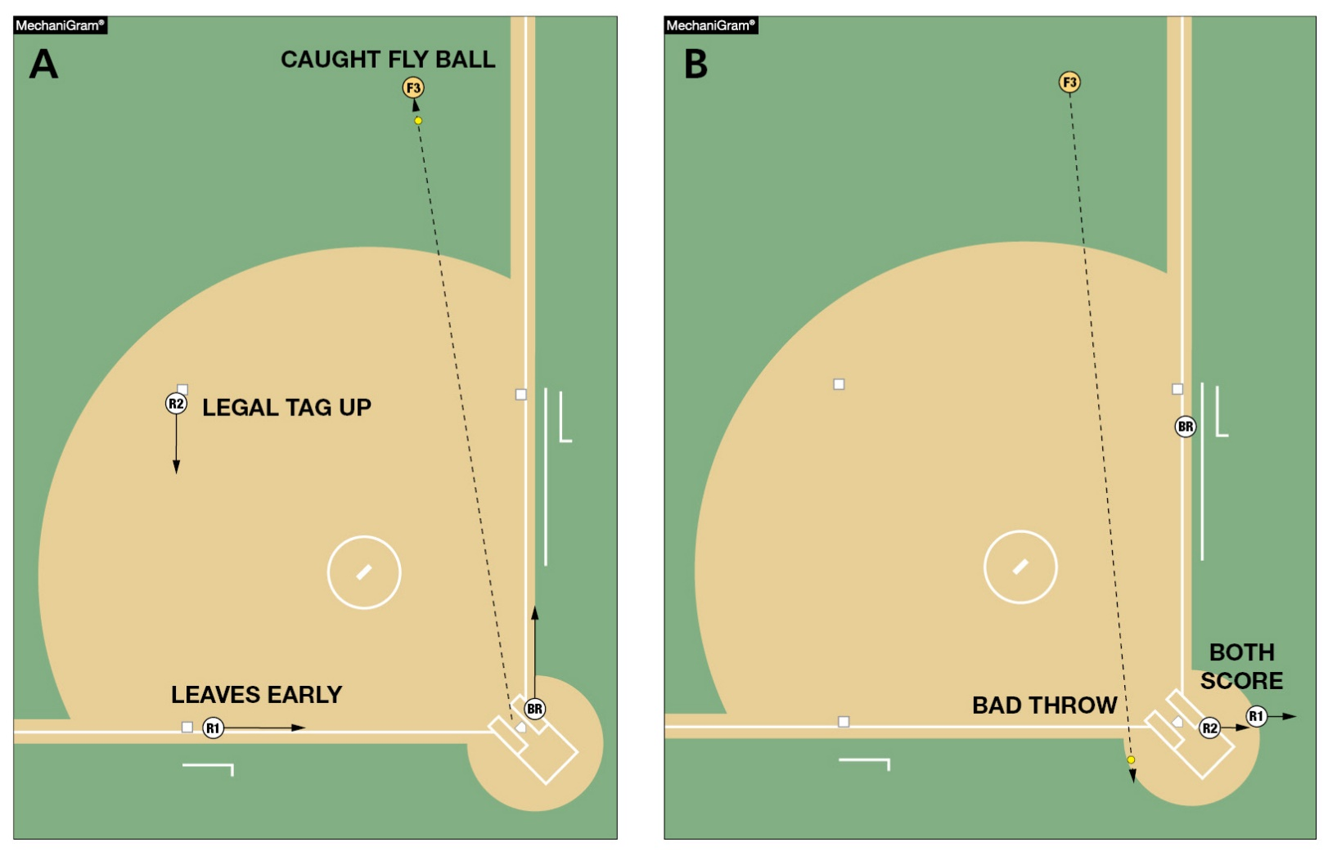
How a team scores Rule 9-1-1 exception C
In MechaniGram A, the fly ball is caught for the second out. Both runners tag. R1 on third base leaves early and scores, R2 on second base leaves legally to advance to third base. In MechaniGram B, the throw is over the defensive player’s head and R2 scores. The defense then appeals that R1 left early. No runs score since R1 is declared out and no runner can score if the preceding runner is called out on appeal for the third out
^{of the inning.}
Notes:
HOW A TEAM SCORES - RULE 9-1-1 EXCEPTION C
In MechaniGram A, the fly ball is caught for the second out. Both runners tag. R1 on third base leaves early and scores, R2 on second base leaves legally to advance to third base. In MechaniGram B, the throw is over the defensive player’s head and R2 scores. The defense then appeals that R1 left early. No runs score since R1 is declared out and no runner can score if the preceding runner is called out on appeal for the third out of the inning.
Rationale: A run is not scored if the runner advances to home plate during action in which the third out is made by the preceding runner who is declared out on an appeal play. Added language clarifies that if a preceding runner is called out on appeal, subsequent runner(s) that cross the plate do not count as run(s) scored.

Slide 12
2020 NFHS SOFTBALL Major editorial changes
Notes:
2020 NFHS SOFTBALL MAJOR EDITORIAL CHANGES

Slide 13
The Field Rule 1-1-7
Game management or a state administrator may establish a media area as needed.
Notes:
THE FIELD - RULE 1-1-7
Game management or a state administrator may establish a media area as needed.
Rationale: This edit clarifies that game management or a state administrator may establish a dead-ball media area within the confines of the field, but that area will remain a dead-ball area throughout the game.

Slide 14
Field and equipment Rule 1-5-1d
Updates to add the new USA Softball All Games certification mark.
This new mark is very similar to the 2004 ASA Softball Logo just with USA Softball wording.
This new mark will begin to be seen in 2020 and beyond.
Notes:
FIELD AND EQUIPMENT - RULE 1-5-1d
Updates to add the new USA Softball All Games certification mark.
This new mark is very similar to the 2004 ASA Softball Logo just with USA Softball wording.
This new mark will begin to be seen in 2020 and beyond.
Rationale: Language was also added to clarify the new certification marking (USA Softball All Games mark).

Slide 15
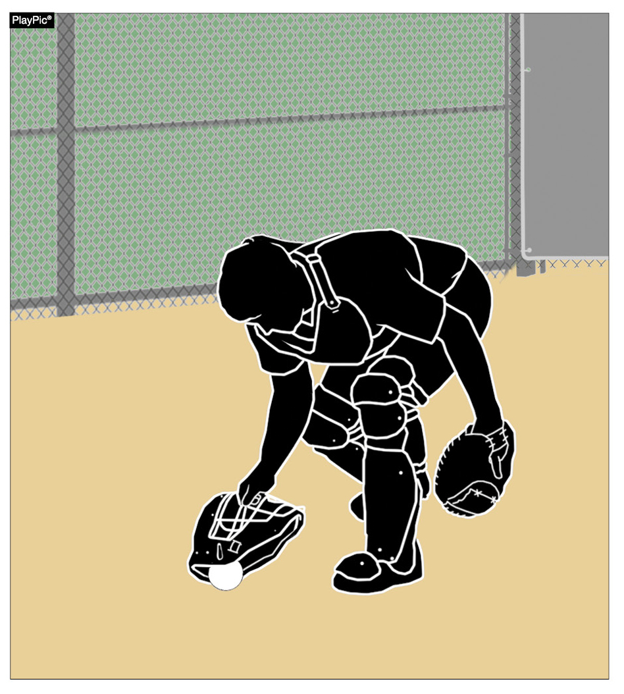
Runners Entitled to advance Rule 8-4-3d Penalty
Language was clarified to indicate that when F2 stops a wild pitch or passed ball with detached equipment, the batter is not awarded bases. But if that pitch completed the batter’s turn at bat, the batter-runner is awarded first base.
Notes:
RUNNERS ENTITLED TO ADVANCE - RULE 8-4-3d PENALTY
Language was clarified to indicate that when F2 stops a wild pitch or passed ball with detached equipment, the batter is not awarded bases. But if that pitch completed the batter’s tun at bat, the batter-runner is awarded first base.
Rationale: Clarifies that the batter-runner, not the batter is awarded bases when a fielder intentionally contacts the ball with detached equipment.

Slide 16
2020 NFHS SOFTBALL points of emphasis
Notes:
2020 NFHS SOFTBALL POINTS OF EMPHASIS

Slide 17
Damaged bat vs. illegal bat
Bats must bear either the 2000, 2004, or the USA Softball All Games certification mark. Additionally, the bat must not appear on USA Softball’s Non-Approved Bats With Certification Marks list (www.usasoftball.com). Bat
barrels made entirely of wood are permitted and need not bear a certification mark but shall not exceed
^{2-1/4 inches in diameter.}
Notes:
BAT CERTIFICATION MARKS Bats must bear either the 2000, 2004, or the USS Softball All Games certification mark. Additionally, the bat must not appear on the USA Softball’s Non-Approved Bats with Certification Marks list (www.usasoftball.com). Bat barrels made entirely of wood are permitted and need not bear a certification mark but shall not exceed 2 ¼ inches in diameter.
NFHS softball recognizes and utilizes USA Softball’s certification process. In order for a bat to be legal for use in NFHS softball it must be marked with the ASA 2000, 2004 or the USA Softball All-Games Certification Mark. Additionally, any bat with one of these certification marks must not appear on the list of the USA Softball Non-Approved Bats with Certification Marks. This list was created as a way to alert players and coaches that a bat that was once approved for use has now been deemed no longer approved for use. All bats that are approved by USA Softball, formally ASA, for use in fast pitch play shall bear one of the markings shown above.

Slide 18
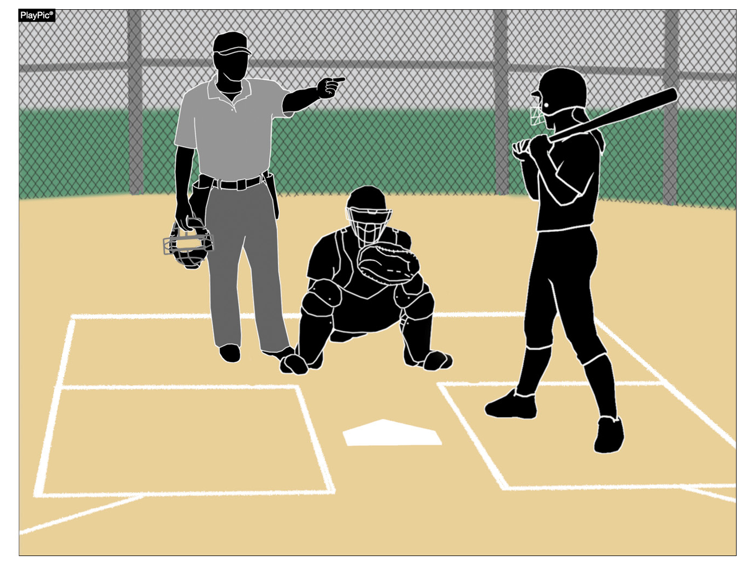
Damaged bat vs. illegal bat
Clarification was needed to delineate the difference between a player using a bat that is damaged versus a bat that is illegal for high school play. By definition, a bat that is damaged (Rule 2-4-3c) is removed from the game without penalty (7-4-2 NOTE). An illegal bat that is non-approved or altered will continue to result in the head coach and the batter
being ejected.
Notes:
DAMAGED BAT VS. ILLEGAL BAT Clarification was needed to delineate the difference between a player using a bat that is damaged versus a bat that is illegal for high school play. By definition, a bat that is damaged (Rule 2-4-3c) is removed from the game without penalty (7-4-2 NOTE). An illegal bat that is non-approved or altered will continue to result in the head coach and the batter being ejected.

Slide 19
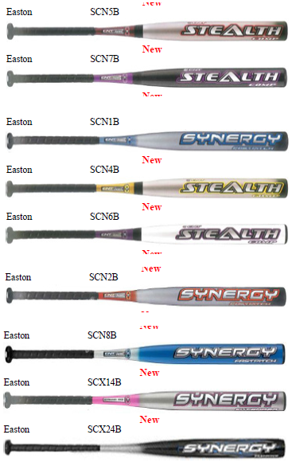
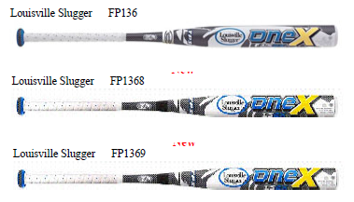
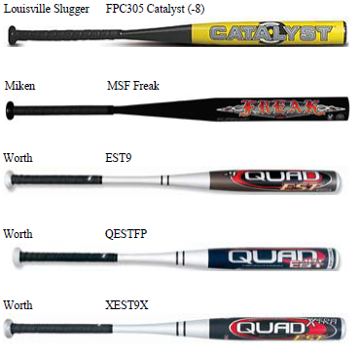
USA softball non-approved Fastpitch bats with certification marks
Notes:
BAT CERTIFICATION MARKS Bats must bear either the 2000, 2004, or the USS Softball All Games certification mark. Additionally, the bat must not appear on the USA Softball’s Non-Approved Bats with Certification Marks list (www.usasoftball.com). Bat barrels made entirely of wood are permitted and need not bear a certification mark but shall not exceed 2 ¼ inches in diameter.
NFHS softball recognizes and utilizes USA Softball’s certification process. In order for a bat to be legal for use in NFHS softball it must be marked with the ASA 2000, 2004 or the USA Softball All-Games Certification Mark. Additionally, any bat with one of these certification marks must not appear on the list of the USA Softball Non-Approved Bats with Certification Marks. This list was created as a way to alert players and coaches that a bat that was once approved for use has now been deemed no longer approved for use. All bats that are approved by USA Softball, formally ASA, for use in fast pitch play shall bear one of the markings shown above.

Slide 20
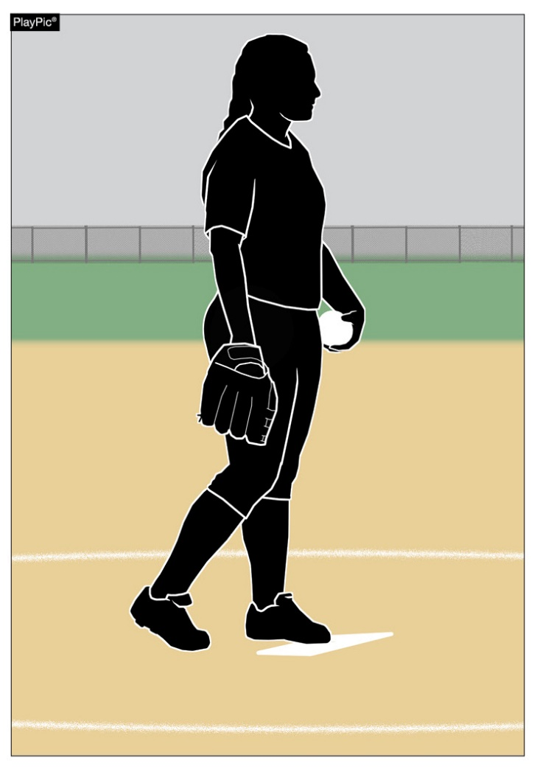
Contact with the pitcher’s plate
Due to the varying levels of play and accompanying variation in pitching skills while pitchers develop, prior to the start of the pitch, NFHS rules allows the pitcher to choose her foot placement. The pitcher may choose to take a position with the pivot foot in contact with the plate and the non-pivot foot behind the pitcher’s plate or both feet in contact with the pitcher’s plate. Prior to the start of the delivery, both feet must be on the ground within or partially within the 24-inch length of the pitcher’s plate. This allows for personal preference and developing pitchers to work through levels of progression.
Notes:
CONTACT WITH THE PITCHER’S PLATE Due to the varying levels of play and levels of skill in pitching development, prior to the start of the pitch, NFHS rules allows the pitcher to choose foot placement. The pitcher may choose to take a position with the pivot foot in contact with the plate and the non-pivot foot behind the pitcher’s plate or both feet in contact with the pitcher’s plate. Prior to the start of delivery, both feet must be on the ground within or partially within the 24-inch length of the pitcher’s plate. This allows for personal preference and developing pitchers to work through levels of progression.

Slide 21
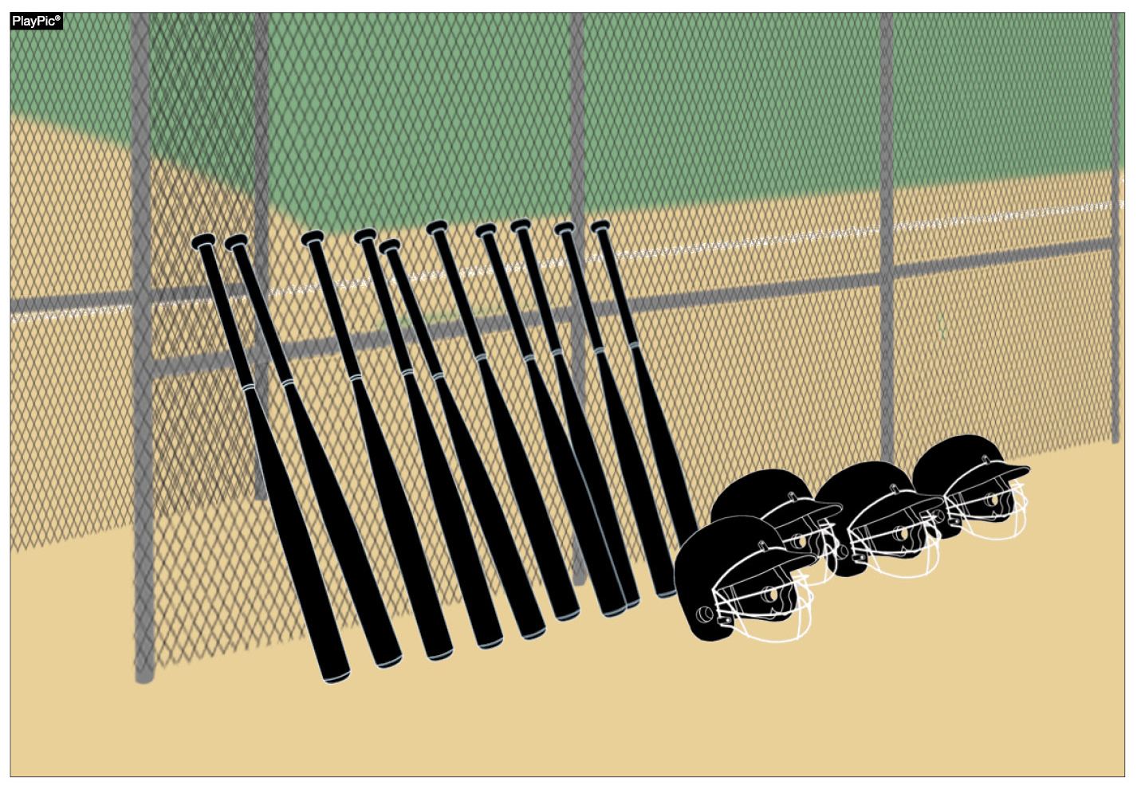
Inspection of equipment
It is the head coach’s responsibility to make certain all players are legally and properly equipped, which includes checking bats, helmets and catcher’s gear prior to every contest. Umpires may inspect equipment but are not required to do so. It is critical that coaches remain vigilant in inspecting equipment before every contest to ensure no damage has occurred or new noncompliant equipment has been purchased since their last inspection.
Notes:
INSPECTION OF EQUIPMENT It is the head coach’s responsibility to make certain all players are legally and properly equipped, which includes checking bats, helmets, and catcher’s gear prior to every contest. Umpires may inspect equipment but are not required to do so. It is critical that coaches remain vigilant in inspecting equipment before every contest to ensure no damage has occurred or new noncompliant equipment has been purchased since their last inspection.
What is important to remember is equipment wears during use. Bats can become damaged, or a player may purchase a new bat that does not meet the NFHS requirements. Both catchers’ helmets as well as batter’s helmets have screws that hold face guards in place. These screws loosen and will eventually fall out rendering the equipment illegal for use and potentially causing risk to the player if not detected.

Slide 22
Umpire Conduct and Rules Interpretation
We expect our umpires to conduct themselves in a professional manner at all times, and we wish to be informed about any issues in which they have not done this.
If you have a rules interpretation question or need clarification on anything dealing with softball or our chapter please contact the chapter officers below.
President- Oscar Strain
Vice President- Tom Cremeans
Assigner- Chuck Allen

Slide 23
Arbiter
Next Chuck is going to be going over the Arbiter System that we use as our assigning platform.
If you need to talk about the schedule please contact Chuck or Oscar.

Slide 24
Scrimmages
We will assign a veteran official to be in charge of a scrimmage site. Please work with them to get what you need out of your scrimmage. If you have any issues please bring it to the scrimmage leader or contact either Oscar, Chuck or Tom.
We are there to work for you during the scrimmages please remember that we are using this time to get back into the softball state of mind, and will be introducing new umpires to fast pitch softball.

Slide 25
Questions

Slide 26
Closing Remarks

Slide 27
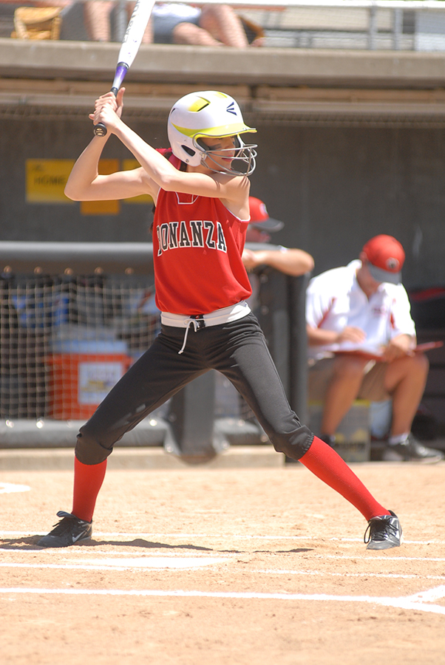
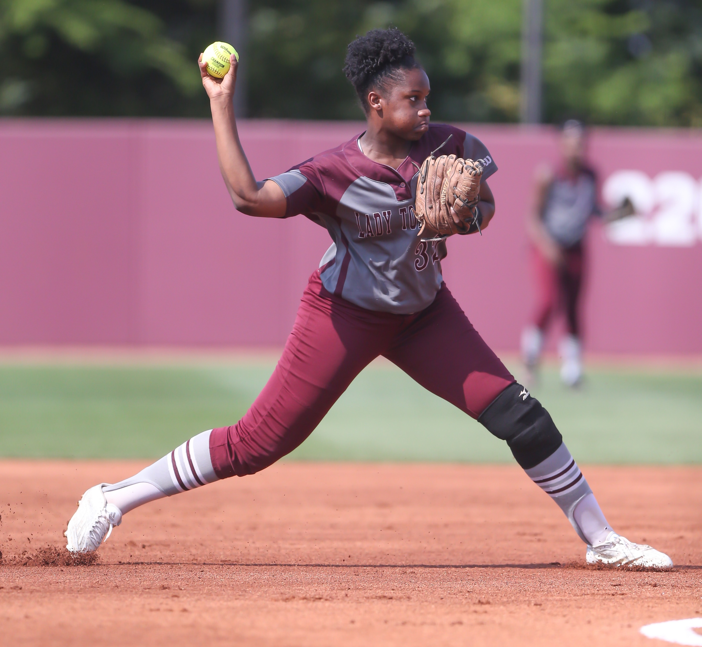
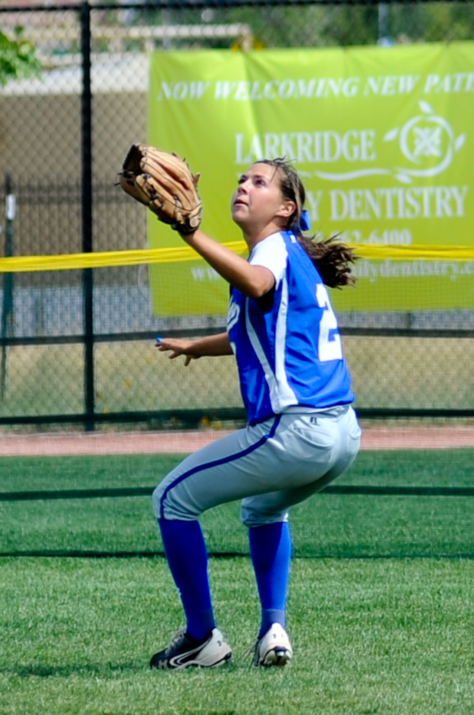
Thank You
Have a Great Season
Notes:
THANK YOU

