Slide 1
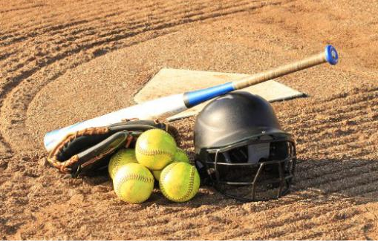
TYLER SOFTBALL CHAPTER Coaches Meeting
January 23, 2019

Slide 2
Agenda
Welcome
Introductions (Coaches and Officials)
Rule Changes and POE’s
Arbiter
Questions
Closing Remarks

Slide 3
Welcome
The Tyler Softball Officials would like to take this time to welcome all the coaches in attendance and to thank them for meeting with us prior to the start of the 2019 Softball season.
We are looking forward to working with you and for you for a successful 2019 Softball Season.

Slide 4
Introductions
We would like to now introduce ourselves.
Coaches- Please let us know who you are and what school you represent.
Officials- Please let us know who you are and how long you have been officiating Softball.

Slide 5
Rules and POE’s

Slide 6
Rules and POE’s

Slide 7
Rules and POE’s

Slide 8
Rules and POE’s

Slide 9
2019 Rule changes – pitching
These slides are being distributed to clarity the illegal pitch rule changes and POE. There was significant discussion during the TASO State Meeting, and some key points were not clear.

Slide 10
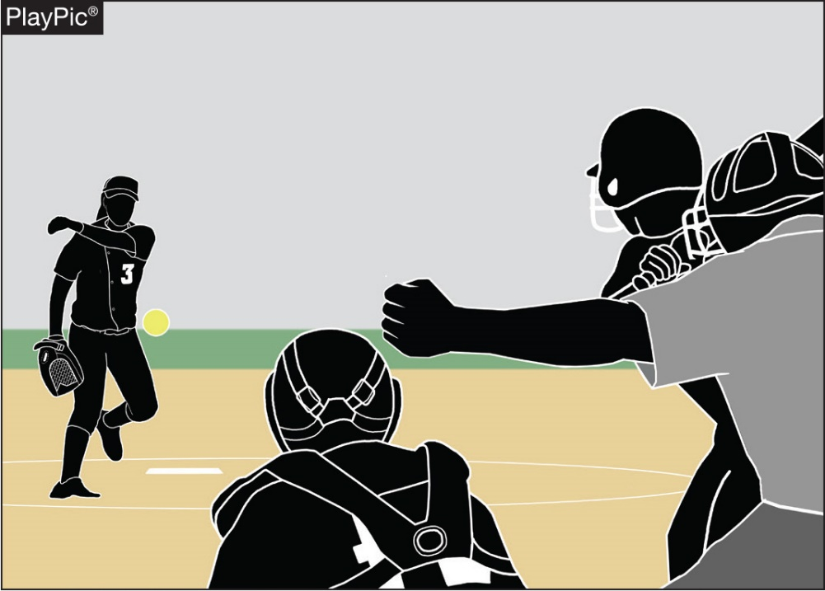
PITCHING RULES 6-1-1 PENALTY, EXCEPTIONS 3 and 4, 6-1-2,3,4 PENALTIES, 6-2-1 PENALTY, 6-2-7 PENALTY
When an illegal pitch is declared by the umpire, the batter is awarded a ball. Previously, the batter was awarded a ball and all base runners were also awarded one base without liability to be put out.
Notes:
PITCHING
RULES 6-1-1 PEN., 6-1-2 THROUGH 4 PEN., 6-2-1 PEN., 6-2-7 PEN.
When an illegal pitch is declared by the umpire, the batter is awarded a ball. Previously, the batter was awarded a ball and all base runners were also awarded one base without liability to be put out.
Language to address the penalty for an illegal pitch was changed. Previously all base runners were advanced one base as well as a ball being called on the batter. The approved change removes the advancement of base runners. Considering that an illegal pitch is designed to hinder the batter, the 2018 NFHS Softball Rules Committee felt that only the batter should receive an advantage from the penalty.

Slide 11
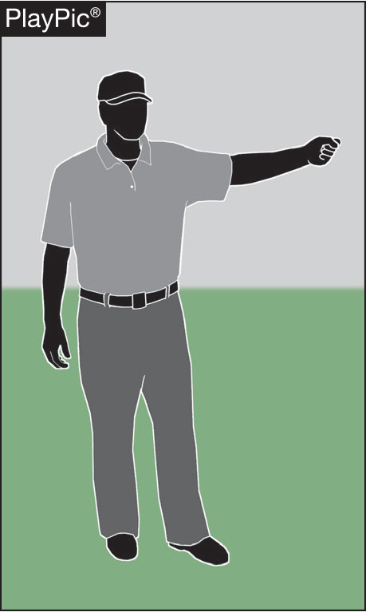
Illegal Pitch Penalty
The penalty to allow the advancement of runners when an illegal pitch is called has been removed.
The intent of an illegal pitch in softball is to deceive the batter, and only the batter should receive an award when an illegal pitch occurs.
Notes:
ILLEGAL PITCH PENALTY
The penalty to allow the advancement of runners when an illegal pitch is called has been removed.
The intent of an illegal pitch in softball is to deceive the batter, and only the batter should receive an award when an illegal pitch occurs.
The NFHS Softball Rules Committee voted to remove the advancement of runners when an illegal pitch is called. Since the intent of an illegal pitch in softball is to deceive the batter, the committee felt that only the batter should receive an award when an illegal pitch occurs. Exceptions to the penalty for an illegal pitch in Rule 6, Section 1, Article 1 have also been modified in order to be in compliance with the new penalty and ensure that runners are no longer advanced as a result of an illegal pitch.

Slide 12
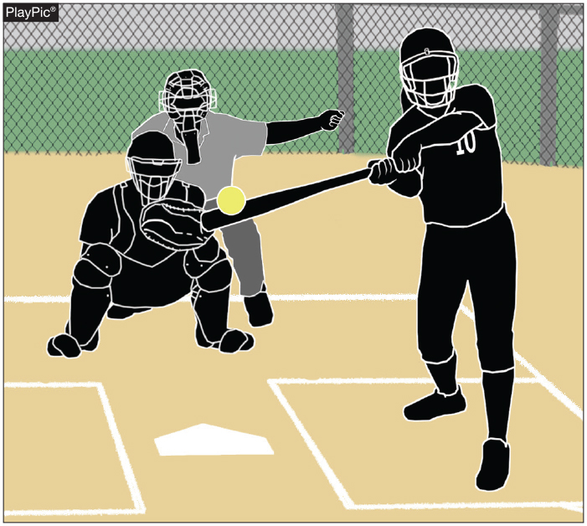
pitching Rule 6-1-1 Penalty Exception 1
An illegal pitch remains a delayed-dead ball. If there is an illegal pitch and the batter reaches first base safely and each other runner advances at least one base, the illegal pitch is nullified.
Notes:
PITCHING
RULES 6-1-1 PENALTY EXCEPTION 1
An illegal pitch remains a delayed-dead ball. If there is an illegal pitch and the batter reaches first base safely and each other runner advances at least one base, the illegal pitch is nullified.

Slide 13
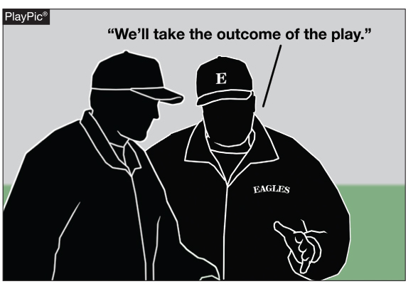
pitching Rules 6-1-1 penalty, Exception 2
As before under the rules, if the batter does not reach first base safely or any base runner fails to advance at least one base, the coach of the team at bat shall have
the option of the result of the play or the penalty of the illegal pitch, which is a ball awarded to the batter.
Notes:
PITCHING
RULES 6-1-1 PENALTY EXCEPTION 2
As before under the rules, if the batter does not reach first base safely or any base runner fails to advance at least one base, the coach of the team at bat shall have the option of the result of the play or the penalty of the illegal pitch, which is a ball awarded to the batter.

Slide 14
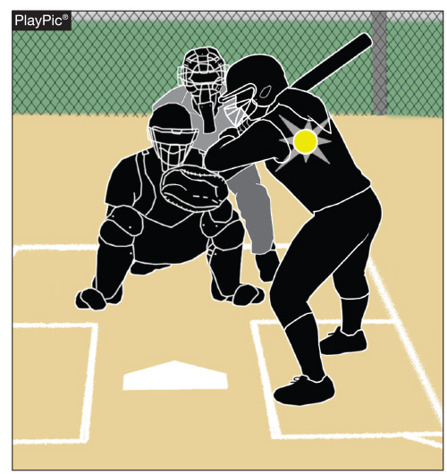
Pitching Rules 6-1-1 penalty EXCEPTION 3
If the batter is hit by an illegal pitch outside the strike zone, the batter is awarded first base, but there is no longer a one-base award to each base runner. The base runners are advanced only if forced.
Notes:
PITCHING
RULES 6-1-1 PENALTY EXCEPTION 3
If the batter is hit by an illegal pitch outside the strike zone or ball four is awarded on an illegal pitch, the batter is awarded first base, but there is no longer a one-base award to each base runner.
The base runners are advanced only if forced.

Slide 15
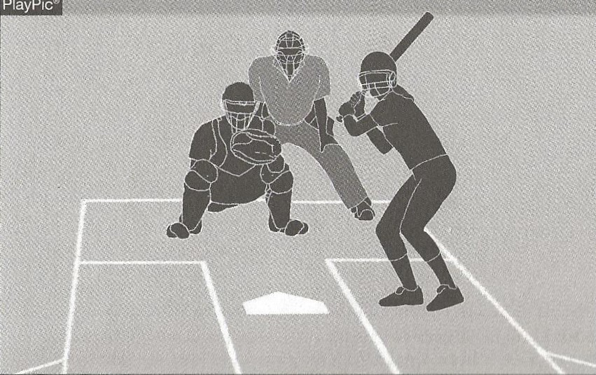
Pitching Rules 6-1-1 penalty EXCEPTION 4
If ball four is an illegal pitch, the batter is awarded first base, but there is no longer a one-base award to each base runner. The base runners are advanced only if forced.
Notes:
PITCHING
RULES 6-1-1 PENALTY EXCEPTION 4
If ball four is an illegal pitch, the batter is awarded first base, but there is no longer a one-base award to each base runner.
The base runners are advanced only if forced.

Slide 16
ILLEGAL PITCH (IP)
Umpire signals delayed-dead ball, and
Verbalizes illegal pitch (loud enough for the nearest players to hear)
Ball NOT hit and no base runners
Ball hit AND/OR there are base runners
Ball awarded to batter
Ball 4 IP OR
Batter hit by IP
Batter reaches 1B AND
Other runners advance at least 1 base
Batter does not reach 1B OR
Other runners fail to advance at least 1 base
Batter awarded 1B
Other runners advance only if forced
Note:
Interference does not negate IP
IP nullified
Coach has option of result of play or IP penalty

Slide 17
No outs, R1 on 1B, batter swings at a 1-1 illegal pitch but misses.
Illegal Pitch – Case Play 1
Ruling:
Delayed dead ball with the illegal pitch
Since both the batter and the runner failed to advance at least one base, technically the offensive coach is given the choice of results of the play, or the illegal pitch penalty
Play result: Strike, 1-2 count on the batter
IP Penalty: Ball award to the batter, count is now 2-1, no impact on base runner, no outs
Offensive coach will take the penalty

Slide 18
No outs, R1 on 1B attempts to steal 2B on a 1-1 illegal pitch that the batter swings at and misses, but R1 is thrown out.
Illegal Pitch – Case Play 2
Ruling:
Delayed dead ball called with the illegal pitch
Since both the batter and the runner failed to advance at least one base, the offensive coach is given the choice of results of the play, or the illegal pitch penalty
Play Result: R1 out stealing, 1-2 count on batter, one out
IP Penalty: R1 returned to 1B, 2-1 count on batter, no outs
Pretty obvious, coach will take the penalty

Slide 19
No outs, R1 on 1B attempts to steal 2B on a 1-1 illegal pitch that the batter swings at but does not contact, she then interferes with the catcher trying to throw to 2B to catch R1 stealing.
Illegal Pitch – Case Play 4
Ruling:
Delayed dead ball called with the illegal pitch, then immediate dead ball on batter’s interference
Interference DOES NOT supersede the illegal pitch
Since both the batter and the runners did not advance one base, coach is given the option of the play result or the IP penalty
Play results: B2 is out on the interference, and R1 returns to 1B, one down
IP penalty: R1 goes back to 1B, 2-1 count on batter, no outs – interference is negated
Pretty obvious, coach will take the penalty

Slide 20
No outs, R1 on 3B, R2 on 1B attempts to steal 2B on a 3-2 illegal pitch that the batter swings and misses, she then interferes with the catcher trying to throw to 2B to catch R2 stealing.
Illegal Pitch – Case Play 5
Ruling:
Delayed dead ball with the illegal pitch, immediate dead ball on interference
Interference DOES NOT supersede the illegal pitch
Coach given option, results of the play or IP penalty
Play Result: Batter out on strikes, R1 (runner closest to home) out because a retired runner interfered with catcher, R2 stays on 1B, 2 down
IP Penalty: Ball 4 on batter, so she goes to 1B forcing R2 to advance to 2B, R1 remains on 3B, no outs - bases loaded, interference is negated
Also obvious, coach will take the penalty

Slide 21
No outs, R1 on 2B, R2 on 1B, F1 throws IP to batter on 1-1 count who hits a ground ball to F4. R2 maliciously crashes into F4 as she is making the play.
Illegal Pitch – Case Play 6
Ruling:
Delayed dead ball with the IP, dead ball on interference
Malicious contact is ALWAYS enforced
R2 is immediately out (and potentially ejected because of the malicious contact)
Interference DOES NOT supercede the illegal pitch
Coach will get option of results or IP penalty
Play Result: R1 remains at 2B, R2 is out, B3 is awarded 1B (unless umpire believed the interference prevented a DP), one down
IP Penalty: R1 remains at 2B, R2 still out, B3 count is now 2-1, one out – interference is negated
Not so obvious, coach has a tougher decision

Slide 22
Pitching 6-1-2a, 6-1-2b
Clarifies that the pitch starts when the pitcher’s hands are separated after they have come together while the pivot foot is on or partially on top of the pitcher’s plate. Any step back with the non-pivot foot must begin before the start of the pitch.
Notes:
START OF THE PITCH RULES 6-1-2a, 6-1-2b
Clarifies that the pitch starts when the pitcher’s hands are separated after they have come together while the pivot foot is on or partially on top of the pitcher’s plate. Any step back with the non-pivot foot must begin before the start of the pitch.
This editorial change defines what motion constitutes the start of the pitch and when the step back of the non-pivot foot may be taken. The pitch starts when the hands separate, whether or not the pitcher uses a windup. Any step back with the non-pivot foot must begin before the start of the pitch. Once the pitch has started (the hands separate), the pitcher shall not take more than one step which must be forward, toward the batter and simultaneous with the delivery.

Slide 23
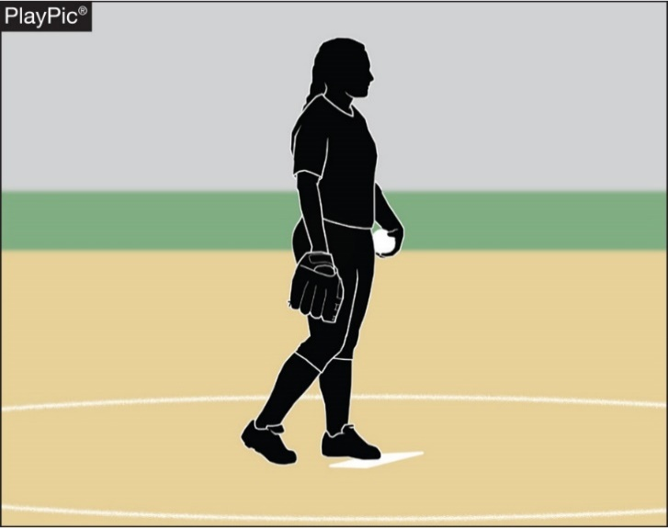
Simulate taking a sign A 2019 Point of EMPHASIS!
If the pitcher does not pause
after stepping onto the
pitcher’s plate to simulate
taking a signal prior to
bringing her hands together,
an illegal pitch should be
called.
Notes:
SIMULATE TAKING A SIGN
if the pitcher does not pause after stepping onto the pitcher’s plate to simulate taking a signal prior to bringing her hands together, an illegal pitch should be called.
While on the pitcher’s plate and prior to bringing her hands together the pitcher must take or simulate taking a signal from the catcher. A signal may be taken from a coach either by hand signals verbal call, or by looking up on a wristband with a playbook/playcard. A signal may be taken from a coach either by hand signals verbal call, or by looking up on the playbook/playcard.

Slide 24
Rules and POE’s

Slide 25
Umpire Conduct and Rules Interpretation
We expect our umpires to conduct themselves in a professional manner at all times, and we wish to be informed about any issues in which they have not done this.
If you have a rules interpretation question or need clarification on anything dealing with softball or our chapter please contact the chapter officers below.
President- Oscar Strain
Vice President- Tom Cremeans
Assigner- Greg Hair

Slide 26
Arbiter
Next Greg is going to be going over the Arbiter System that we use as our assigning platform.
If you need to talk about the schedule please contact Greg or Oscar.

Slide 27
Scrimmages
We will assign a veteran official to be in charge of a scrimmage site. Please work with them to get what you need out of your scrimmage. If you have any issues please bring it to the scrimmage leader or contact either Oscar, Greg or Tom.
We are there to work for you during the scrimmages please remember that we are using this time to get back into the softball state of mind, and will be introducing new umpires to fast pitch softball.

Slide 28
Questions
?

Slide 29
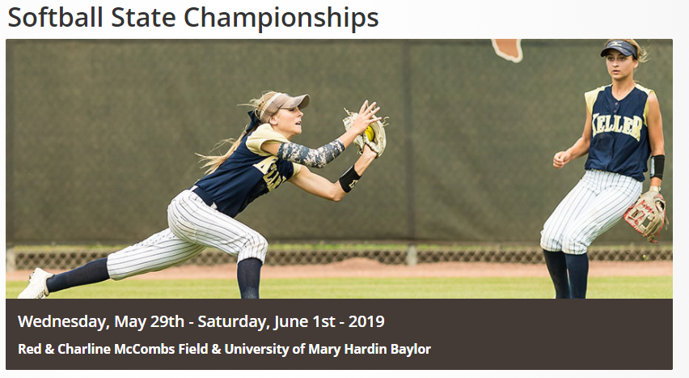
Good luck on your season from the Tyler Lone Star Softball Chapter
And just maybe we will see you here at the end of it!!!

