Slide 1

Tyler Lonestar
Chapter
Post Season Information/ 3 and 4 Person Mechanics
April 24, 2022
General Meeting

Slide 2
Post-Season Information
Congratulations you’ve made it, you’ve been selected to work a post-season contest.
Now what do you do next?
Notification

Slide 3
Post-Season Information
First thing to do is to ensure that you are available for the contest and then accept your assignment in Arbiter.
Notification

Slide 4
Post-Season Information
Next make sure that your uniform and equipment are ready. If they’re not, then get them ready.
Remember you might be going a long ways away to work the game(s) be prepared for this.
Uniform & Gear

Slide 5
Post-Season Information
We wear the following clothing to and from the contests that we officiate in the post-season.
Chapter Polo Shirt or another color if all crew is the same.
Khaki or Black Dress Pants
Business Casual Shoes
Crew Chief Decides the Travel Uniform..
NOTE-- AT NO TIME ARE SHORTS CONSIDERED PART OF THE TRAVEL CLOTHING ATTIRE..
Travel Clothes

Slide 6
Post-Season Information
Crew Chief is responsible for:
Contacting their fellow umpires and ensure all of you know..
Where your contest is
When your contest is
What time you will meet at the contest site (Minimum of 1 Hour Prior to start)
Whether or not you will ride together
What travel uniform you will wear
Crew Chief

Slide 7
Post-Season Information
Crew Chief is also responsible for:
Being in contact with the coach(s) in case of weather, other delays or changes to the location or time. Especially if your crew is already in route to the location and it's changed to another. Chasing fields in the Post Season is a necessity so get ready and be prepared for it.
Crew Chief

Slide 8
Post-Season Information
Crew Chief is also responsible for:
Relaying information to the crew in the most expedient way possible and ensure all are updated. You MUST make sure the chapter leadership knows what is going on as well.
Crew Chief

Slide 9
Post-Season Information
Crew Chief is also responsible for:
Gathering and reviewing pay sheets and W9’s of your crew prior to submitting them to the coach(s) or the Game site administrator depending on how its being run. Make sure they are correct if not get them corrected.
Crew Chief

Slide 10
Post-Season Information
Beginning with Warm-Up Games and Play-In Games their will be several changes from the regular season.
Championship Play (Post-Season)
10 Runs after 5 Innings.
AT NO TIME WILL YOU COMPLETE A GAME USING THE ITB RULE.. Or any other Run Rule Scenarios other than mentioned above…
TASO Game ending Scenarios

Slide 11
Post-Season Information
If your game is not completed and is suspended due to lightning or weather. The Crew Chief will get with the coaches and remind them to get the information to Chuck and Oscar so that they can ensure the continuation of the game is covered.
The Crew Chief and Crew will ensure that ALL pertinent data needed to continue the game is recorded and passed on if necessary.
TASO Game ending Scenarios

Slide 12
Post-Season Information
We DO NOT end the games unless there is a clear winner. Games are suspended pending decisions from TASO, and the Schools Involved in the contest.
TASO Game ending Scenarios

Slide 13
Post-Season Information
The pre-game conference will prepare the crew for a successful contest. What should you discuss during this pre-game conference?
Plate Umpire whether you are using 3 Person/4 Person Mechanic’s, review them and how you want the crew to react to situations.
Review UIL/NFHS Post Season ending of games or suspension of play.
Remember if you “Deviate communicate”
Pre-Game Conference with the Crew

Slide 14
Post-Season Information
Walk the field together and look for:
-Dead Ball Areas
-Holes in the fence
-Field Markings
-Potential Ground Rules
After your walk if you are dressed then move toward Home Plate and be ready to start the game on time. If you walked it in your travel clothes move to the dressing room to continue your preparation for the contest.
Walking the Field

Slide 15
Post-Season Information
When conducting the Pre-Game Coaches Meeting remember that this is a business meeting. Get the information out that needs to be put out and get the information that you need back and get the meeting over. The meeting should not last long, however if coaches have questions answer them.
Remember this saying.. “Silence cannot be misquoted”
Plate Pre-Game Coaches Meeting

Slide 16
Post-Season Information
What information do we need?
AD on Duty or Site Administrator
Review Line-Ups (DP/FLEX)
Coaches Certification that players are equipped by rule (JEWLERY)
Ground Rules
Run Rules (Reminder 10 After 5 ONLY)
Changes to Line-up
1 Minute or 5 Pitches
No Buckets/Huddle Safely/Sportsmanship
Plate Pre-Game Coaches Meeting

Slide 17
Post-Season Information
What I covered above is if were all coming from the same chapter if you are one of the few “Lucky Ones” or rather “Unlucky Ones” that get the honor of working a split crew it will be challenging but doable.
Remember the following:
1. Attempt to reach out and communicate with the other chapter to find out whom they are sending and maybe you’ll communicate with umpire(s).
2. You can only ensure that yourself and your partner if two of you are coming from the same chapter are there on time and ready as stated above.
Closing

Slide 18
Post-Season Information
3. Be ready for anything
4. On the field you are a cohesive group off the field is where you “discuss things”
5. If you have an incident remember you MUST contact two (2) of the following personnel.
a. President- Oscar Strain
b. VP/UIC- Tom Cremeans
c. Assigner- Chuck Allen
d. Treasurer- Shane Helms
Closing

Slide 19
Post-Season Information
Everything said above only happens if everything falls in line. As always be ready for the unexpected and be flexible. After all we are there for the Coaches as they either chose us or we were selected by our chapter leadership. Represent the TYLER LONE STAR SOFTBALL CHAPTER with professionalism and pride.
Closing

Slide 20
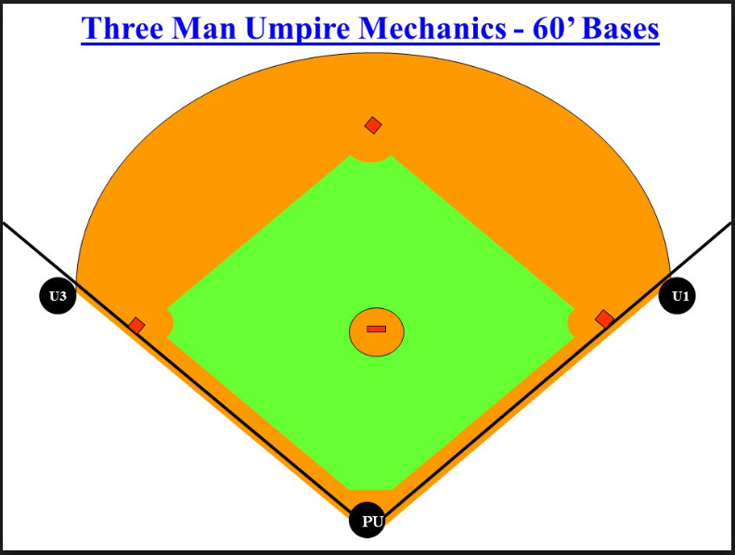
Post-Season Information
3-Person Mechanics

Slide 21
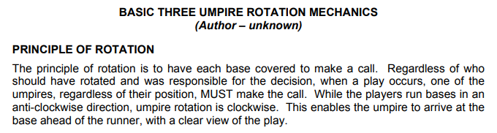
Post-Season Information
3-Person Mechanics

Slide 22
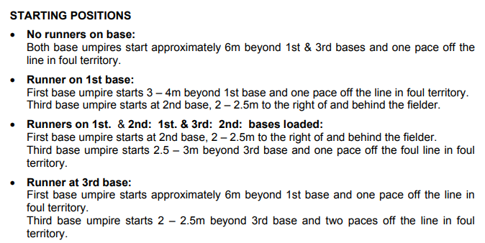
Post-Season Information
3-Person Mechanics

Slide 23
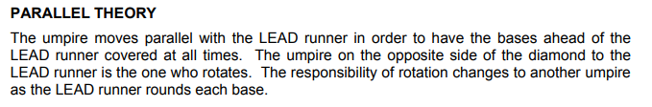
Post-Season Information
3-Person Mechanics

Slide 24
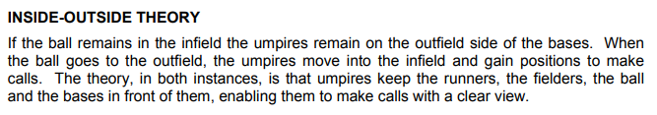
Post-Season Information
3-Person Mechanics

Slide 25
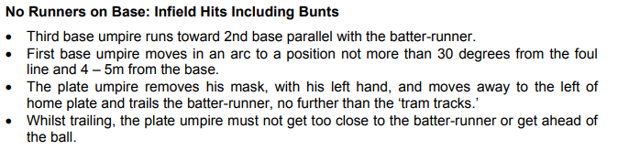
Post-Season Information
3-Person Mechanics

Slide 26
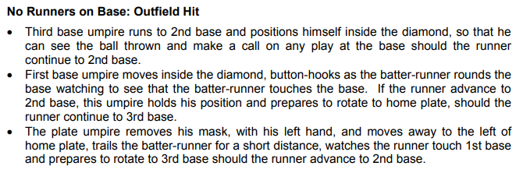
Post-Season Information
3-Person Mechanics

Slide 27
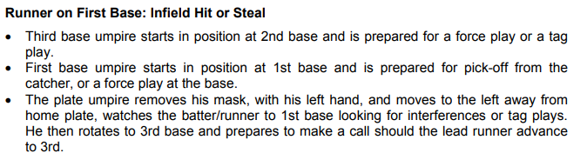
Post-Season Information
3-Person Mechanics

Slide 28
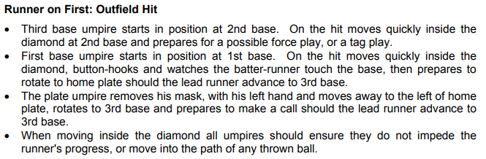
Post-Season Information
3-Person Mechanics

Slide 29
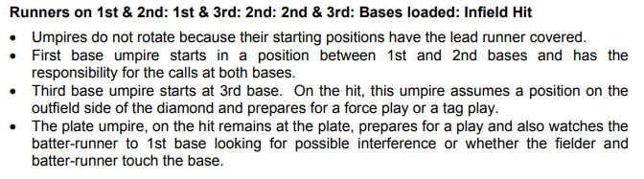
Post-Season Information
3-Person Mechanics

Slide 30
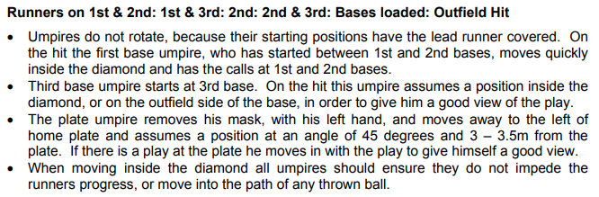
Post-Season Information
3-Person Mechanics

Slide 31
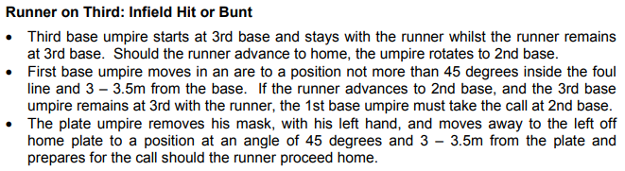
Post-Season Information
3-Person Mechanics

Slide 32
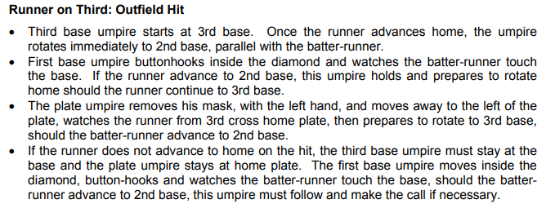
Post-Season Information
3-Person Mechanics

Slide 33
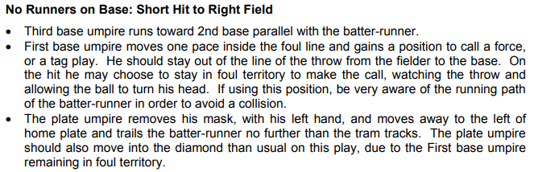
Post-Season Information
3-Person Mechanics

Slide 34
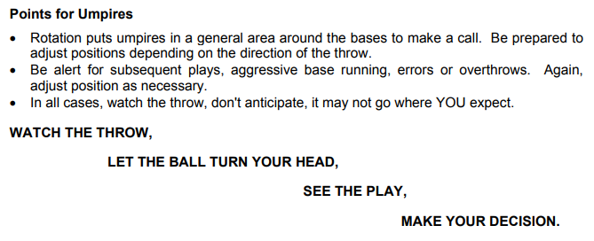
Post-Season Information
3-Person Mechanics

Slide 35
4-Person Mechanics
Although it is not unheard of that a single chapter will provide four umpires for a game it is usually a split crew where each Head Coach’s home chapter supplies two umpires each. In this instance if the HC we cover is home for the game, then we will have the Plate and our partner will be on 2B, while the visiting HC’s umpires will be on 1B and 3B.
It will be imperative as the Plate Umpire that you have a good pre-game meeting, and you discuss how you want your fellow umpires to cover the game. Remind them of our statement (See Below).
Preface

Slide 36
4-Person Mechanics
“If you are going to deviate communicate”
*** Our goal is to ALWAYS have a BLUE in front of the runners***
Plate Umpire part of your review during your pre-game will need to include where you will go if you have a check swing appeal.
If you have a RH Batter, then you will go to the 1BU
If you have a LH Batter, then you will go to the 3BU
Preface

Slide 37
4-Person Mechanics
PU= Plate Umpire - Starts behind the dish
1BU= (1st Base Umpire) - Start on the 1B Line 6-10 Feet slightly off the line with your belt buckle facing home plate. Set Position
2BU= (2nd Base Umpire)- Modified B Position 6-10 Feet behind 2B and inline with
3B with your belt buckle facing home plate. Set Position
3BU= (3rd Base Umpire) - Start on Left Foul Line, 6-10 Feet slightly off the line with your belt buckle facing home plate. Set Position
Start Positions

Slide 38
4- Person Mechanics
Flyball/Line Shots-
Flyball/Line Shot to anywhere in the V (Between the RF and LF)-
2BU will go out (Chase) and observe the play and make the call. Then they will turn and face the infield and assist in any adjudication if needed.
1BU will button hook in and observe the runner as they pass 1B.
Flyball Coverage in the “V”

Slide 39
4- Person Mechanics
3BU will come across the infield (same as 3-Person) toward 2B and be ready to make a call if needed.
PU will move holding zone on the 3B Line and be ready to make a call at 3B if needed.
1BU will go to their holding zone and be ready to move toward the Plate and make a call if needed.
Once all play has ceased the 1BU will call time and all Umpires will move to their next position. We will always keep an eye on the players.
Flyball Coverage in the “V”

Slide 40
4- Person Mechanics
Flyball/Line Shot to the RF between them and the Right Foul Line-
1BU will go out (Chase), observe the play and make the call. They will face back in toward the infield and assist with adjudication if needed.
PU will trail the BR and then move toward Left Foul Line holding zone.
Flyball Coverage to RF and the Foul Line.

Slide 41
2BU move inside the diamond observe the runner touch 1B, be ready to make a call or move to Right Foul Line holding zone.
3BU will move inside the diamond toward 2B and be ready to make a call.
Once all play has ceased the PU (If not rotated to 3B will call time and all Umpires will move to their next position. We will always keep an eye on the players.
4- Person Mechanics
Flyball Coverage to RF and the Foul Line.

Slide 42
Flyball/Line Shot to the LF between them and the Left Foul Line-
a. 3BU will go out, observe the play and make the call. They will face back in toward the infield and assist with adjudication if needed.
b. 1BU will button hook in and observe the runner as they pass 1B, then move to holing zone.
c. 2BU will move inside the diamond and will watch 2B, be ready to make a call.
4- Person Mechanics
Flyball Coverage to LF and the Foul Line.

Slide 43
d. PU will move to the holding zone on the 3B Line and be ready to make a call at 3B if needed.
e. 1BU will have moved to the Right Foul Line holding zone and then if needed will move toward Home and be ready to make the call.
Once all play has ceased the 1BU will call time and all Umpires will move to their next position. We will always keep an eye on the players.
4- Person Mechanics
Flyball Coverage to LF and the Foul Line.

Slide 44
Runner on 1B and the ball is hit to the infield-
a. PU will trail BR toward 1B, then move to holding zone of Left Foul Line.
b. 1BU will move to a position to make a call on the BR or the follow-on play.
c. 2BU is in position to adjudicate 2B
d. 3BU will move inside the diamond and be ready to adjudicate a play if needed.
4- Person Mechanics
Runner on 1B and ball is hit to the infield

Slide 45
Runners on 1B and 2B and the ball is hit to the infield-
a. PU will trail BR toward 1B, then move to holding zone of Left Foul Line
b. 1BU will move to a position to make a call on the BR or the follow-on play.
c. 2BU is in position to adjudicate 2B.
d. 3BU will move inside the diamond and be ready to adjudicate a play if needed.
4- Person Mechanics
Runner on 1B and 2B ball is hit to the infield

Slide 46
4- Person Mechanics
Runners on 1B, 2B, and 3B and ball hit to the infield-
a. ALL umpires freeze and observe their base as needed to adjudicate the play.
Runner on 1B, 2B and 3B ball is hit to the infield

Slide 47
4- Person Mechanics
Good communications throughout the contest will help ensure that the crew is in a good place to adjudicate anything that comes up. It’s only you four officials so you must make it work some how and some way for the girls that are playing for a chance to move on.
Closing

Slide 48

Questions

