Slide 1

Tyler Lonestar
Chapter
Post Season Information & 3 Person Mechanics
March 20, 2022
General Meeting

Slide 2
Post-Season Information
Congratulations you’ve made it, you’ve been selected to work a post-season contest.
Now what do you do next?
Notification

Slide 3
Post-Season Information
We have put together the following presentation to alleviate your angst and assist you with being prepared to handle this responsibility.
Notification

Slide 4
Post-Season Information
First thing to do is to ensure that you are available for the contest and then accept your assignment in Arbiter
Notification

Slide 5
Post-Season Information
Next make sure that your uniform and equipment are ready. If they’re not, then get them ready. Remember you might be going a long ways away to work the game(s) be prepared for this.
Uniform & Gear

Slide 6
Post-Season Information
We wear the following clothing to and from the contests that we officiate in the post-season.
Chapter Polo Shirt or another color if all crew is the same.
Khaki or Black Dress Pants
Business Casual Shoes
NOTE-- AT NO TIME ARE SHORTS CONSIDERED PART OF THE TRAVEL CLOTHING ATTIRE..
Travel Clothes

Slide 7
Post-Season Information
Crew Chief is responsible for:
- Contacting your fellow umpires and ensure all of you know..
Where your contest is
When your contest is
What time you will meet at the contest site
Whether or not you will ride together
What travel uniform you will wear
Crew Chief

Slide 8
Post-Season Information
Crew Chief is responsible for:
Being in contact with the coach(s) in case of weather, other delays or changes to the location or time. Especially if you are already in route to one location and it's changed to another. Chasing fields is a necessity sometimes in the post season get ready for it
Crew Chief

Slide 9
Post-Season Information
Crew Chief is responsible for:
Relaying information to the crew in the most expedient way possible and ensure all are updated. Also make sure the chapter leadership knows what is going on as well.
Crew Chief

Slide 10
Post-Season Information
Crew Chief is responsible for:
Gathering and reviewing pay sheets and W9’s of your crew prior to submitting them to the coach(s) or the Game site administrator depending on how its being run.
Crew Chief

Slide 11
Post-Season Information
Beginning with Warm-Up Games and Play-In Games their will be several changes from the regular season.
Championship Play (Post-Season)
10 Runs after 5 Innings.
AT NO TIME WILL YOU COMPLETE A GAME USING THE ITB RULE.. Or any other Run Rule Scenarios…
TASO Game ending Scenarios

Slide 12
Post-Season Information
If your game is not completed and is suspended due to lightning or weather. Crew Chief get with the coaches and remind them to get the information to Chuck and Oscar so that they can ensure the continuation of the game is covered.
TASO Game ending Scenarios

Slide 13
Post-Season Information
We DO NOT end the games unless there is a clear winner. Games are suspended pending decisions from TASO, and the Schools Involved in the contest.
TASO Game ending Scenarios

Slide 14
Post-Season Information
The pre-game conference will prepare the crew for a successful contest. What should you discuss during this pre-game conference?
If you are using 3 Person/4 Person Mechanic’s, the Plate Umpire will review them and how they want the crew to react to situations.
Review UIL/NFHS Post Season ending of games or suspension of play.
Remember if you deviate communicate
Pre-Game Conference with the Crew

Slide 15
Post-Season Information
When conducting the Pre-Game Coaches Meeting remember that this is a business meeting. Get the information out that needs to be put out and get the information that you need back and get the meeting over. The meeting should not last long, however if coaches have questions answer them.
Remember this saying.. “Silence cannot be misquoted”
Plate Pre-Game Coaches Meeting

Slide 16
Post-Season Information
What information do we need?
AD on Duty
Review Line-Ups (DP/FLEX)
Coaches Certification that players are equipped by rule (JEWLERY)
Ground Rules
Run Rules
Changes to Line-up
1 Minute or 5 Pitches
No Buckets/Huddle Safely/Sportsmanship
Plate Pre-Game Coaches Meeting

Slide 17
Post-Season Information
There are 2 things that I want you to remember about 3-Person Mechanics.
There will always be a “Blue” in front of the runners.
When possible, get down to 2-Person mechanics. This is what were used to the most.
3-Person Mechanics

Slide 18
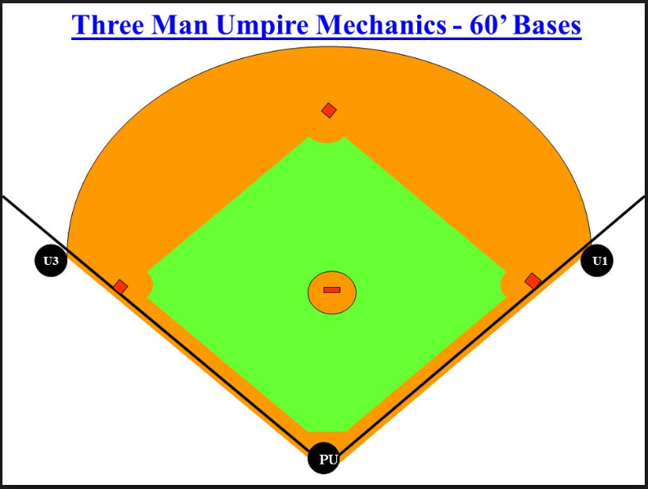
Post-Season Information
3-Person Mechanics

Slide 19
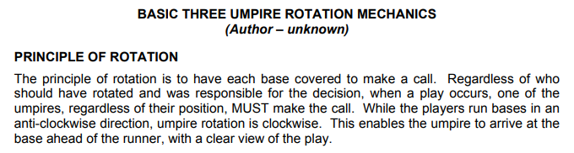
Post-Season Information
3-Person Mechanics

Slide 20
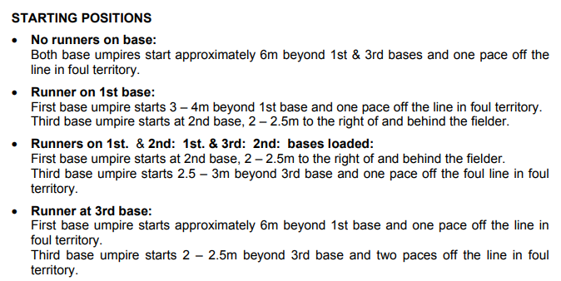
Post-Season Information
3-Person Mechanics

Slide 21
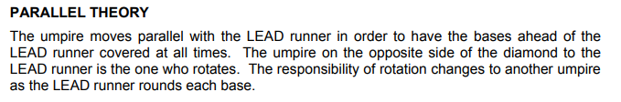
Post-Season Information
3-Person Mechanics

Slide 22
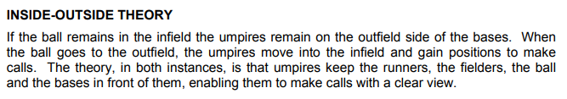
Post-Season Information
3-Person Mechanics

Slide 23
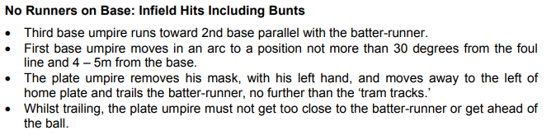
Post-Season Information
3-Person Mechanics

Slide 24
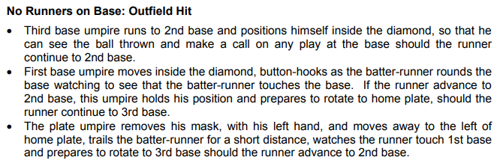
Post-Season Information
3-Person Mechanics

Slide 25
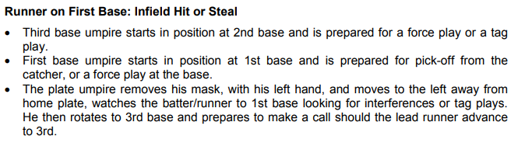
Post-Season Information
3-Person Mechanics

Slide 26
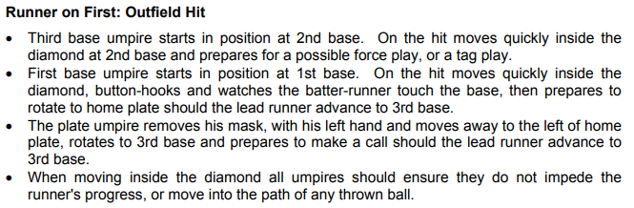
Post-Season Information
3-Person Mechanics

Slide 27
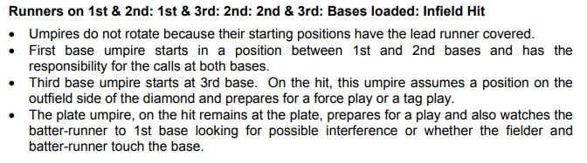
Post-Season Information
3-Person Mechanics

Slide 28
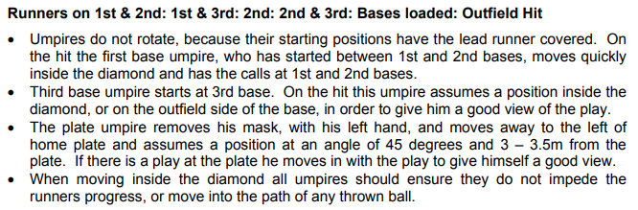
Post-Season Information
3-Person Mechanics

Slide 29
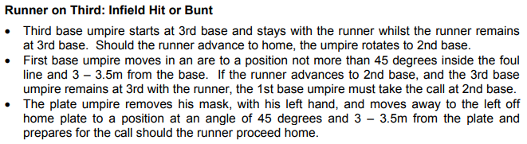
Post-Season Information
3-Person Mechanics

Slide 30
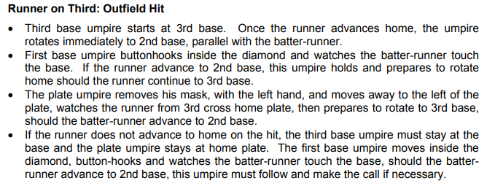
Post-Season Information
3-Person Mechanics

Slide 31
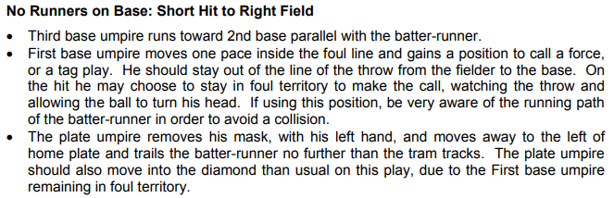
Post-Season Information
3-Person Mechanics

Slide 32
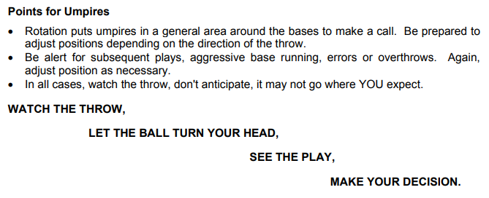
Post-Season Information
3-Person Mechanics

Slide 33

Questions

