Slide 1

Tyler Lonestar
Chapter
Taking care of business for the upcoming season
January 3, 2024
General Meeting

Slide 2
Message from Chuck
-Get your Clinic completed either State, Regional or Online
-You MUST Pass the test to take the field for paying games.
-Currently right at 80 Scrimmages.
-You will MUST call BOTH DAYS of our Tournament Feb 22 & 24 .
-Tournament Weekend are the first two weekends of the season and the first weekend in March. There will also be three JV Tournaments in March

Slide 3
Message from Chuck
February 29-Mar 2
Tyler High
Tyler Legacy
Union Grove
Frankston
Athens
-Varsity Tournaments
February 15-17
Carlisle
Carthage
Kemp
Sabine
Westwood
-JV Tournaments
Carthage February 15-17
Grand Saline March 7-9
Spring Hill March 7-9
Troup March 9

Slide 4
Training
1-3-24 Season Preparation & Requirements
1-6-24 State Meeting/Training (Abilene)
1-10-24 Coaches Meeting
1-13-24 Regional Meeting/Training (Longview)
1-21-24 Plate Meeting/Starting & Stopping a game
2-4-24 Obstruction v. Interference
2-18-24 Pitching/Look Back Rule
3-10-24 Batting Out of Order/Dead Ball Tables
3-24-24 Post Season/3 & 4 Person Mechanics
4-7-24 Post Season/3 & 4 Person Mechanics
4-28-24 Post Season/ 3 & 4 Person Mechanics

Slide 5
What you need to take care of to be a member in good standing
-Pay your State Dues
-Work the Chapter Tournament or Pay your Local Dues and Fine.
-Attend either the State Meeting, Regional Clinic, or the Online Clinic.
-Take and pass the test with a minimum score of 70 to be eligible for the Regular Season and an 80 or better to be eligible for Post Season consideration.
-Work Scrimmages
- Pay all fines if issued any during the year

Slide 6
Handling your Business
Calling your partner once you learn you have a contest together, the plate umpire for the Varsity Contest is the Crew Chief and is responsible for initiating contact. If the Crew Chief does not initiate communications, then the partner should initiate.
Communications

Slide 7
Handling your Business
Review site parking protocols
Determine what color shirt you are going to wear.
Determine if you may be able to ride together, if not determine where and what time to meet either onsite or prior to the site.
Partner Communications

Slide 8
Handling your Business
Once on site find the home head coach and let them know that you are there and that you and your partner will get ready and be back on the field prior to 10 minutes before the start of the contest.
Coach Communications
Notes:
Once you arrive find the coach and let them know you’re there so that they will not get anxious and attempt to call Oscar or Chuck.

Slide 9
Handling your Business
Remember “If you deviate, then you must communicate”.
Communications

Slide 10
Handling your Business
Reminder you MUST Call two (2) of the following Board Members (Oscar/Tom/Chuck/Shane) if you have something out of the ordinary happen before during or after your game(s) this includes but not limited to a Fan, Coach, or Player ejection. If you feel the coach or AD will make a call to Oscar or Chuck it will be in your best interest to make the call right after the contest has ended.
Communications
Notes:
It comes up every year that inevitably an official fails to alert Oscar or Chuck on an issue that they feel was a nonissue, but the coach saw it different. So friendly advice if think there is even the slightest chance that a coach is going to call in then you make the call first, right after the contest.

Slide 11
Uniform
www.officalsgearoutlet.com
www.stripesplus.com
www.umpjunksa.com
www.officalsports.net
Vendor Information

Slide 12
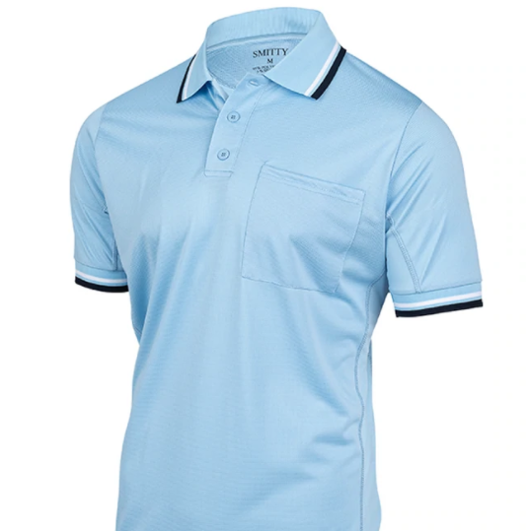
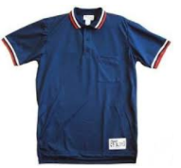
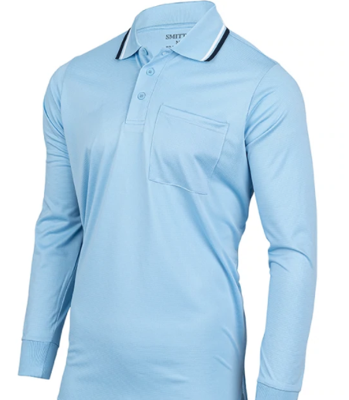

Uniform
Shirt
Notes:
OLD standbys

Slide 13
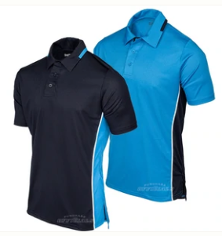
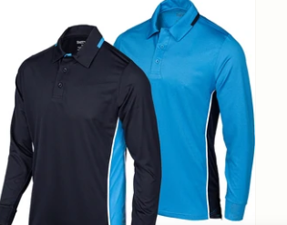
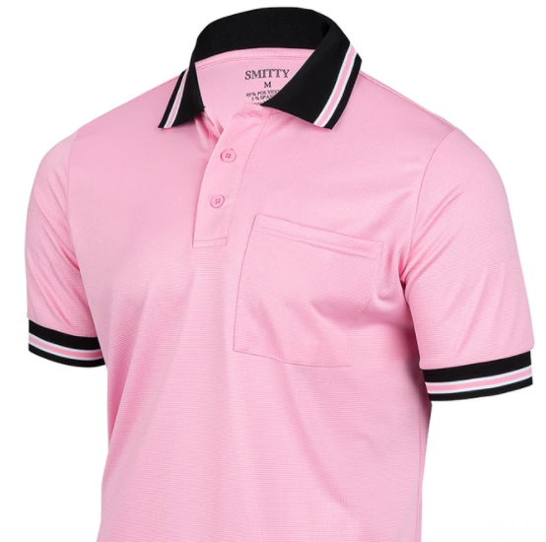

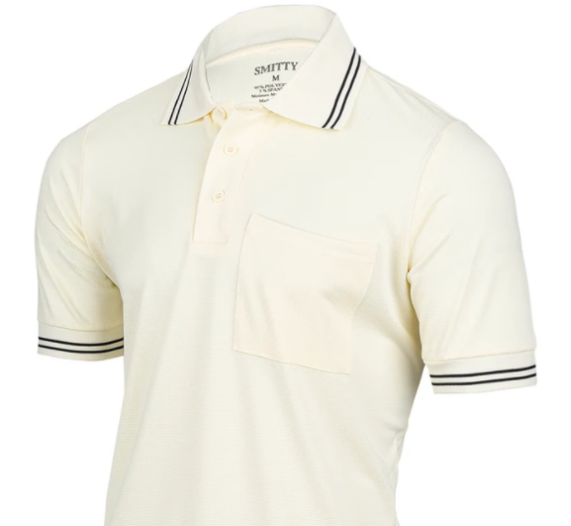
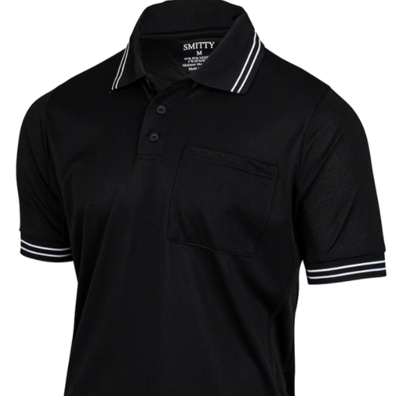
Uniform
Alternative Shirts
Notes:
TASO has authorized the use of multiple colors as well as the NEW College uniforms. Just remember that you and your partner(s) must match.

Slide 14
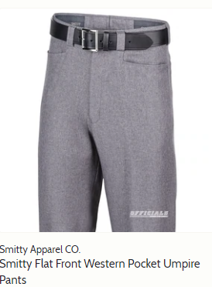
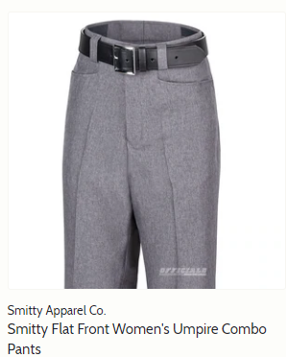
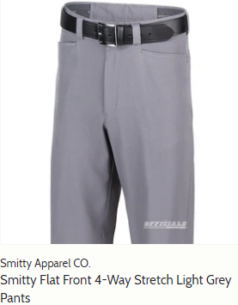
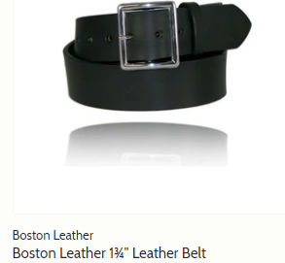
Uniform
Pants & Belt
Notes:
Pants are to be Heather Grey or Light Grey if like the 4-Way Stretch style.

Slide 15


Looking the part
Hats
Notes:
There are multiple stitch hats out there a 4 stitch hat or (Plate Hat) is used for the plate white a 6 or 8 stitch hat can be used in the field. The NEW Bucket hat may be worn in the field in lieu of the normal style cap on hot days when skin protection is needed. It will not be worn at night and although preferred that all partners match the bucket hat and cap styles may be worn on the field together.

Slide 16
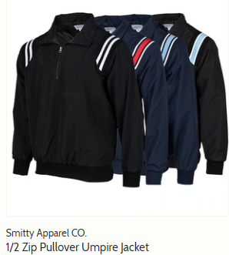
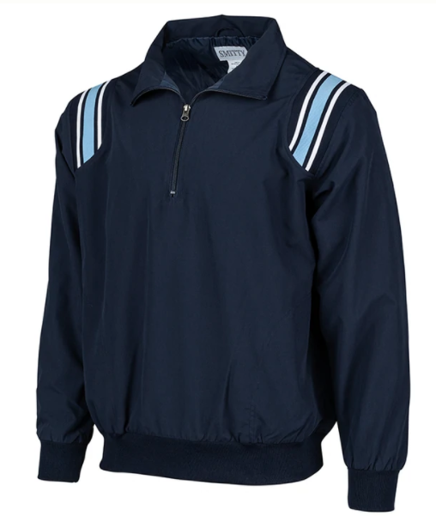
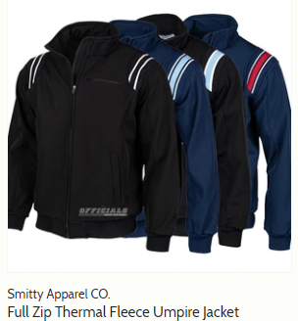
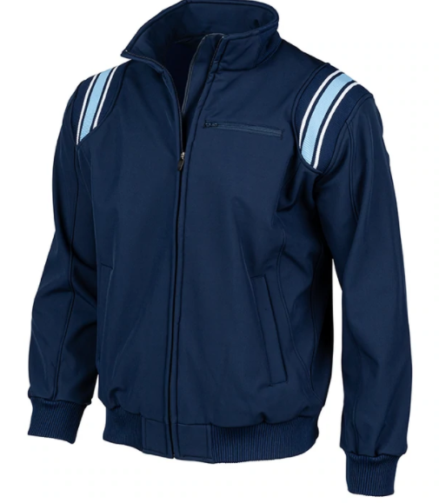
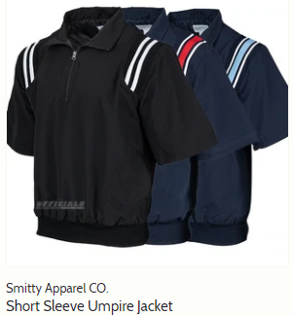
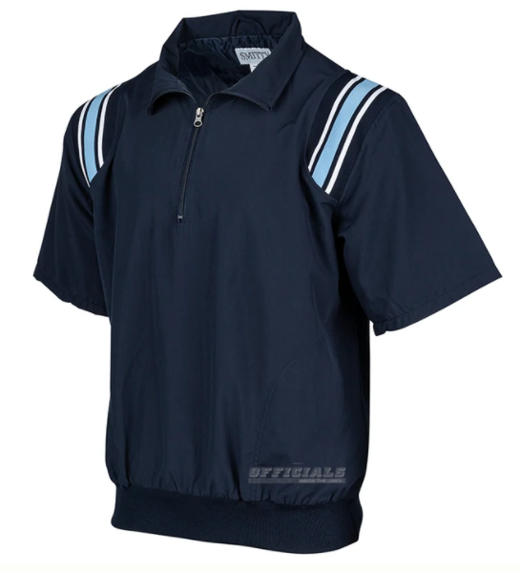
Looking the part
Jackets
Notes:
Choices are abundant for jacket selections

Slide 17
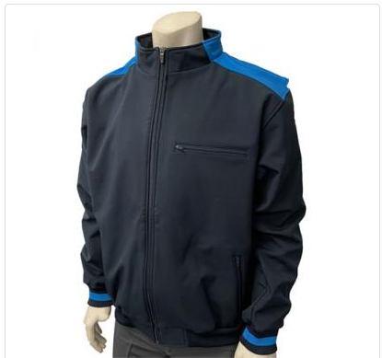
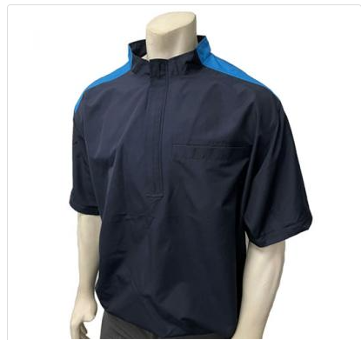
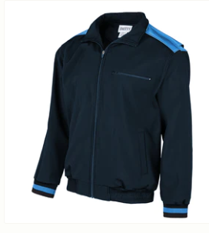
Looking the part
New NCAA Softball Jackets
Notes:
Choices are abundant for jacket selections

Slide 18
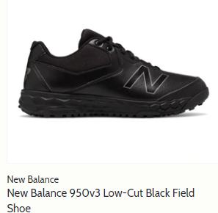
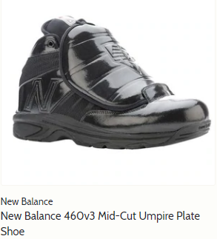
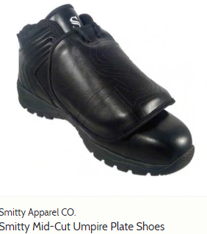
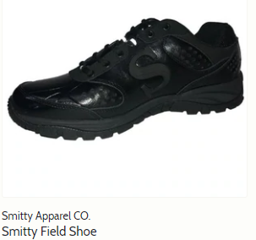
Looking the part
Shoes
Notes:
Shoes are to be predominantly Black

Slide 19
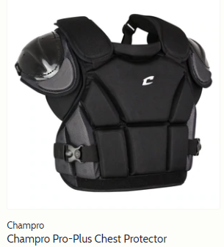
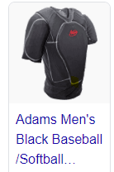
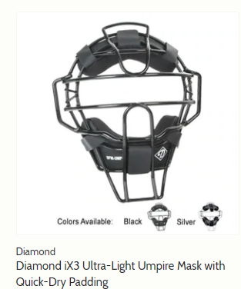
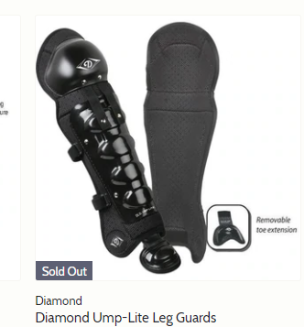
Looking the part
Chest Protector, Mask , and Shin Guards
Notes:
There are lots of options on Chest Protectors from the two pictured to many others. The Mask pictures is one of many on the markets as well as the shin guards.

Slide 20
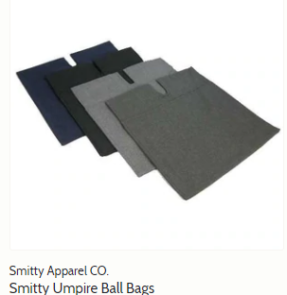
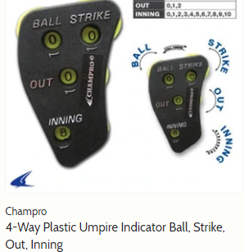
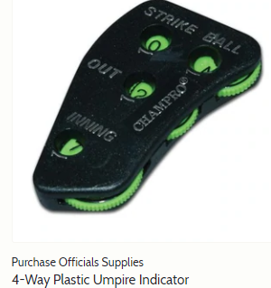
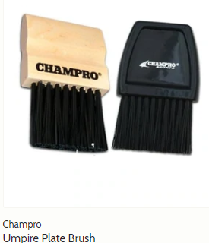
Looking the part
Ball Bag, Indicator, and Brush
Notes:
Navy Blue Ball Bags 2 each for working the plate, indicator and brush

Slide 21
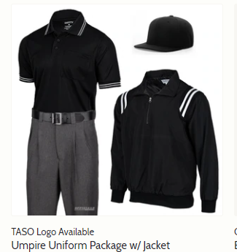
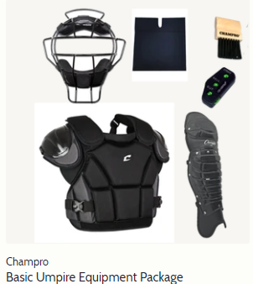
Looking the part
Packages
Notes:
Starter packages are available just shop around..

Slide 22

Chapter Website
Home Page

Slide 23

Chapter Website
Information Page

Slide 24
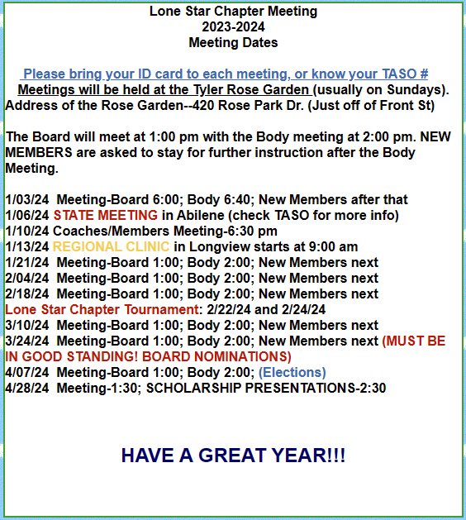
Chapter Website
2023 Meeting Dates

Slide 25
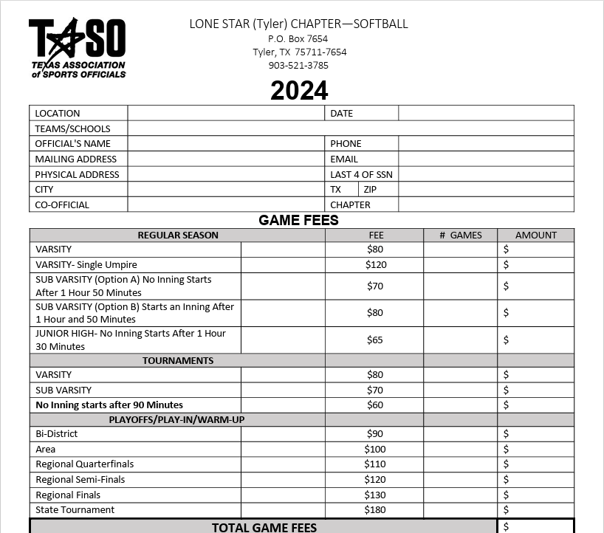
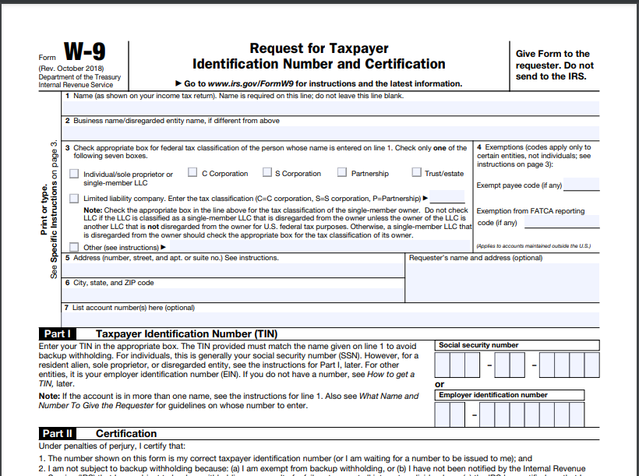
Chapter Website
Information Page- Pay Sheet & W9
Notes:
I suggest you take a copy of the Pay Sheet and W9 fill in all of your pertinent information and then make copies and carry them with you to the games. This is how you get paid..

Slide 26

Chapter Website
Favorites Page

Slide 27

Chapter Website
Board Page

Slide 28
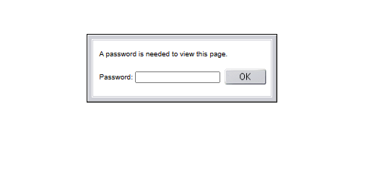
Chapter Papers Page
Chapter Website
lonestar

Slide 29

Chapter Papers Page
Chapter Website

Slide 30
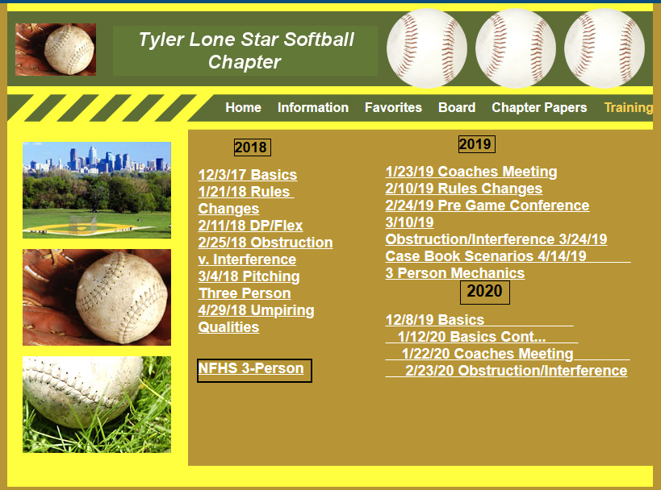
Training Page
Chapter Website

Slide 31
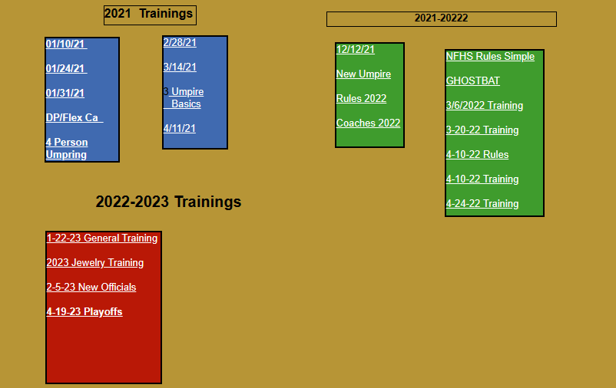
Training Page
Chapter Website

Slide 32
Communication portrayed to the Coaches
We assign a veteran official to oversee each scrimmage site. Please work with them to get what you need out of your scrimmage. If you have any issues, please bring it to the scrimmage leader or contact either Oscar, Chuck or Tom.
We are there to work for you during the scrimmages please remember that we are using this time to get back into the softball state of mind and will be introducing new umpires to fast pitch softball.
Scrimmages

Slide 33
Communication portrayed to the Coaches
We expect our umpires to always conduct themselves in a professional manner, and we wish to be informed about any issues in which they have not done this.
If you have a rules interpretation question or need clarification on anything dealing with softball or our chapter, please contact the chapter officers below.
President- Oscar Strain
Vice President- Tom Cremeans
Assigner- Chuck Allen
Scrimmages

Slide 34
Site UIC
Contact all members assigned to work with you a minimum of 48 hours prior to scrimmage.
Arrive on site early and talk to coach and discuss what they want to get out of the scrimmage today. As well as any protocols the crew will need to follow while on site.
Brief your crew as to how you are going to assist the coach in reaching their goals for the scrimmage and any protocols that need to be followed.
Take attendance and report this as well as the start and finish time to Oscar and Chuck.
Provide Chuck and Oscar feedback on how the scrimmage went and how the officials performed to include good and needs improvement points.
Work with the lesser experienced officials on mechanics and understanding the game. Do not be afraid to challenge them after you observe them in action.
Get some work in yourself, knock off the rust.
Scrimmages

Slide 35
Official
After receiving the call/text from the Site UIC ensure that the following takes place.
Respond back to the UIC and let them know that you have received the message and will be there.
Ensure that your equipment is ready, don’t need any late surprises!
Wear clothes that you can get your equipment under ie.. chest protector and leg guards.
Dress for the weather and be prepared for any changes in the weather.
Show up to the site on or before the designated time by the UIC. If first one there wait on the UIC to arrive prior to meeting the Coach.
Remember we are there to support the coach and their team get ready for the season this goes for all the other coaches and teams that are present at their site.
Scrimmages

Slide 36

Questions

