Slide 1
Tyler Lonestar Chapter
Chapter Website and Arbiter Website Training
January 3, 2024
New Official’s

Slide 2
Chapter Website
How to log into the chapter website:
Open search engine
Type in:
www.tylertasosoftball.com
How to log into the chapter website:

Slide 3
Chapter Website
Home Page

Slide 4
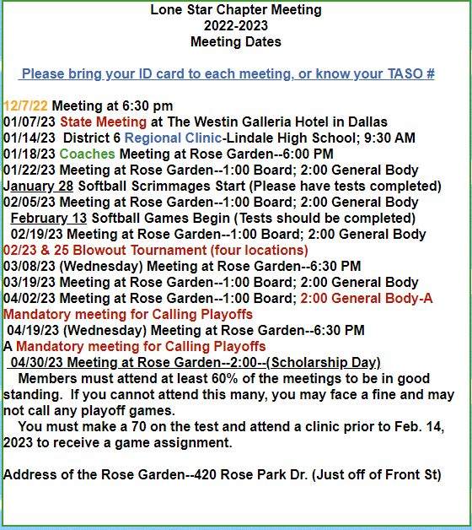
Chapter Website
2023-2024 Meeting Dates

Slide 5
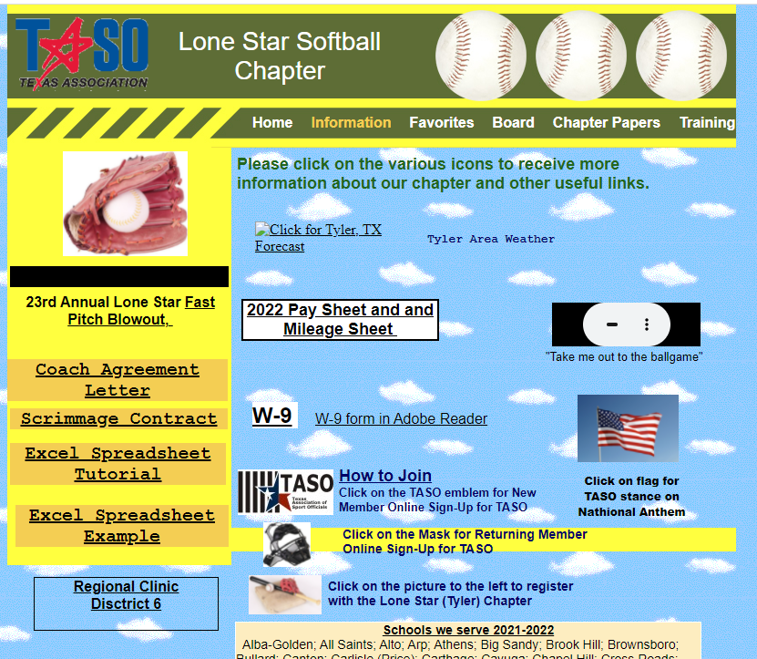
Chapter Website
Information Page

Slide 6
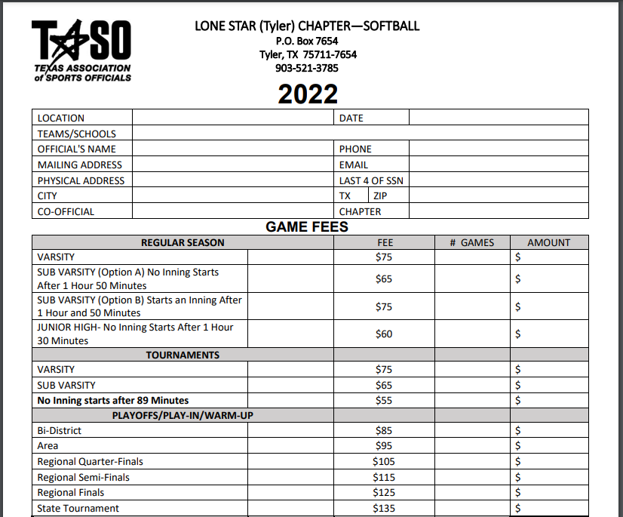
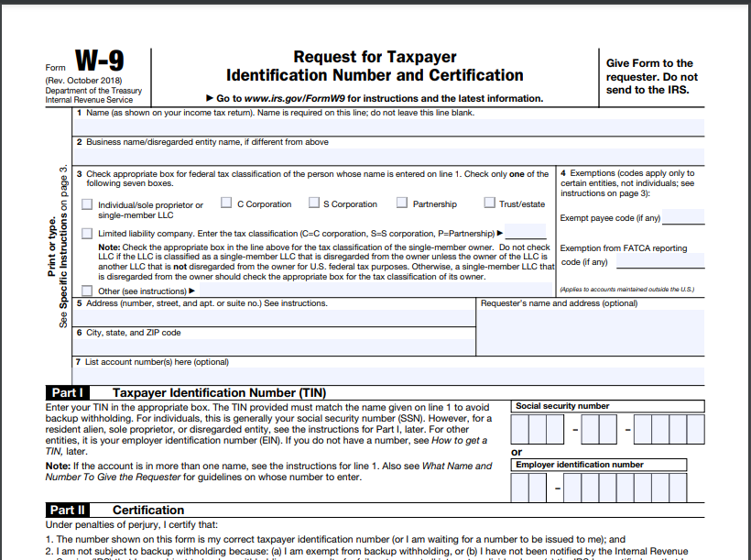
Chapter Website
Information Page- Pay Sheet & W9
Notes:
I suggest you take a copy of the Pay Sheet and W9 fill in all of your pertinent information and then make copies and carry them with you to the games. This is how you get paid..

Slide 7
Chapter Website
Favorites Page

Slide 8
Chapter Website
Board Page

Slide 9
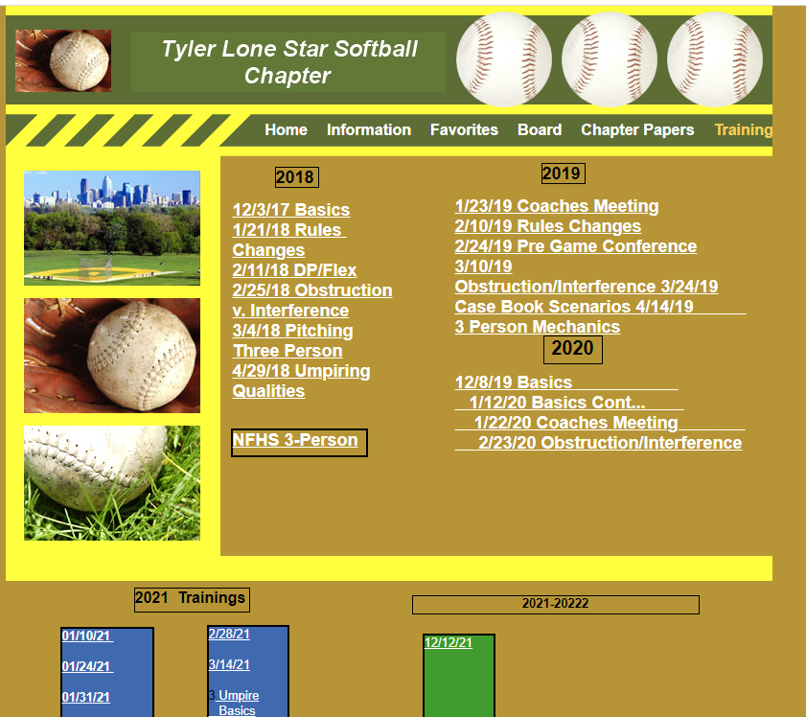
Training Page
Chapter Website

Slide 10
Arbiter Training
How to log into the Arbiter Website:
Open search engine
Type in:
www.arbitersports.com
How to log into the Arbiter Website:

Slide 11
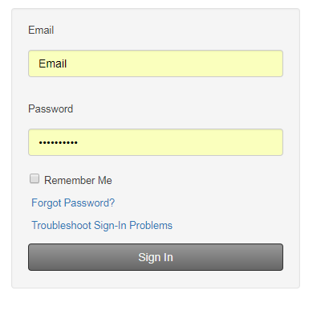
Arbiter Training
How to log in

Slide 12
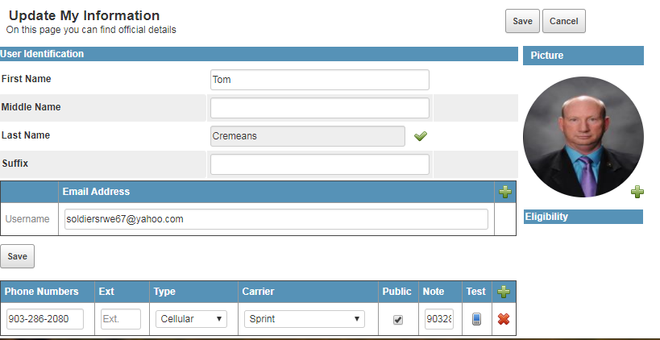
Arbiter Training
How to check and update your Profile

Slide 13
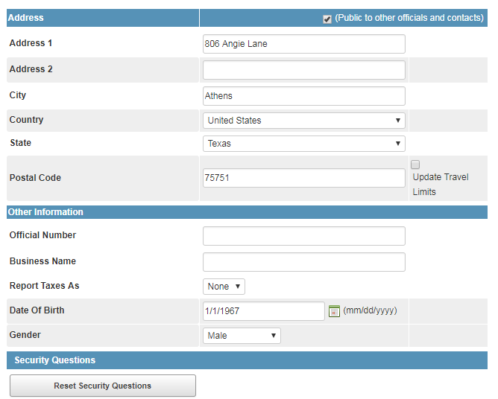
Arbiter Training
How to check and update your Profile

Slide 14
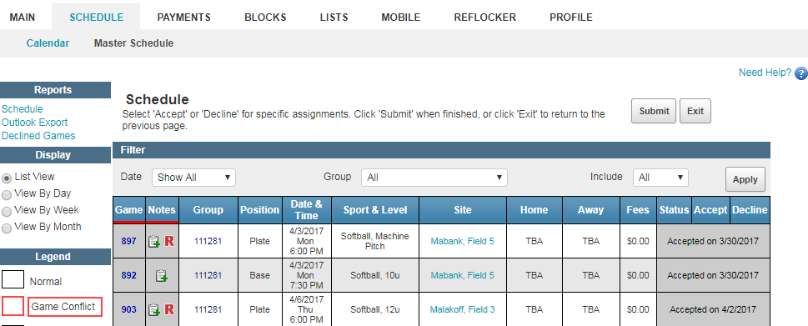
Arbiter Training
How to check game assignments and partners

Slide 15
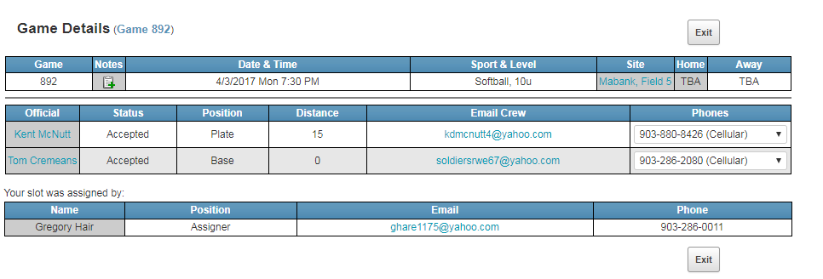
Arbiter Training
How to check game assignments and partners

Slide 16
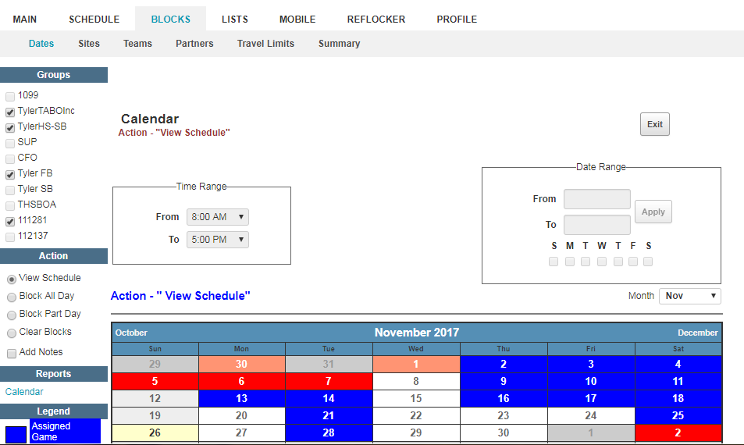
Arbiter Training
How to set up Blocks

Slide 17
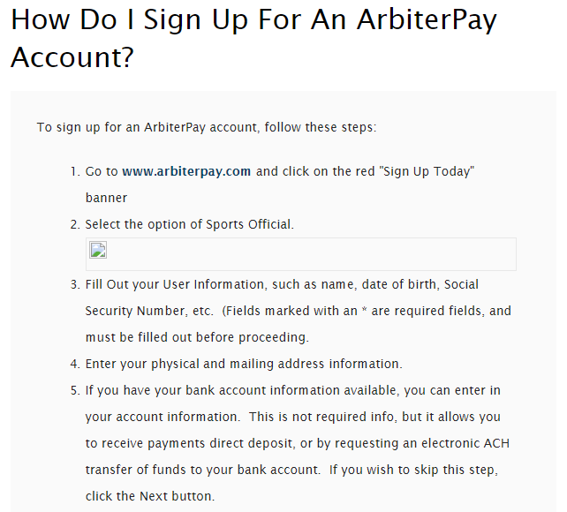
Arbiter Pay Training
How to set up an Arbiter Pay Account

Slide 18
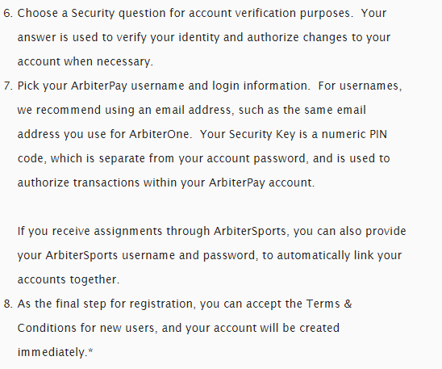
Arbiter Pay Training
How to set up an Arbiter Pay Account

Slide 19
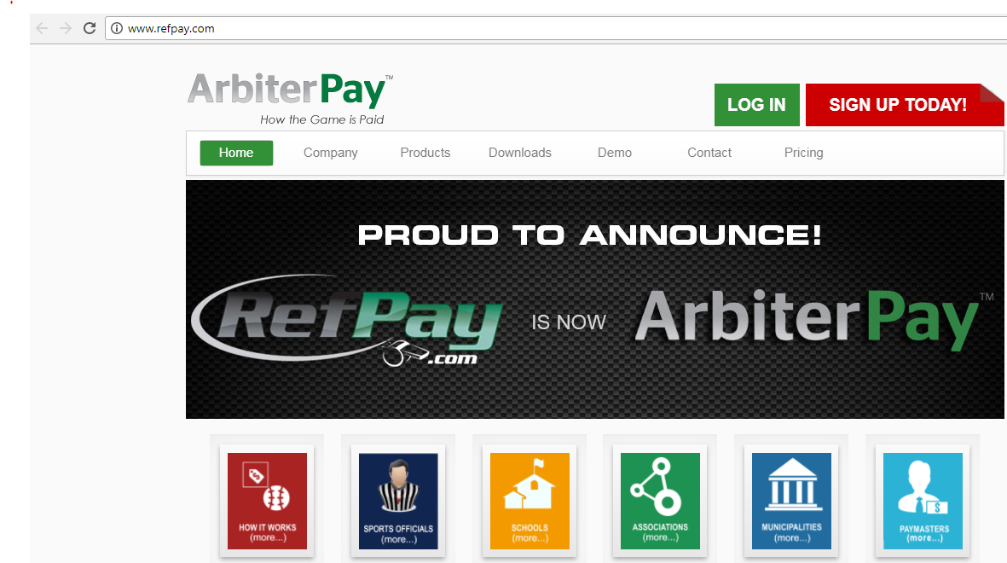
Arbiter Pay Training
How to set up an Arbiter Pay Account

Slide 20
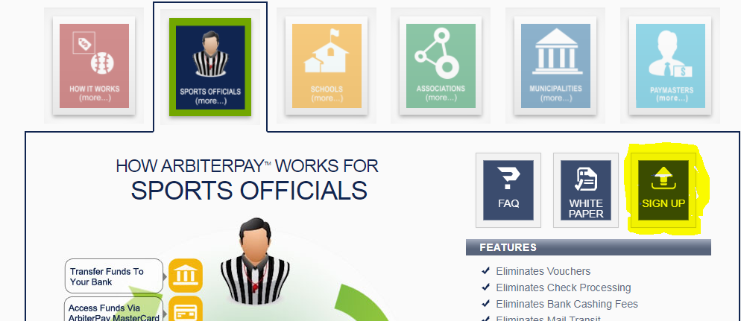
Arbiter Pay Training
How to set up an Arbiter Pay Account

Slide 21
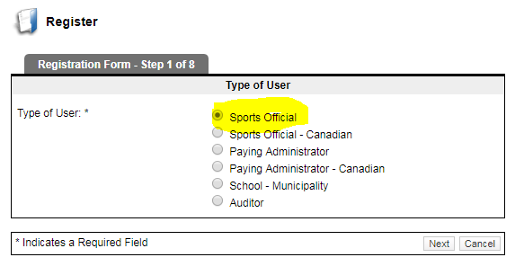
Arbiter Pay Training
How to set up an Arbiter Pay Account

Slide 22
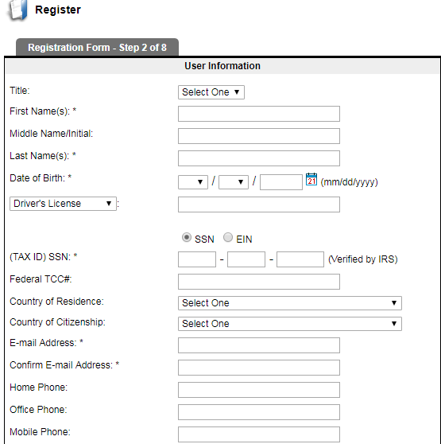
Arbiter Pay Training
How to set up an Arbiter Pay Account

Slide 23
TASO Website Training
How to log into the TASO Website:
Open search engine
Type in:
www.taso.org
How to log into the TASO Website:

Slide 24
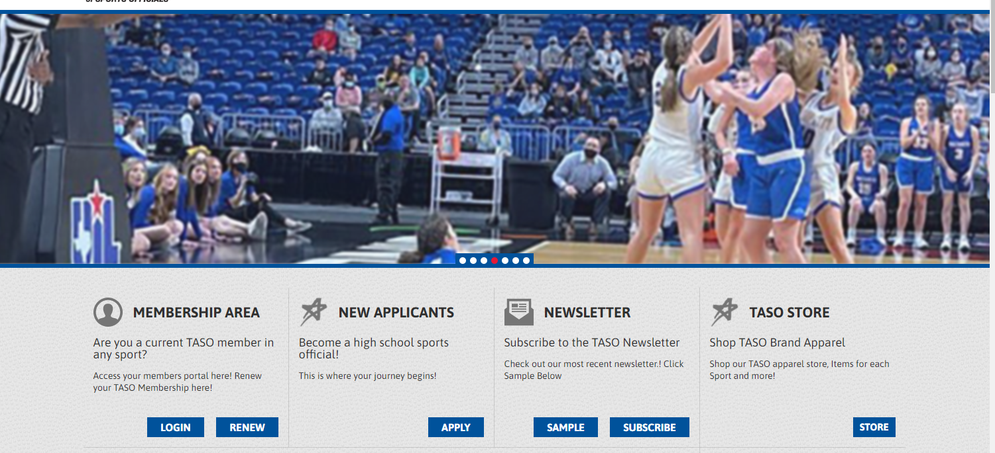
TASO Website Training
How to log in

Slide 25
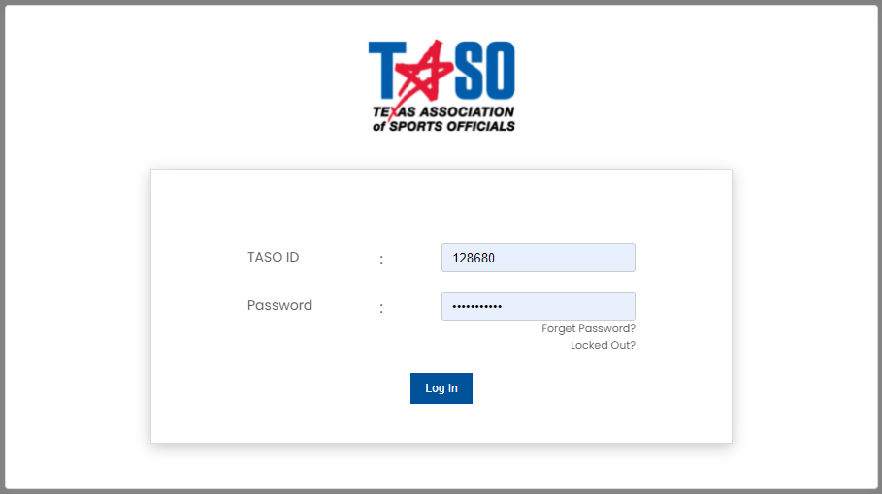
TASO Website Training
How to log in

Slide 26
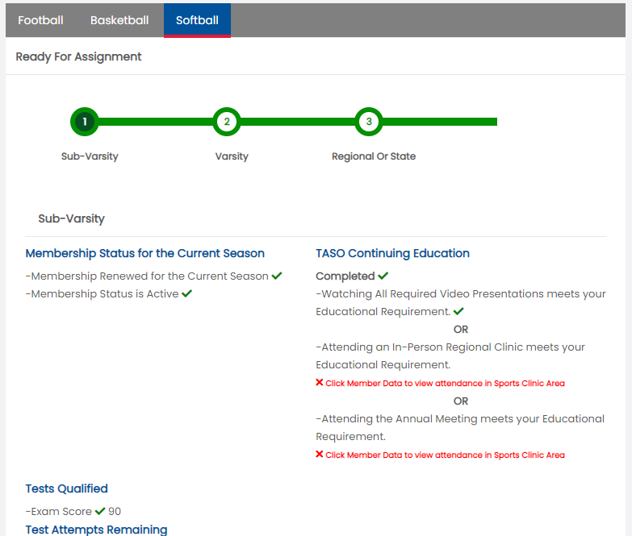
TASO Website Training
How to log in

Slide 27
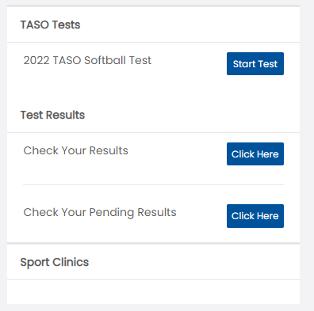
TASO Website Training
How to take the test

Slide 28
TASO Website Training
How to look at your portal

Slide 29
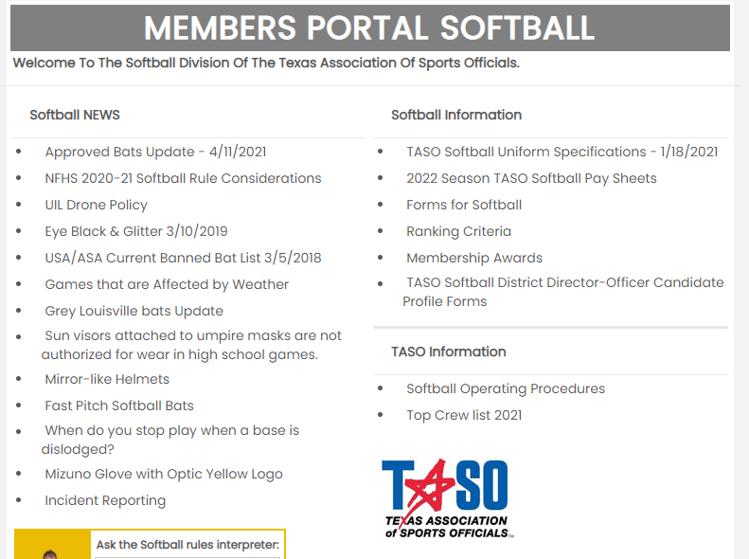
TASO Website Training
Portal

Slide 30
Questions

