Slide 1

Tyler Lonestar
Chapter
Conducting a Plate Meeting with the Head Coaches’
January 21, 2024
Official’s Training

Slide 2
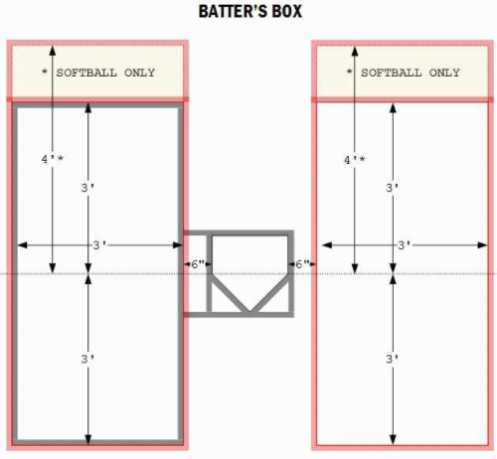
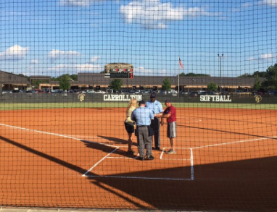
The
Pregame
Conference

Slide 3
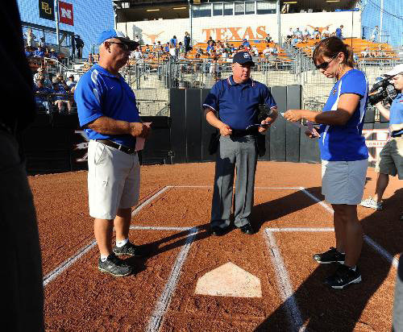
The Coaches’ Pregame Conference

Slide 4
Tyler Lonestar
Chapter
The plate umpire conducts the pregame conference.
  If you need to work the pregame conference from a checklist, then use one. It’s better than forgetting something.
  Remember there should be no players warming up in fair ball territory at this time.
First thing - Introduce yourself and your partner(s).
Coaches Pregame Conference

Slide 5
Tyler Lonestar
Chapter
Receive lineup cards from the coaches.
  Check to see that the proper number of players is listed
  Both first initial and last names must be listed.
  Jersey number (no duplicate numbers)
  Position and batting order of each starter.
  Eligible substitutes listed below the starters.
  Note whether the lineup includes a FLEX player and if so, she is listed in the 10th spot.
Coaches Pregame Conference

Slide 6
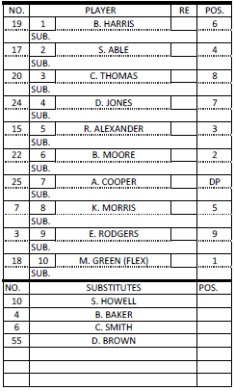
Line Up Card Maintenance
When maintaining your line-up card there are
many, many ways to accomplish you MUST develop your system, but here is a list of the
absolutes that must be written on your line-up
cards during the course of the game.
Knowing who the Pitcher is
Knowing who the Catcher is
DP if used in one of the top 9 Spots
Flex must be in the 10th Spot
Record any usage of a Courtesy Runner
Record all Substitutes
Record all conferences both Offense and
Defense
Record all information if something unusual happens ie..Ejection, Warning, Suspension of Game. Administrator not available…
Record information needed to continue a
game that has been suspended:
a. Time
b. Inning
c. Score
d. Where you are at in the batting order

Slide 7
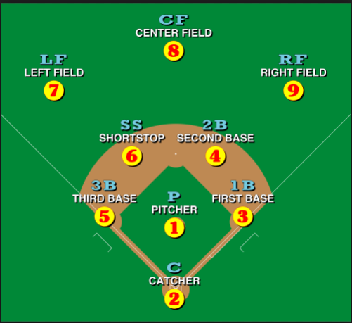
Positions
Positions
Coaches use different ways to annotate
their players position on the lineup card. Some will use numbers, and some will use letters.
Pitcher
Catcher
1st base
2nd Base
3rd Base
Short Stop
Left Fielder
Center Fielder
Right Fielder
DP Designated Player (Offense)
FLEX (Defense)

Slide 8
Tyler Lonestar
Chapter
Have home coach review Ground Rules
Remind the coaches that their pitchers are allowed 5 pitches or 1 minute between innings. This begins with the final out of the previous half-Inning
Ask them to have their girls hustle on and off the field in between innings.
Remind them of sportsmanship
Remind them to be safe when huddling in the field of play
Coaches Pregame Conference

Slide 9
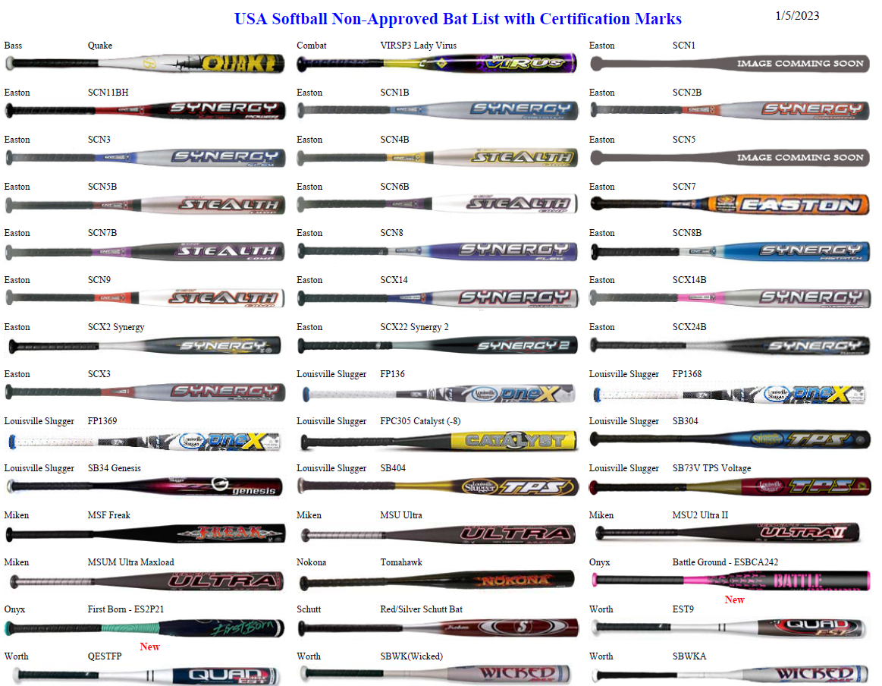
Tyler Lonestar
Chapter
USA Non-Approved Bat List

Slide 10
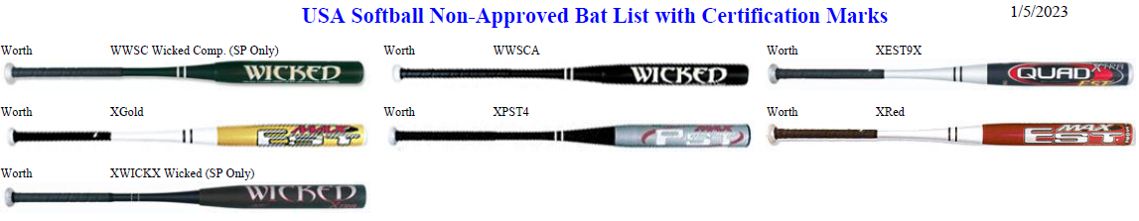
Tyler Lonestar
Chapter
USA Non-Approved Bat List

Slide 11
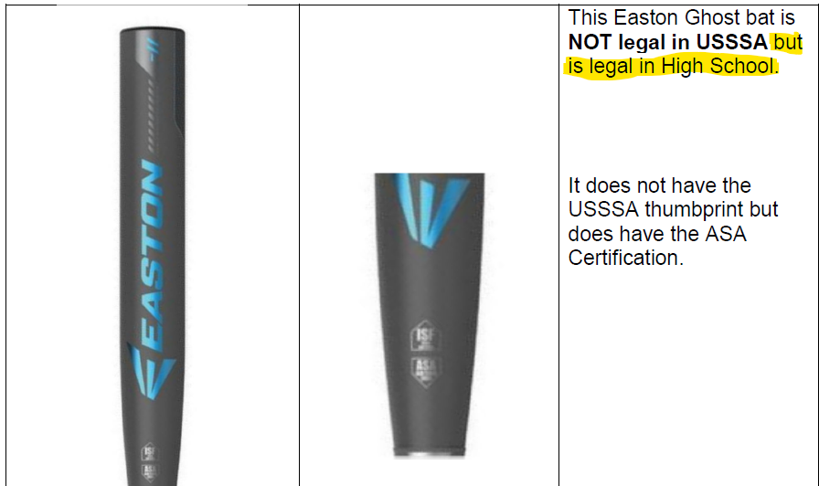
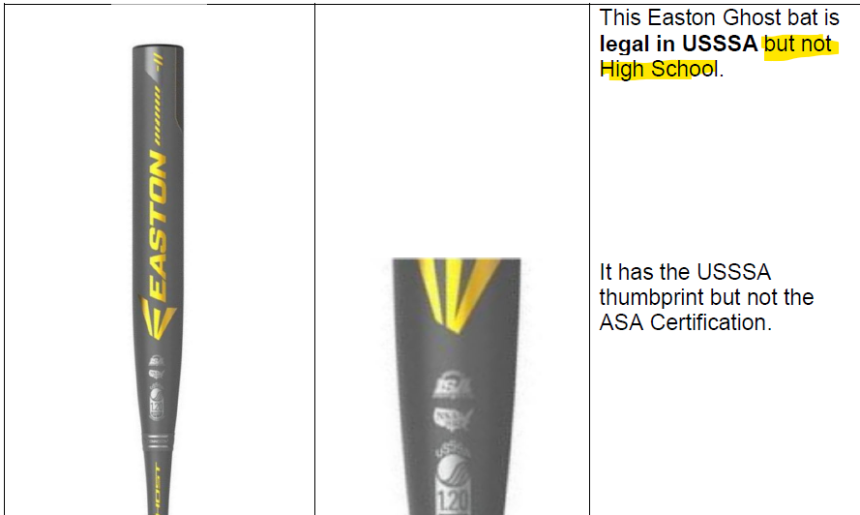
Tyler Lonestar
Chapter
Easton Ghost Bat
Blue= GOOD
Gold= NO GOOD

Slide 12
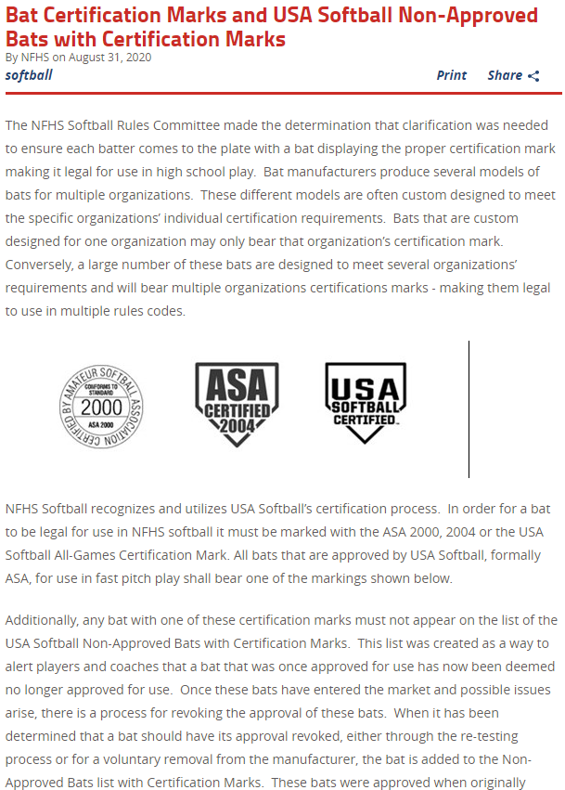
Tyler Lonestar
Chapter
USA/ASA Bat Certification Marks

Slide 13
Tyler Lonestar
Chapter
Lineup Card Holder w/clips to secure the lineups in place. Also has notes in and on it for the pre-game meeting and other items.
Some type of writing instrument to record the changes to the lineups as well the number of conferences both on offense and defense. Pen(s) Red, Blue, and Black
DP/FLEX Card- Cheat Sheet
An extra indicator
An extra brush
Copy of the Non-Approved Bat List just in case
My Ballbag

Slide 14
Tyler Lonestar
Chapter
Rule 4
Pre-Game and Post Game
January 21, 2024
Official’s Training

Slide 15
Tyler Lonestar
Chapter
Arrive 45 minutes before start time.
Notify host administration when you arrive.
Never forget you are being observed from the time you arrive until the time you leave the site.
Host administration should give a game ball to each team for warm up.
Become familiar with the field:
  Discuss ground rules with home coach after walking the field with your partner.
  All ground rules are finalized by umpires prior to pregame conference.
Pre-Game

Slide 16
Tyler Lonestar
Chapter
Review new rules and rule changes.
Discuss fair/foul and dead ball coverage.
Review illegal pitch calls and who has primary responsibilities.
Review proper tag up, missed bases, and appeal responsibilities.
Review check swing mechanics.
Review keeping count and warm up pitches.
Pre-Game
Partner Discussion

Slide 17
Tyler Lonestar
Chapter
Review communications:
If you deviate, COMMUNICATE!!!
Review any knowledge of the teams
  tendencies of teams are they rivals etc.
Review pregame conference with coaches.
Review the ground rules.
Determine if there is a national anthem or announcements.
Arrive at the field in time for pregame conference.
Pre-Game
Partner Discussion

Slide 18
Tyler Lonestar
Chapter
Even though Pre-Game inspections are no longer required, umpires still have responsibility to inspect any issues with equipment seen or brought to their attention during the contest.
Pre-Game
Equipment Checks

Slide 19
Tyler Lonestar
Chapter
Must have NOCSAE stamp on helmet. (1-6-1)
Must have legible exterior warning label. (1-6-1)
May be on outside or either side of the bill.
The batting helmet shall have a non-glare (not mirror-like) surface.
Must have ear flaps that cover both ears and temples. (1-6-4)
Look for breaks, cracks, dents, missing screws or having been altered. (1-6-5)
“Meets NOCSAE Standard” must be permanently affixed to the face protector. (Figure 1-8)
Any eye shields attached to the helmet must allow 100% light transmission.
Pre-Game
Batting Helmet Requirements

Slide 20
Tyler Lonestar
Chapter
Must have NOCSAE stamp on helmet. (1-7-1, Figure 1-9)
  - Throat protector, can be a part of or attached to the mask.
  - Any face shields must allow 100% light transmission.
The catcher’s helmet shall have a non-glare (not mirror-like) surface. (1-6-1)
Chest protector and shin guards. (1-7-2)
Any non-adult warming up a pitcher at any location within the confines of the field shall wear a helmet that complies with 1-7-1. (1-7-3)
Pre-Game
Catchers Equipment Requirements

Slide 21
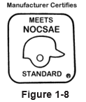
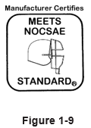
Tyler Lonestar
Chapter
Pre-Game
NOCSAE Seals

Slide 22
Tyler Lonestar
Chapter
Must be on- piece, multi-pieces and permanently assembled or two pieces with interchangeable barrel construction. (1-5-1a)
No exposed rivets, pins, rough or sharp edges or any hazardous fasteners. (1-5-1b)
Must be free of rattles, dents, burrs, cracks and sharp edges, must not be altered or warmed these are damaged and removed without penalty. (1-5-1c)
Must have ASA 2000, 2004 or the USA Softball All Games certification mark. (1-5-1d) And not appear on USA Softball’s Non-Approved Bats with Certification Marks List.
If entirely made of wood doesn’t have to have a certification mark but can’t exceed 2 ¼ “ diameter.
Pre-Game
Bat Checks

Slide 23

Tyler Lonestar
Chapter
Pre-Game
Bat Certification Marks

Slide 24

Tyler Lonestar
Chapter
Pre-Game
Bat Diagram

Slide 25
Tyler Lonestar
Chapter
Knob. The knob may be molded, lathed, welded or permanently fastened. Devices, attachments or wrappings that cause the knob to become flush with the handle are permitted. The knob may be covered with grip tape. A one-piece rubber knob and bat grip combination is illegal.
Handle/Grip. The bat handle is the area of the bat that begins at but does not include the knob and ends where the taper begins to increase in diameter. The handle shall have a round or oval cross-section. The grip shall extend a minimum of 10 inches, but not more than 15 inches, from the small end of the bat. A safety grip shall be made of cork, tape (no smooth, plastic tape) or composition material (commercially manufactured). Resin, pine tar or spray substances to enhance the hold are permitted on the grip only.
Pre-Game
Bat Check Procedures

Slide 26
Tyler Lonestar
Chapter
Taper. The taper is the transition area which connects the narrower handle to the wider barrel portion of the bat. The taper shall have a conical shape. Its length and material may vary.
Barrel. The barrel is the area intended for contact with the pitch; the barrel shall be round cylindrically symmetric with a smooth contour.
End Cap. The end cap is made of rubber, vinyl, plastic or other approved material. It shall be firmly secured and permanently affixed to the end of the bat so that it cannot be removed by anyone other than the manufacturer, without damaging or destroying it. A one-piece construction bat will not have an end cap.
Pre-Game
Bat Check Procedures

Slide 27
Tyler Lonestar
Chapter
Warm-up bats used in the on-deck circle shall have all parts permanently and securely attached at the time of manufacture and at the time of use. No more than two bats shall be used when warming up in the on-deck circle. Devices added to a bat for warm-up purposes shall be commercially manufactured specifically for a softball bat and shall be securely attached, so as not to disengage during use. Such devices shall take, but not exceed, the general shape and size of a bat including the grip.
Pre-Game
Warm Up Bats

Slide 28
Tyler Lonestar
Chapter
The home coach shall decide whether the grounds and other conditions are suitable for starting the game.
2. Pregame Conference. The pregame conference should take place approximately five minutes prior to the game and before the home team takes the field.
Starting a Game

Slide 29
Tyler Lonestar
Chapter
Introduce yourself and your partner(s), have others introduce themselves.
Verify with the coaches that all players are legally and properly equipped, and all equipment is in compliance with NFHS rules.
Review ground rules:
  Start with 3rd base dugout and go all the way around the diamond covering all items.
Plate Conference

Slide 30
Tyler Lonestar
Chapter
Ask if there are any questions about any rules, quick discussion not a rules meeting.
Remind teams if there are questions during the game, after the ball is dead only one person approaches the umpire responsible for the call in a sporting manner.
Check the lineups from each team. Look for first initial, last name, defensive position and number, ensure there are no duplicates then hand it back to each coach for inspection.
Review with all in attendance the expectations of good sporting behavior and wish them the best of luck.
Plate Conference

Slide 31
Tyler Lonestar
Chapter
During the pregame conference:
There shall be no balls hit or thrown in live-ball territory.
The home team and then the visiting team shall deliver their respective lineup cards, in duplicate, to the plate umpire who will verify their accuracy. The umpire shall then permit inspection by both captains and coaches. Once returned, the substitution regulations as in Rule 3 are then in effect.
Ground rules, as in 4-1-3, shall be announced.
Umpires shall ask head coaches to verify that their players are legally and properly equipped and shall remind participants about proper sporting behavior.
Plate Conference

Slide 32
Tyler Lonestar
Chapter
Ground Rules. If there are unusual conditions, such as spectators or obstacles too near the playing field, the home coach shall propose special ground rules. If sanctioned by the visiting team, these shall be in force. If the teams cannot agree, the umpires shall formulate ground rules. Ground rules shall not supersede a rules book rule.
Ground Rules

Slide 33
Tyler Lonestar
Chapter
The field should be clearly marked. Markings may include flags on foul poles along the foul lines past first base and third base and vertical foul-line markings on any wall that limits the outfield.
b. When a fair or foul fly lands near a stand or fence, Rule 7-4-11 applies. If there is a screen behind the catcher or any permanent obstruction in front of the stands, a batted ball that goes behind these becomes dead. It is recommended that no such obstruction be less than 25 feet from the diamond.
Ground Rules

Slide 34
Tyler Lonestar
Chapter
Wild pitches, overthrows and batted balls that go over or through a fence or into a dugout are governed by Rule 8-4-3; if the field has unusual obstructions, ground rules should attempt to be similar to this rule.
d. For special field conditions, such as a drainpipe that makes a spot where it is impossible or very difficult for a fielder to retrieve the ball, the ball should become dead if it goes to that spot, and each runner’s advance should be limited to two bases.
Ground Rules

Slide 35
Tyler Lonestar
Chapter
e. For an unfenced field, a chalk or imaginary out-of-bounds line should be established to define live-ball area. If cars are parked along the out-of-play lines, umpires should consider these the same as bleachers and the ball becomes dead if it bounces into the line of cars. The umpires should anticipate such a situation and announce the ground rule in advance.
Ground Rules

Slide 36
Tyler Lonestar
Chapter
The visiting team shall be the first to take its turn at bat. On a neutral field or by agreement, either team may be designated as Home Team.
The game begins when the umpire calls “Play Ball.”
After the game starts (when the umpire calls “Play Ball”), the umpires are sole judges as to whether conditions, including grounds, are fit for play, and as to whether conditions are suitable for starting the second game of a scheduled doubleheader (two games between the same teams during the same day).
Starting a Game

Slide 37
Tyler Lonestar
Chapter
A game ends when the team behind in score has completed its turn at bat in the seventh inning or in any extra inning. If the home team scores a go-ahead run in the bottom of the seventh inning or in any extra inning, the game is terminated at that point.
If a game ends because of weather conditions, or darkness interferes with play so that the game is called (ended) by the umpire, it is a regulation game provided:
Ending a Game

Slide 38
Tyler Lonestar
Chapter
five full innings have been played; or if the home team has scored an equal or greater number of runs in four or four and a fraction turns at bat than the visiting team has scored in five turns.
b. play has gone beyond five full innings and is called when the teams have not had an equal number of completed turns at bat. The score shall be the same as it was at the end of the last completed inning; unless the home team, in its half of the incomplete inning, scores a run (or runs) which equals or exceeds the opponent’s score, in which case, the final score shall be as recorded when the game is called.
Ending a Game

Slide 39
Tyler Lonestar
Chapter
A state association may adopt game-ending procedures that determine how games are ended, including suspended games. However, if a state association does not have established game-ending procedures, by mutual agreement of the opposing coaches and the plate umpire, any remaining play may be shortened at anytime or the game terminated.
Ending a Game

Slide 40
Tyler Lonestar
Chapter
If a game is called before completion of the number of innings and conditions as specified in 4-2-2, the umpire shall declare the contest “no game” unless play is terminated by 4-2-3.
5. If a regulation called game has a tie score when ended as in 4-2-2, it is a tie game unless the state association has any prescribed game-ending procedures. Batting and fielding records are counted, but the game is not counted in computing percentages of games won and lost.
6. By state association adoption, a tie-breaker procedure may be
instituted at a point in the game specified by the state association.
Ending a Game

Slide 41
Tyler Lonestar
Chapter
Make sure not to exit until you are sure there isn’t going to be a protest.
Be sure to exit the field as a team.
Exit through the dugout with the least amount of conflict.
    Path of least resistance.
Ending a Game

Slide 42
Tyler Lonestar
Chapter
Don’t discuss the game with players, coaches or fans.
  Usually not a good outcome.
  Always be professional.
  Bite your tongue when you have to.
If confronted by press refer them to home management.
Ending a Game

Slide 43
Tyler Lonestar
Chapter
Take time to have a post game.
Get out away from everyone where you can discuss the game.
Mention positive things about the game.
  Everyone needs a little reassurance they are doing the right things.
Discuss any difficult situations that occurred and what might have gone better.
  We are the only ones that can make ourselves better honest feedback will help everyone get better.
Complete any reports necessary.
Post Game

Slide 44
Tyler Lonestar
Chapter
A game shall be forfeited to the offended team by the umpire when a team:
is late in appearing or in beginning play after the umpire calls “Play Ball.” State associations are authorized to specify the time frame and/or circumstances before a forfeit will be declared for a late arrival by one of the teams.
refuses to continue play after the game has started.
delays more than one minute in resuming play after the umpire calls “Play Ball” or in obeying the umpire’s order to remove a player or coach for violation of the rules.
persists in tactics designed to delay or shorten the game.
willfully and persistently violates any one of the rules after being warned by the umpire.
Forfeiture of a Game

Slide 45
Tyler Lonestar
Chapter
Cannot provide 9 players (F. P.), 10 players (S.P.) or 11 players (S.P. if an EP is used) to start the game.
Cannot provide 8 players (F.P.), 9 players (S.P.) or 10 players (S.P. if an EP is used) in the batting order to finish the game. An out is called in that spot of the batting order (7-4-1). If that player has safely reached base, then the most recent batter not on base is allowed to run for that player, until that player is put out, scores, or the half-inning ends.
On its home field, fails to comply with the umpire’s order to put the field in condition for play.
Forfeiture of a Game

Slide 46
Tyler Lonestar
Chapter
It is optional on the part of a state association as to whether protests are permitted. When allowed, protests are permitted regarding rules one through nine only. When protests are submitted to organizations which do allow the filing, such protest shall be submitted using a prescribed procedure
(10-2-3i). All individual and team averages shall be included in the official records, except that no pitcher shall be credited with a victory or a loss in such a game if the game is not completed.
There are NO Protests in UIL Softball it must be settled prior to continuing the contest.
Forfeiture of a Game

Slide 47
Tyler Lonestar
Chapter
There are NO Protests in UIL Softball it must be settled prior to continuing the contest.
Forfeiture of a Game

Slide 48

Questions

